Slide 1

UTC
Conference for Counselors
2024

Slide 2
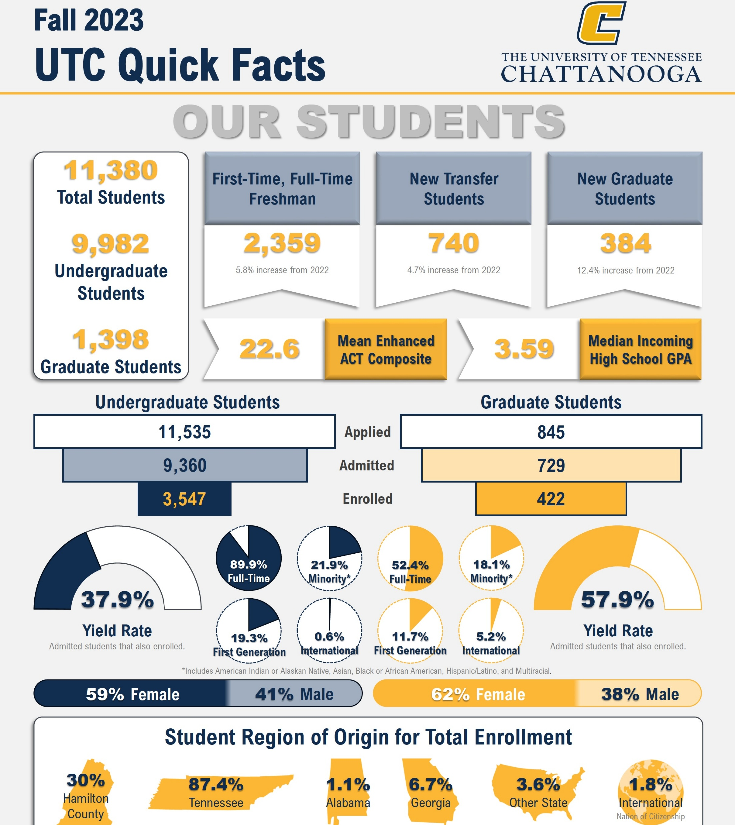
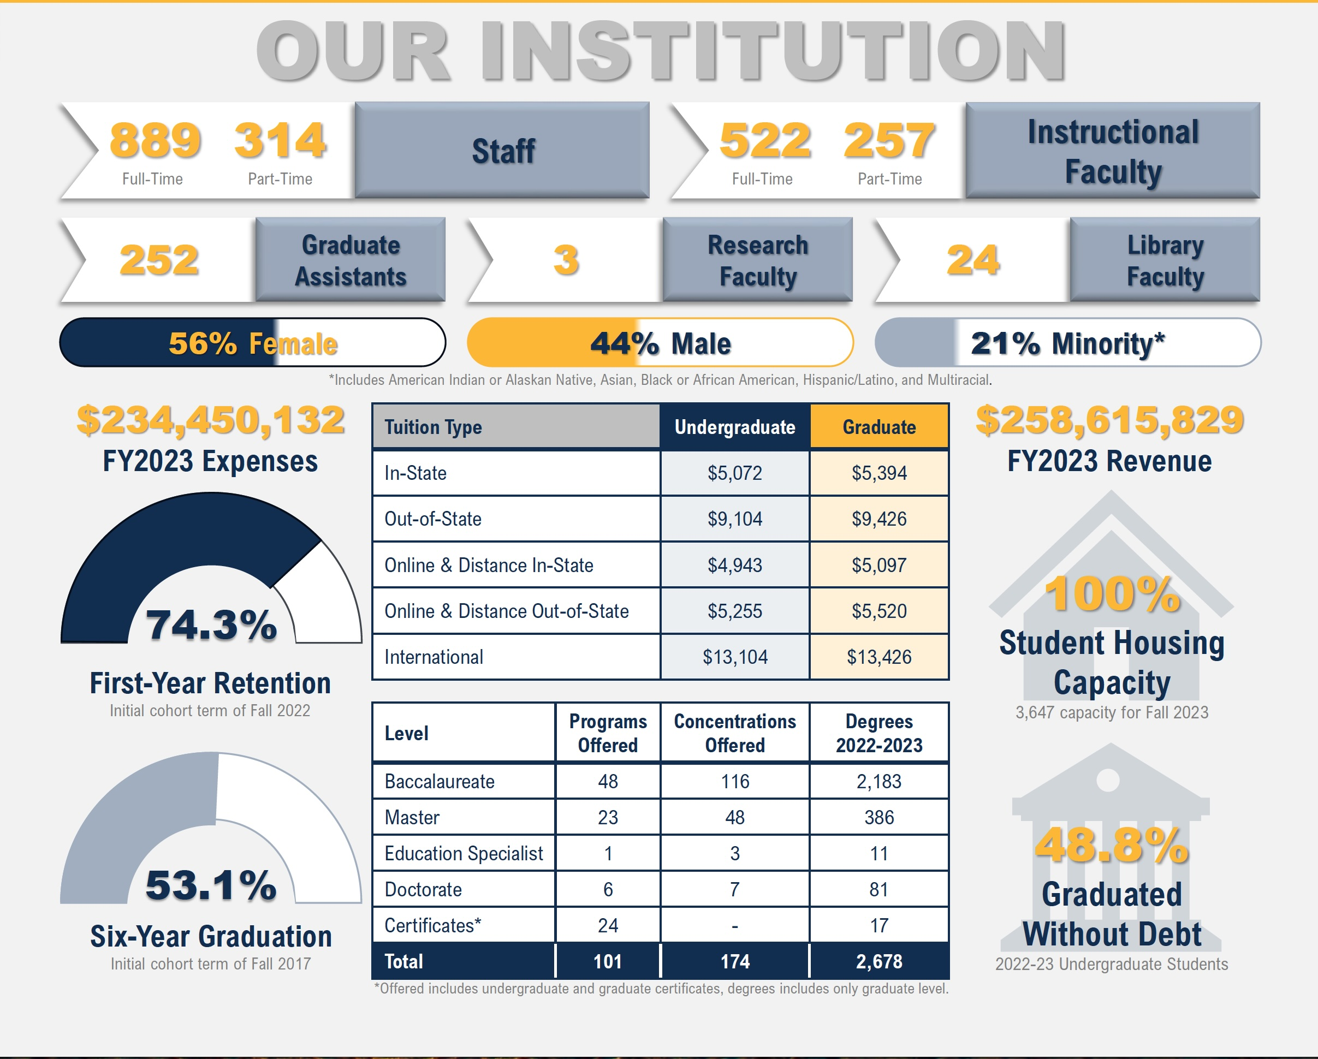
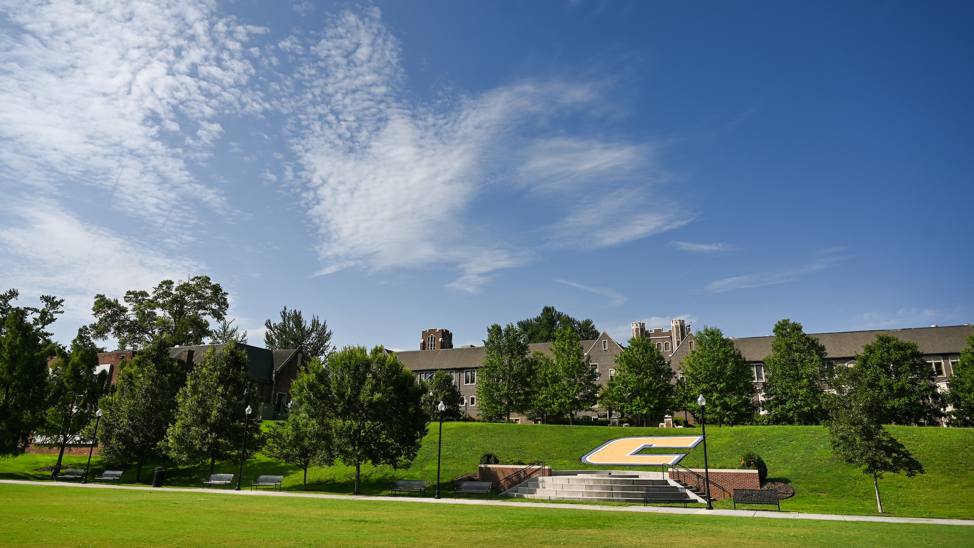

Slide 3
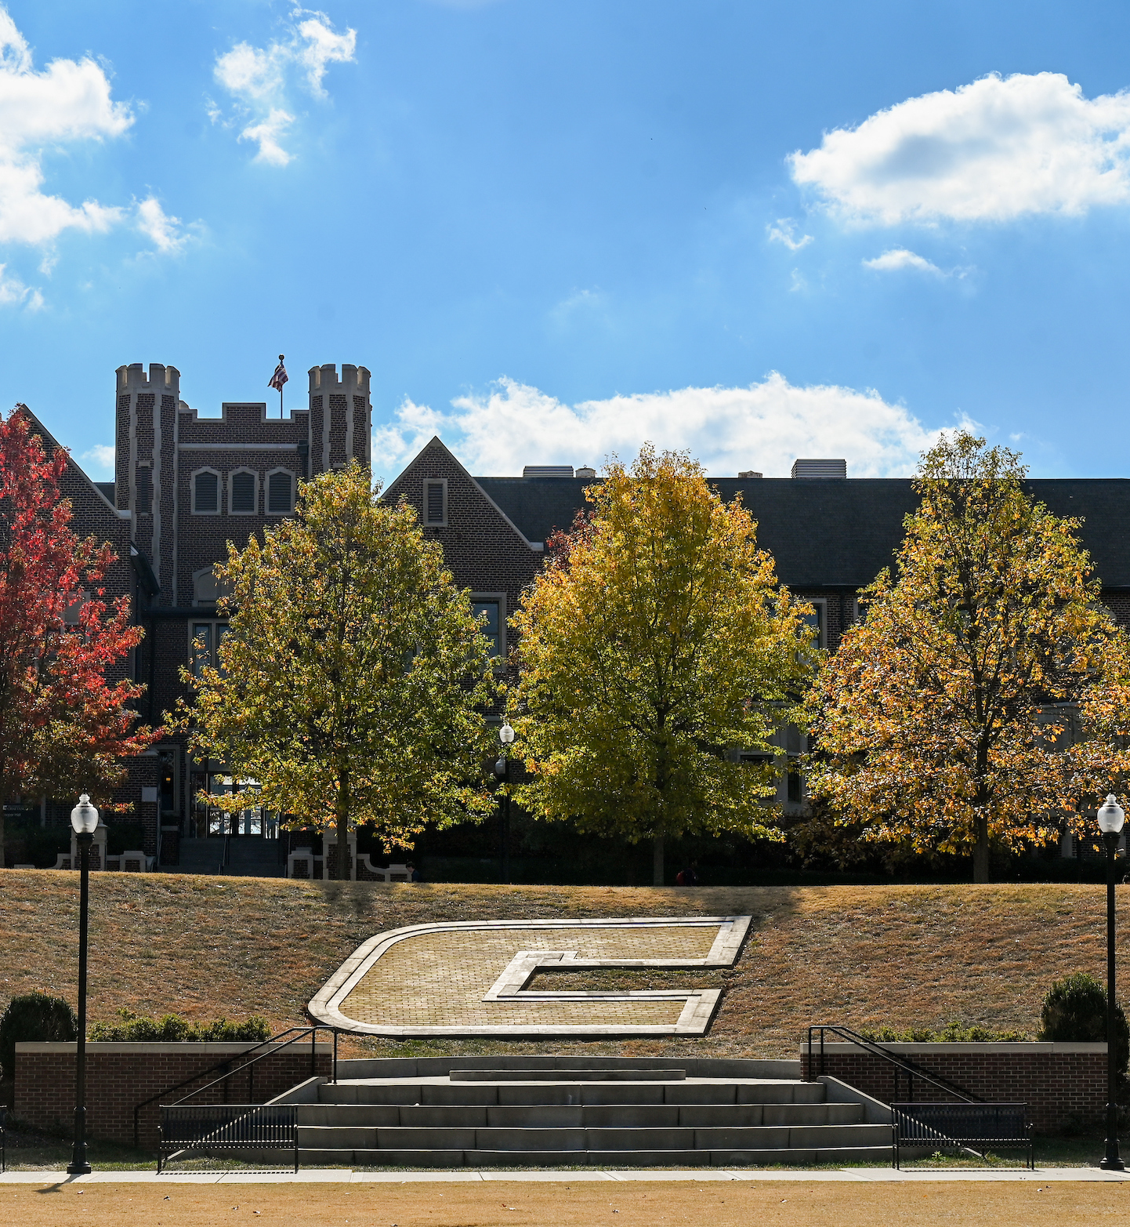
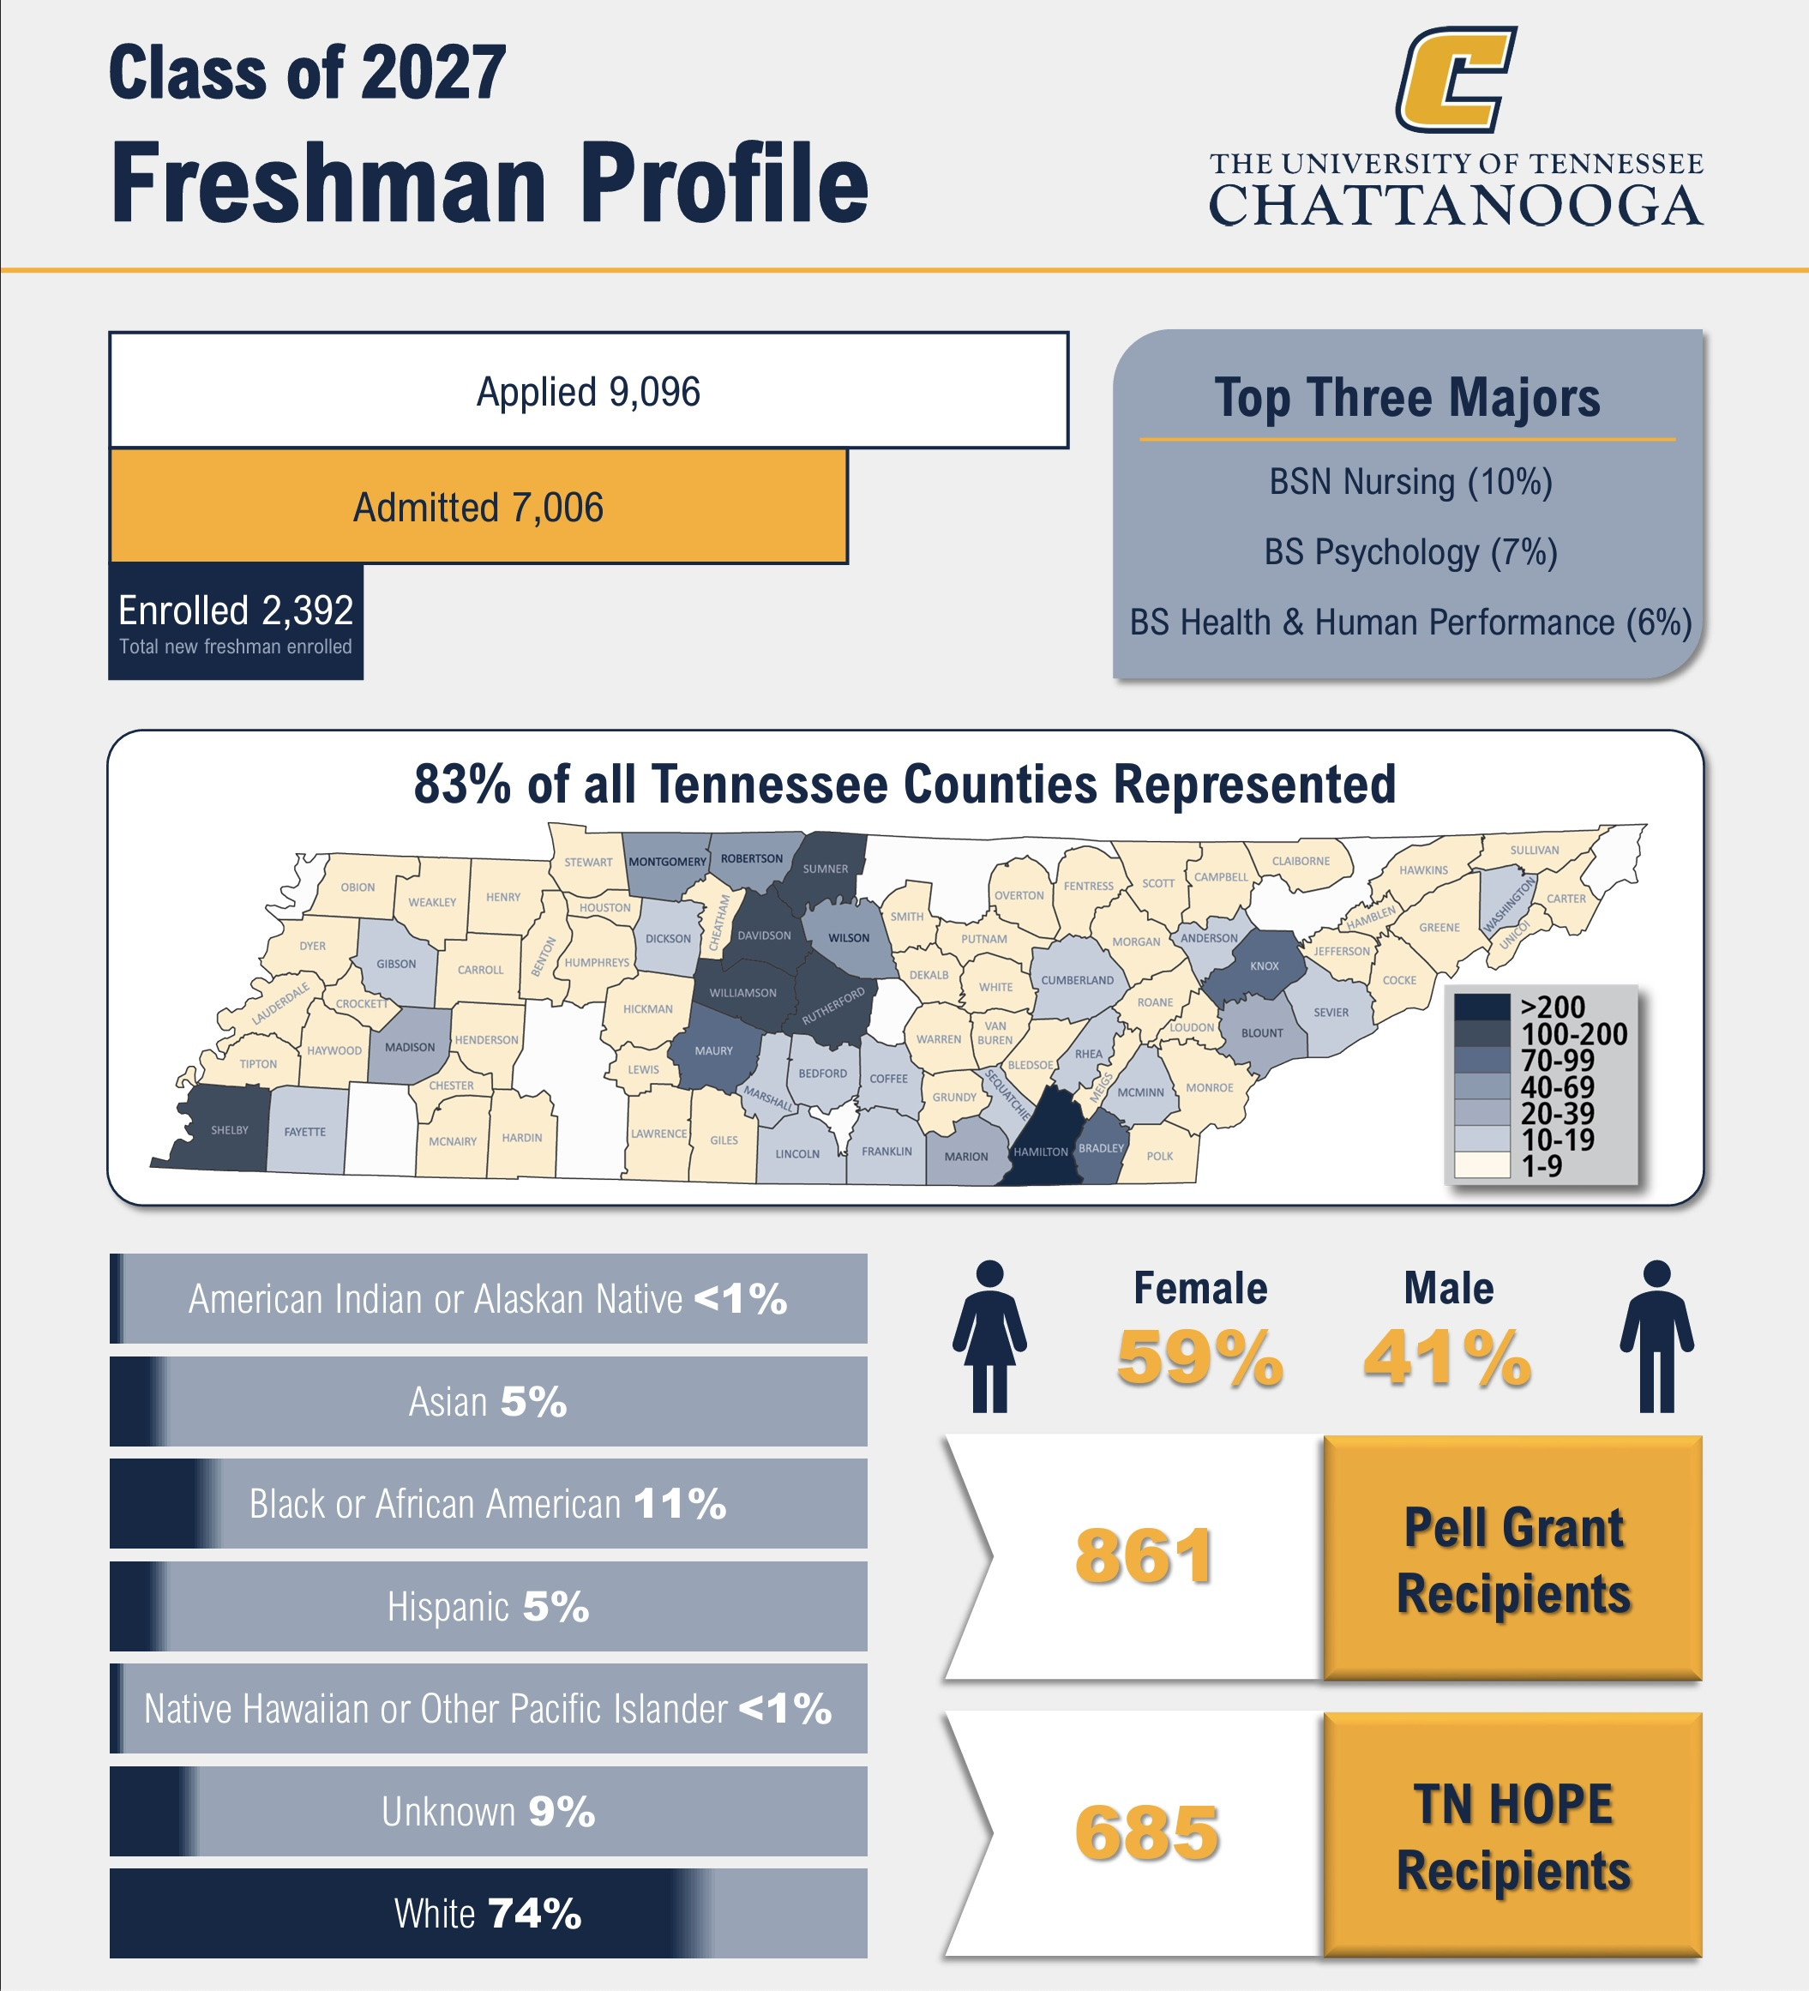

Slide 4
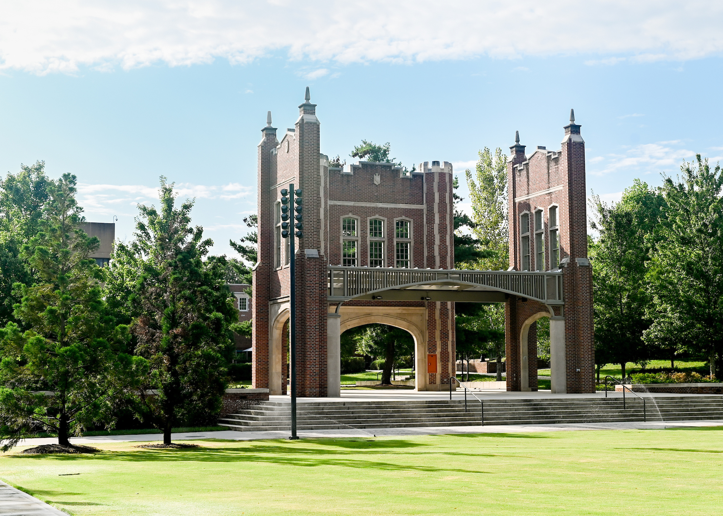
Fall 2024 at a glance:
16,806 total applications
  13,666 freshman applications
  2,432 transfer applications
  9% increase in total applications
10,291 admitted students
  8,520 freshman admitted
  1,087 transfers admitted
  17% increase in admissions
Record Admissions Year
  Most enrolled students ever
    11,841 (10,266 graduate)
  Largest freshman class ever
    2,541

Slide 5
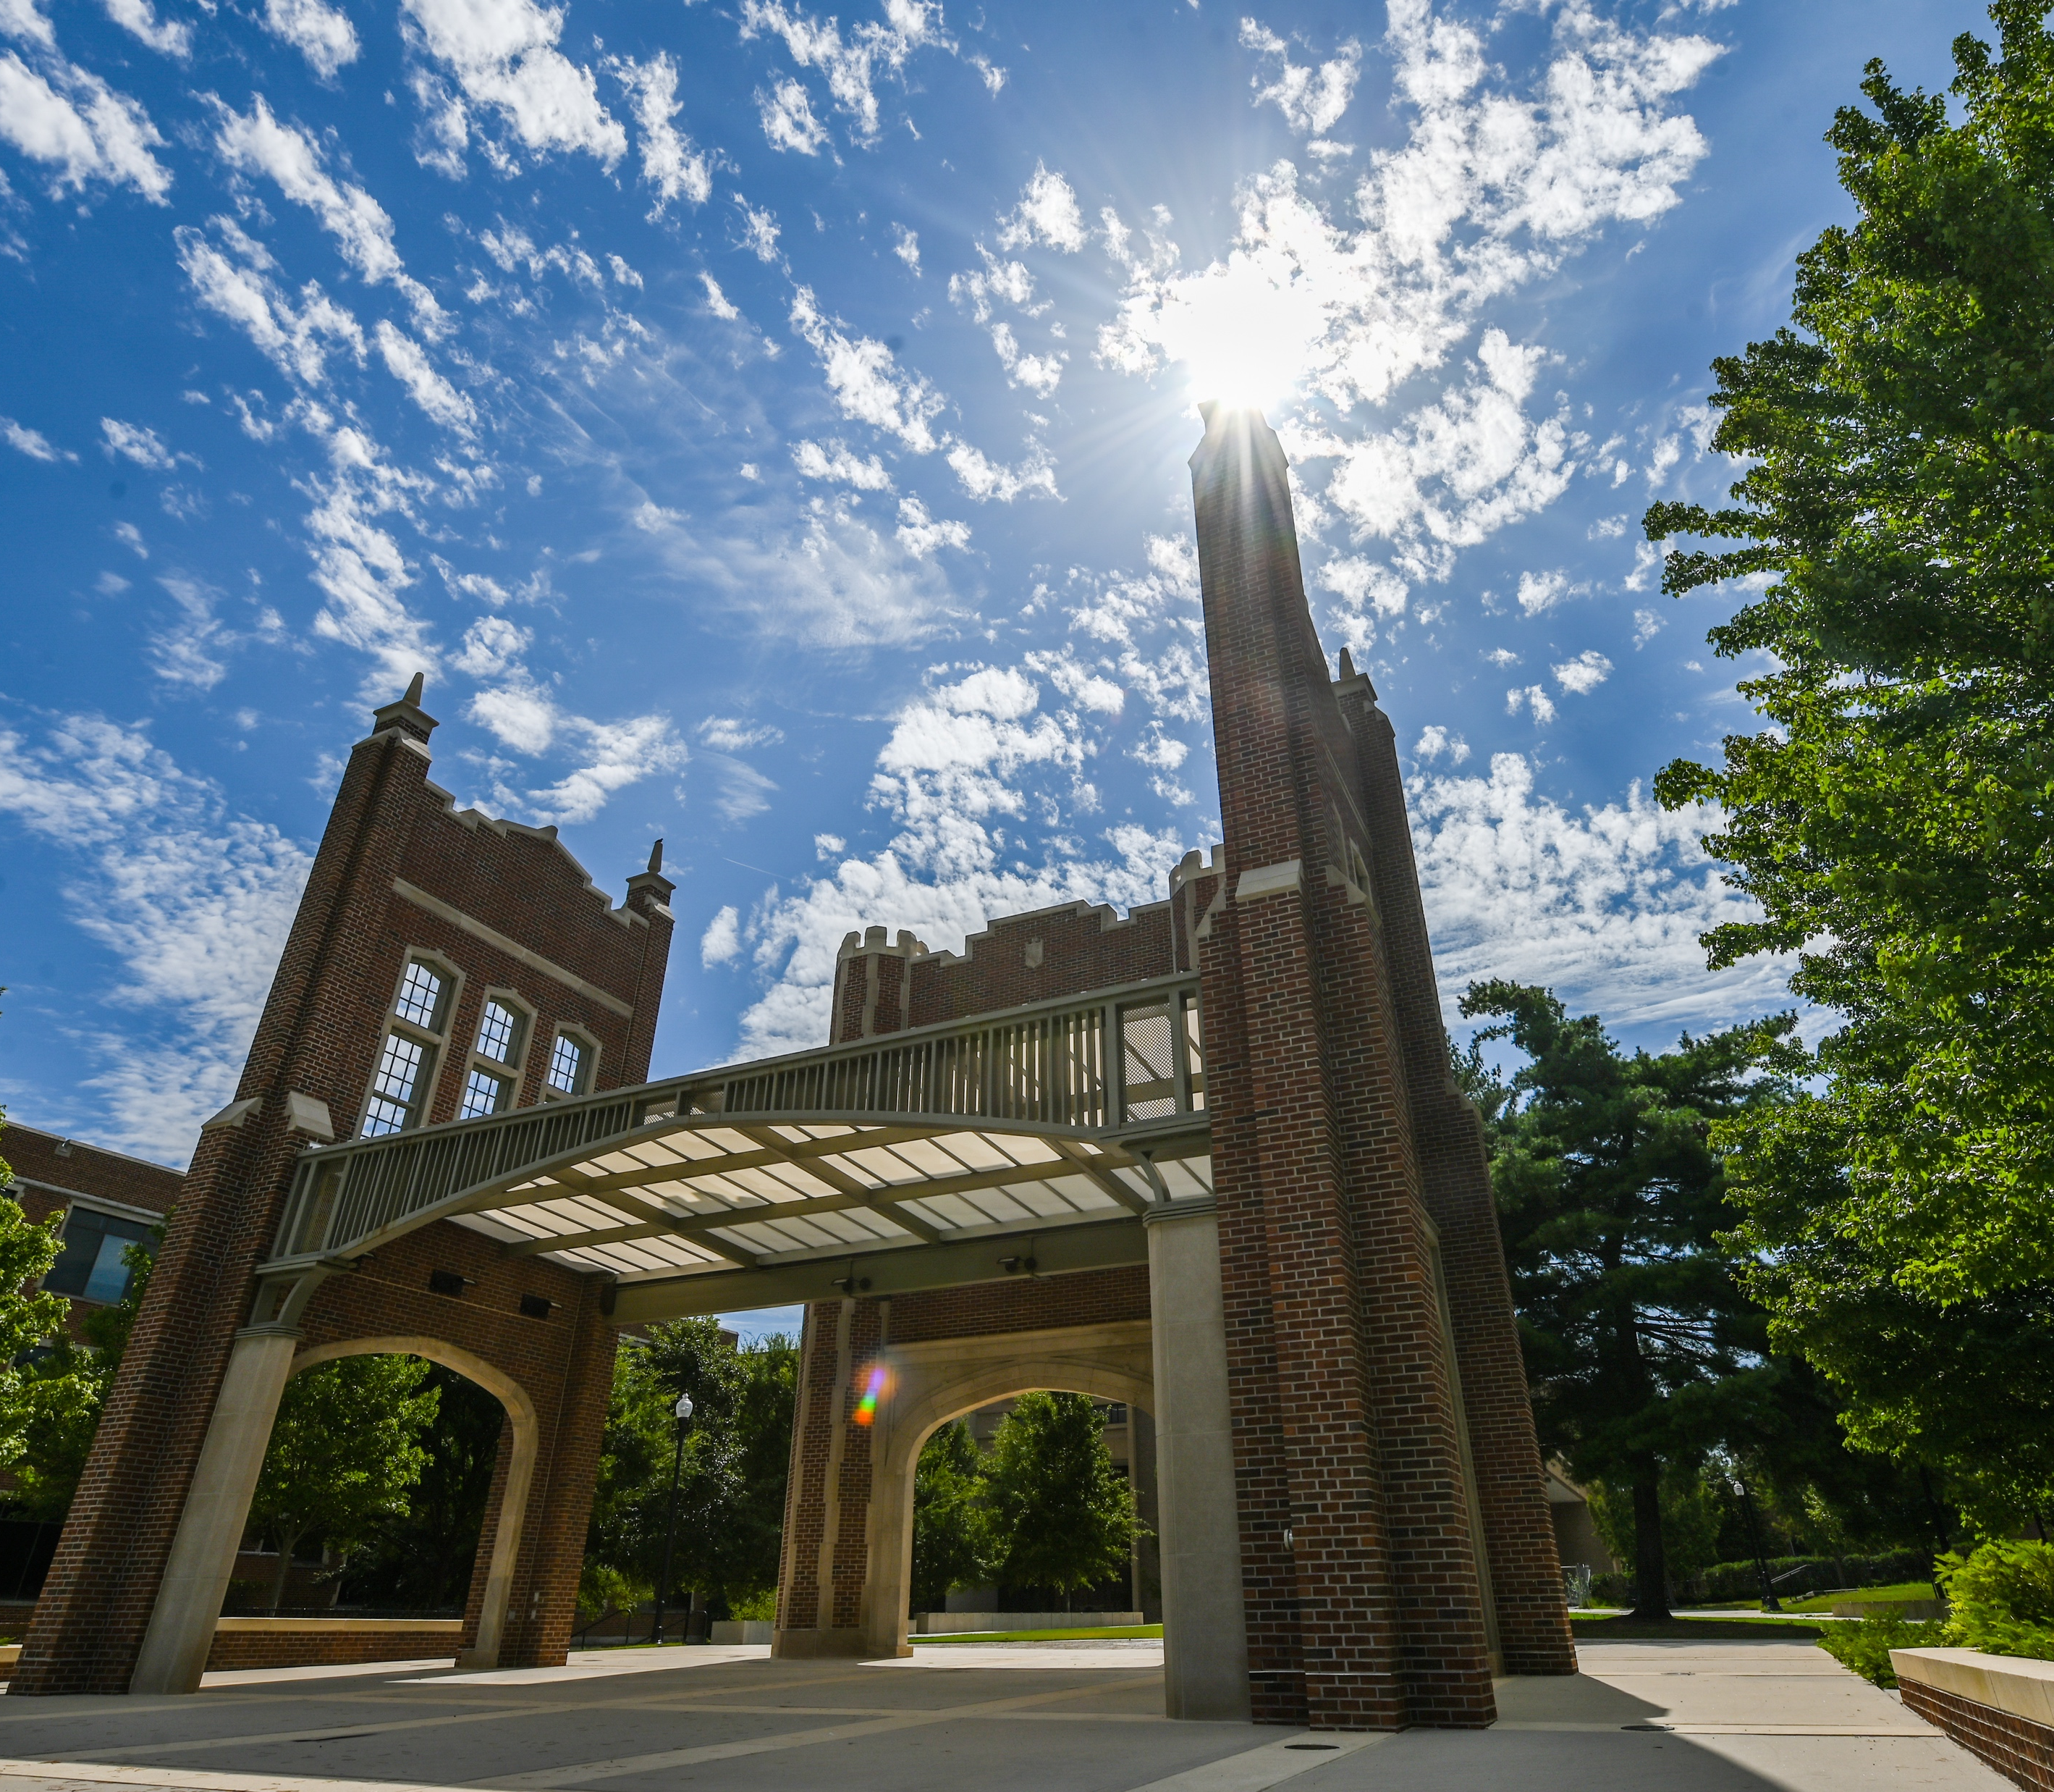

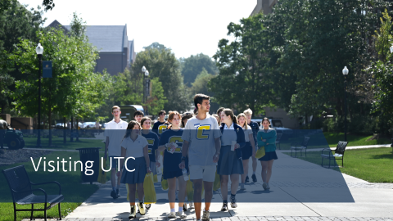






Fall 2024 Changes

Slide 6
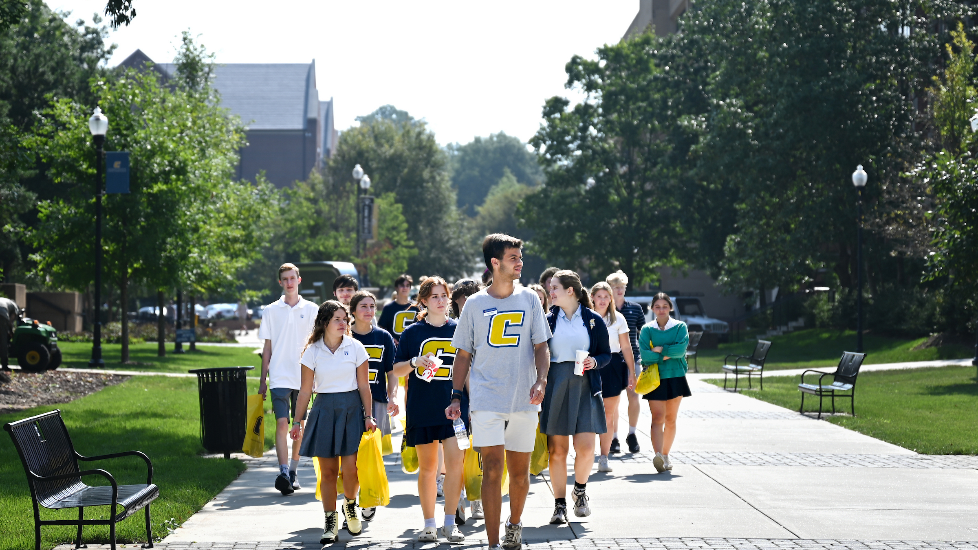
Visiting UTC

Slide 7
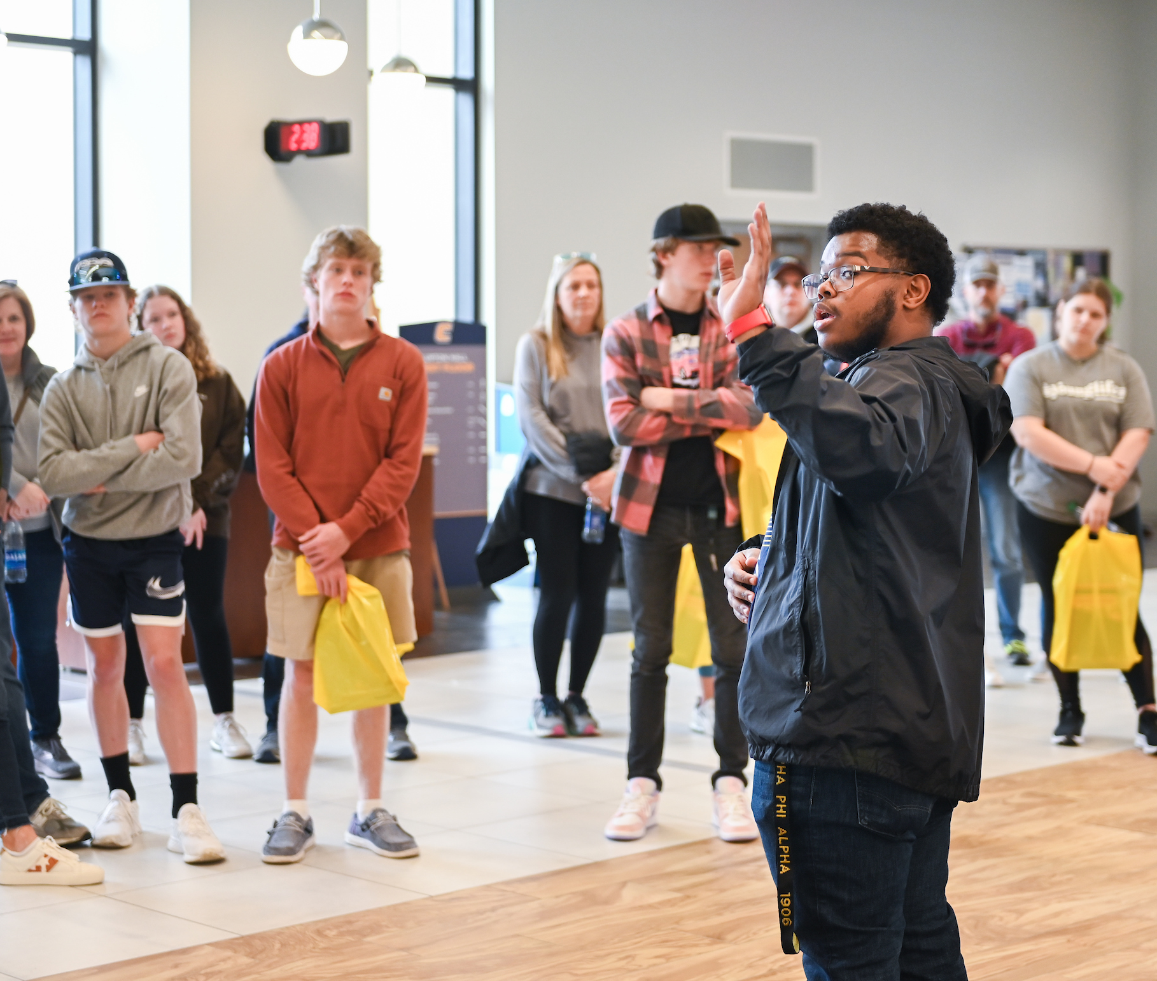
Tour Changes
Fall tours begin Sept. 4th
  10 am & 2 pm options
  Monday through Friday
Saturday tour
  Sept. 21st & Oct. 12th
  Tours at 11, 11:30, 12 & 12:30
Group tours
  Limited availability
  Contact Brandalyn Shropshire (Brandalyn-Shropshire@utc.edu)

Slide 8
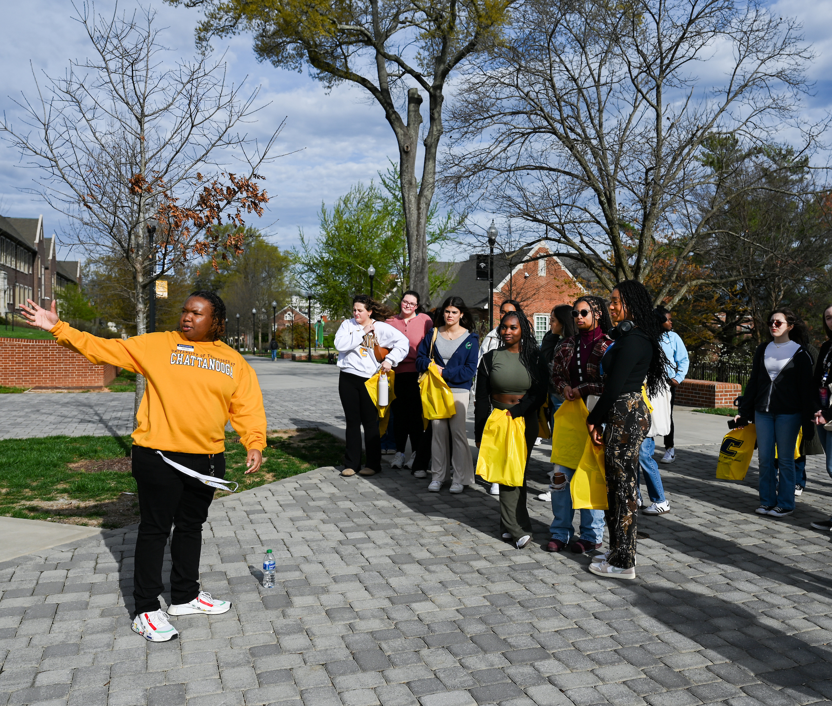
Tour Changes
Departmental visits
  Monday, Wednesday & Thursday at noon
  Participating colleges:
    Arts & Sciences
    Engineering & Computer Science
    Health, Education & Professional Studies
    Rollins College of Business

Slide 9

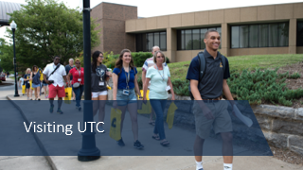
Fall 2024 Changes

Slide 10
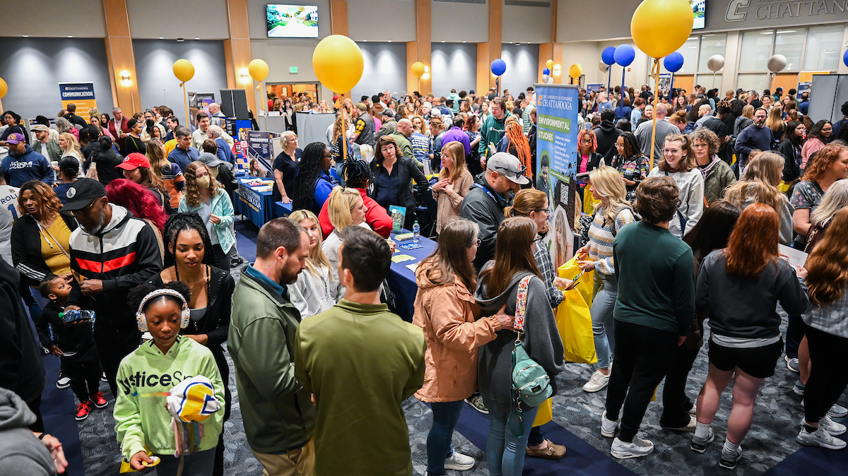
Upcoming Events

Slide 11
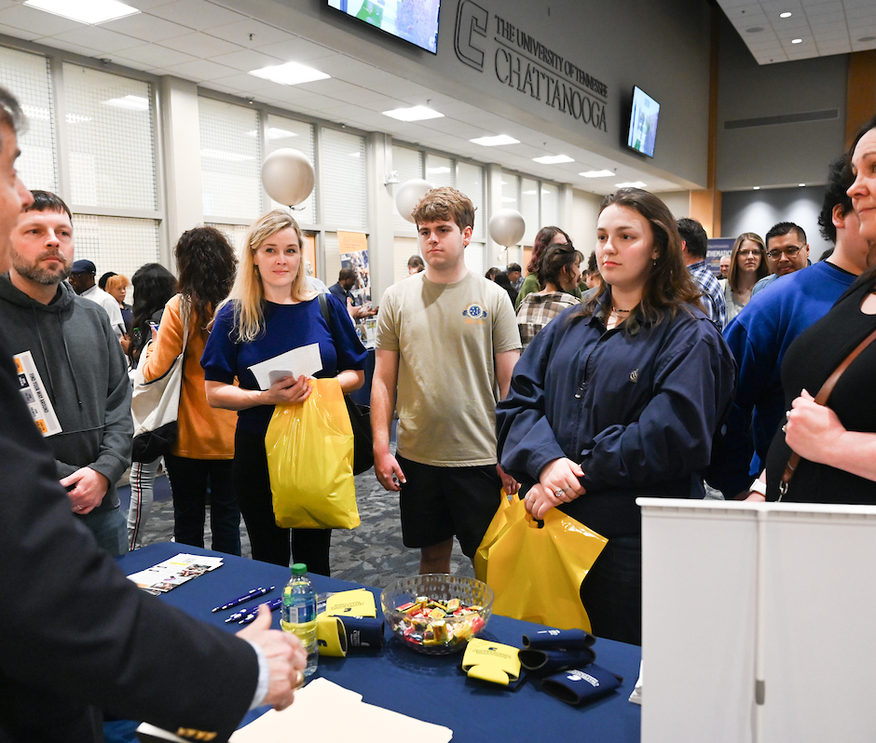
Upcoming Events
Blue & Gold Preview Day
  November 2nd
Our largest event
  Over 1600 guests
  Campus tour
  Housing tour
  Department fair
  Application workshop

Slide 12


  Bringing UTC to you
  Includes Moc Minute
  Scholarship giveaways
Memphis
  October 3rd
  Marriott Memphis East
Nashville
  October 28th
  Franklin Cool Springs Marriott
Knoxville
  October 23rd
  Knoxville Convention Center
Chattanooga
  November 13th
  UC – Tennessee Room

Slide 13
Fall 2024 Changes

Slide 14
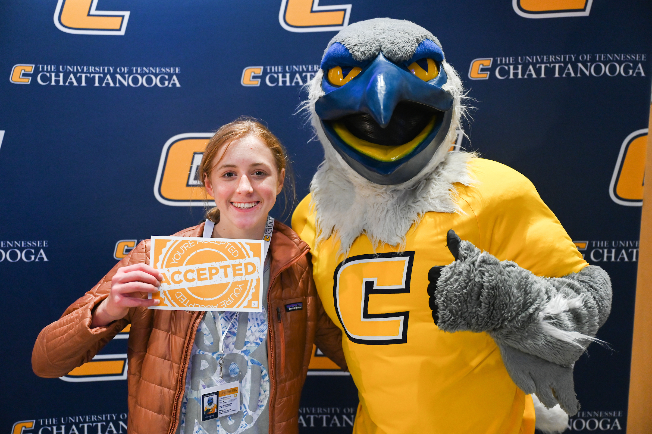
Admission changes

Slide 15
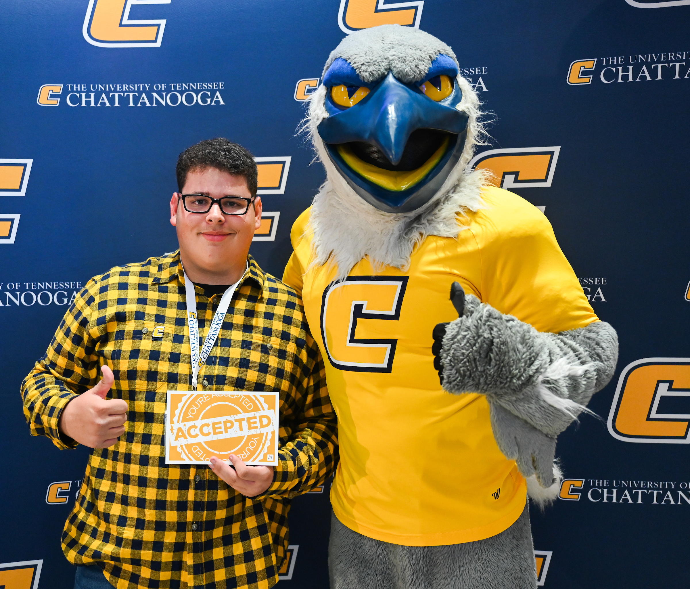
Admissions Changes
Requirements
  2.85 GPA with an 18 ACT (960 SAT) or 2.5 GPA with a 21 ACT (1060 SAT)
UTC now takes the Common App
Highest GPA listed on transcript
Continue to take superscores for admission & scholarships
Fee waivers
Transcripts can be sent to transcripts@utc.edu
Sept. 16th – 20th – Free app week

Slide 16

Admissions Tips
Apply EARLY!
Utilize the free application week & events for fee waivers
Students should check their UTC email address
ACCEPT YOUR SCHOLARSHIP!

Slide 17
Fall 2024 Changes

Slide 18
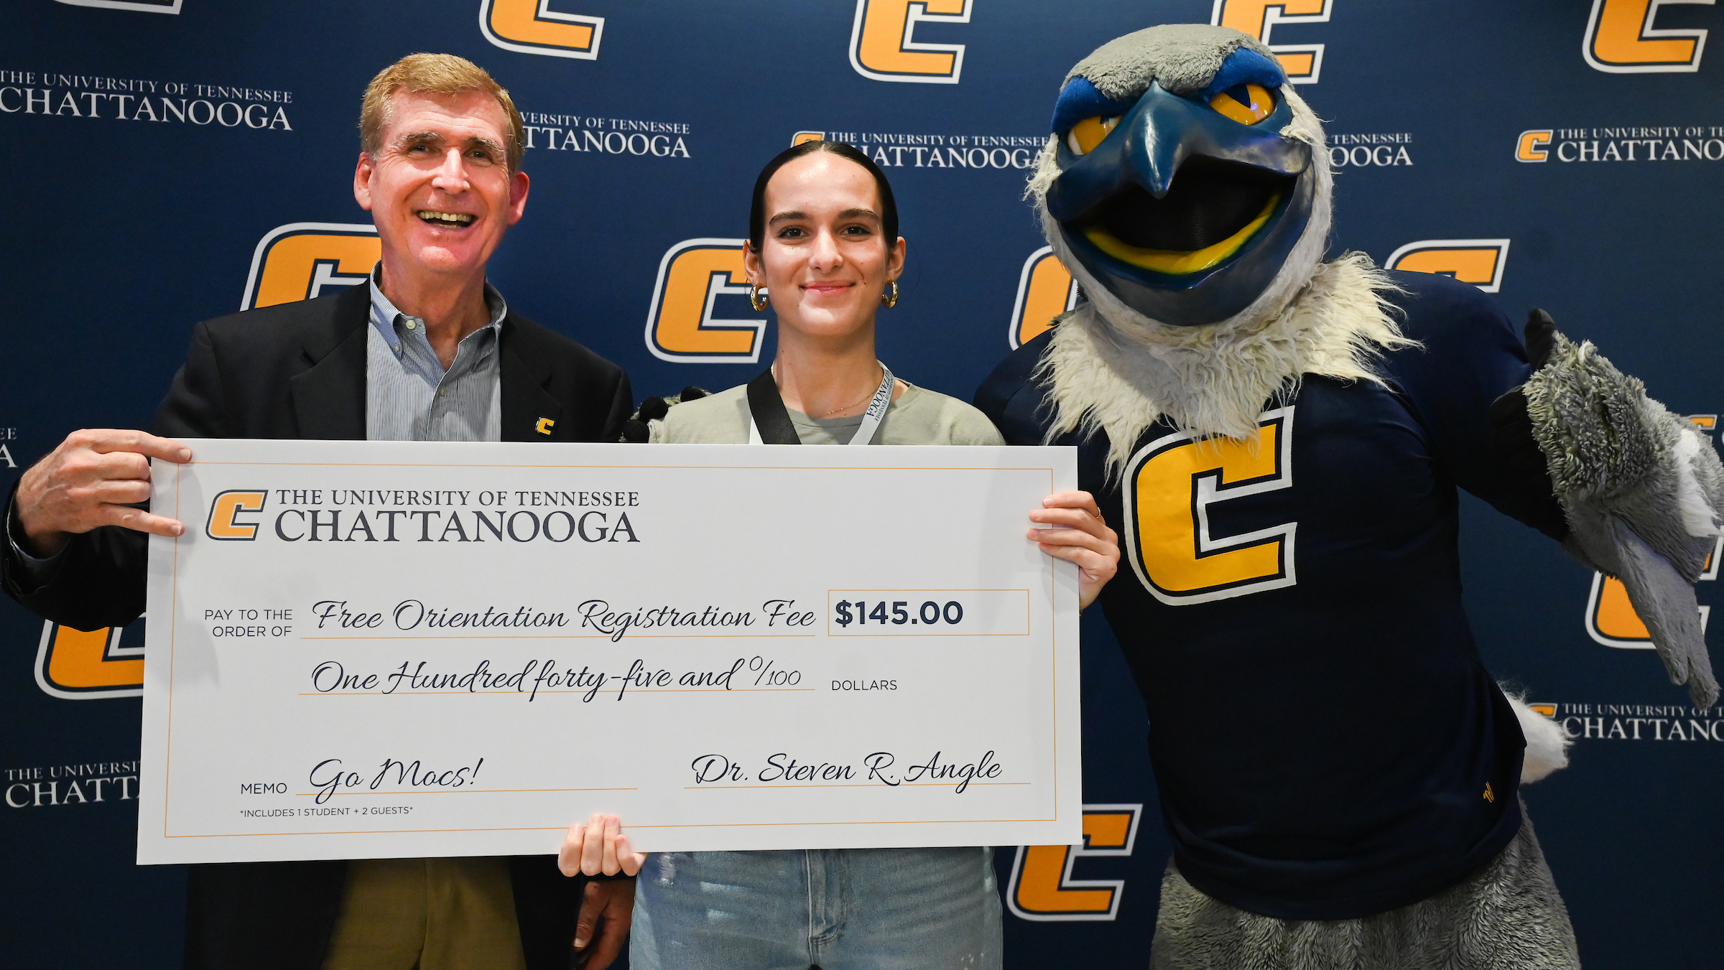
Scholarship Changes

Slide 19
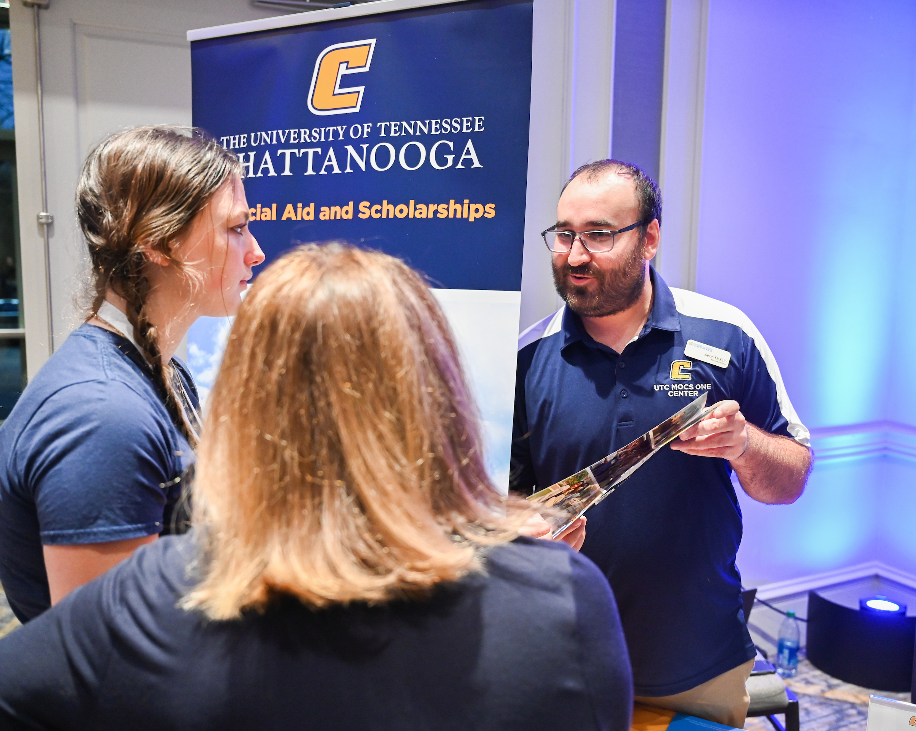
Scholarship Changes
Institutional Scholarships
Chancellor’s Scholarship
  3.75 GPA & 29 ACT (1330 SAT)
  $10,500
Provost’s Scholarship
  3.4 GPA & 25 ACT (1200 SAT)
  $8,500
Mocs Scholarship
  3.2 GPA & 22 ACT (1100 SAT)
  $7,500

Slide 20
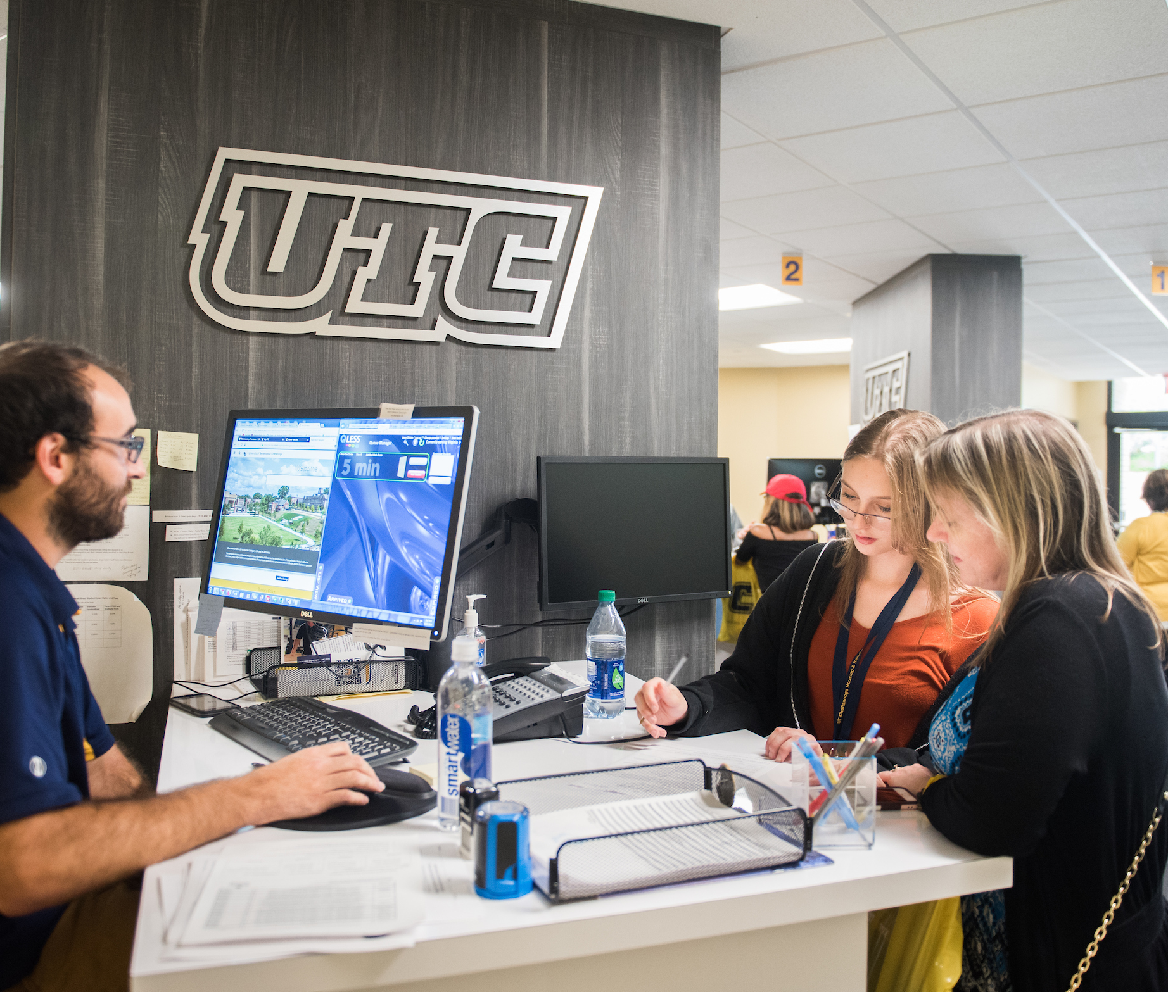
Scholarship Changes
Scholarship application available on Sept. 1st.
Admission priority deadline for scholarship consideration is
December 1st.
Students admitted by that date must complete the scholarship application by FEBRUARY 1st.

Slide 21
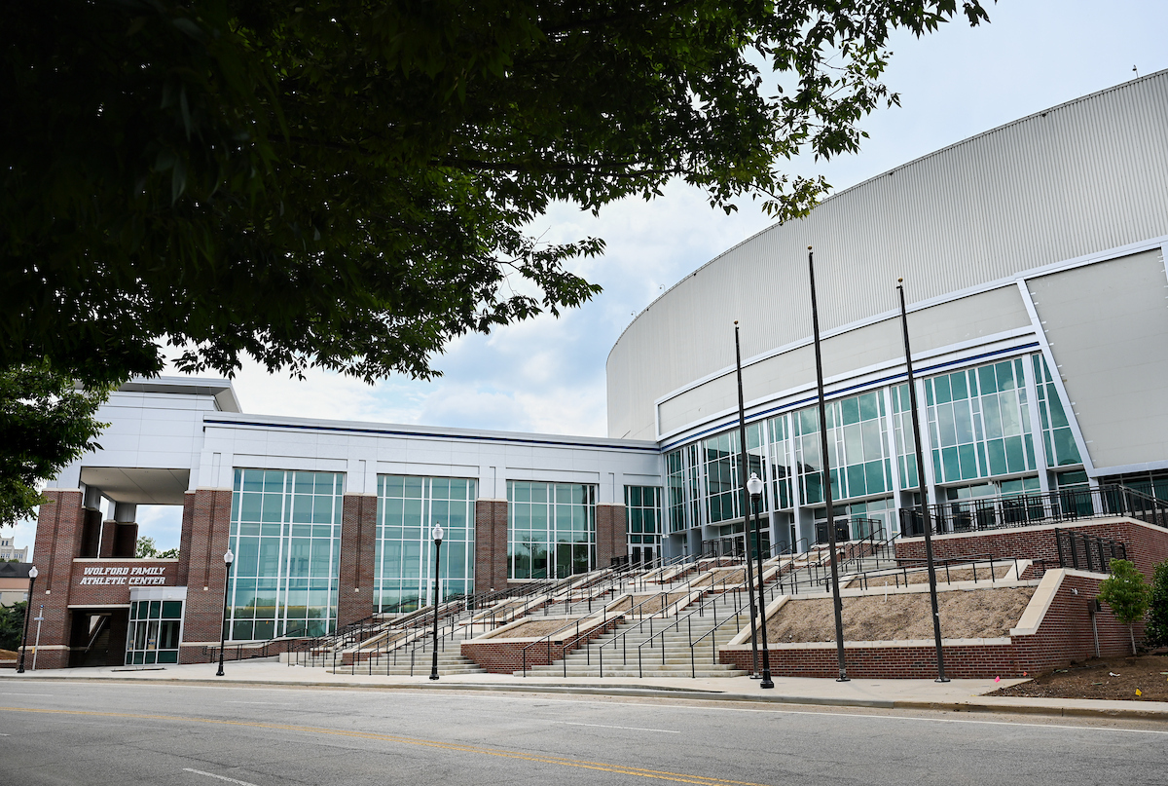
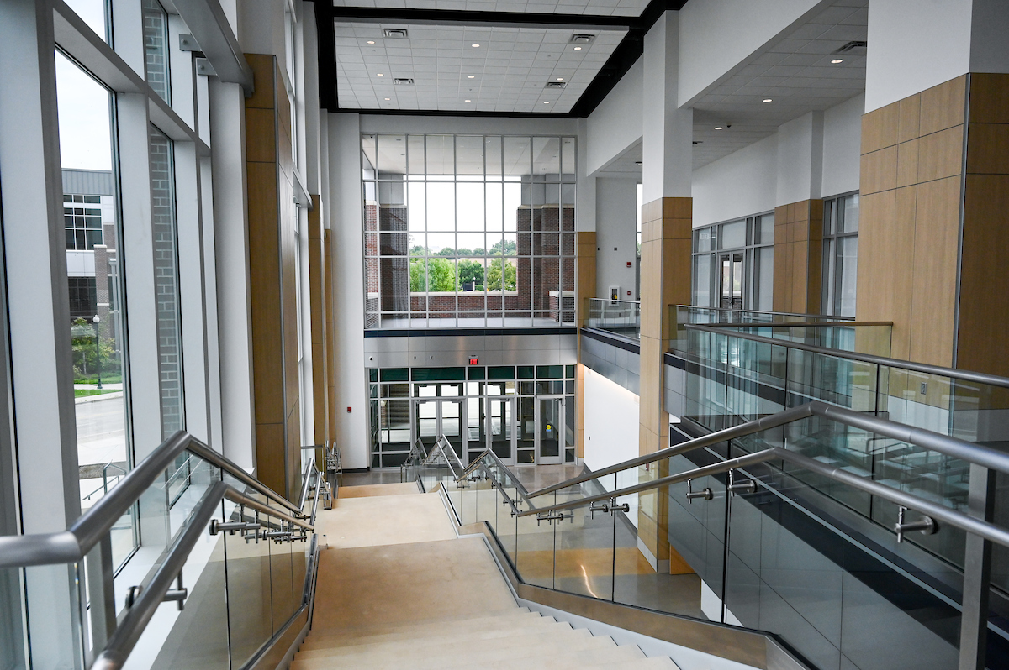
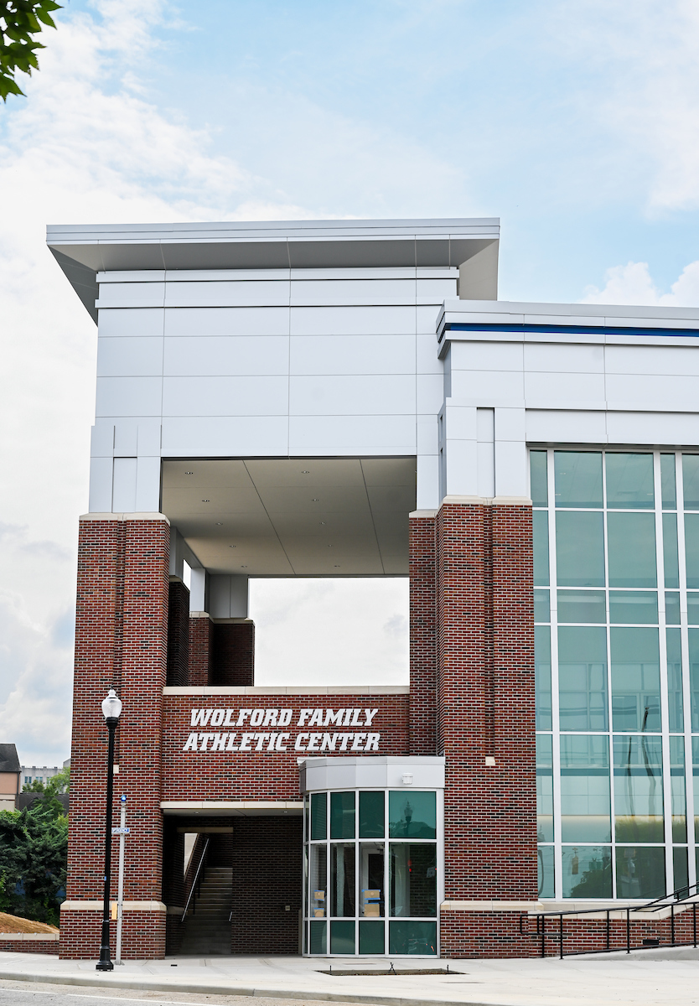
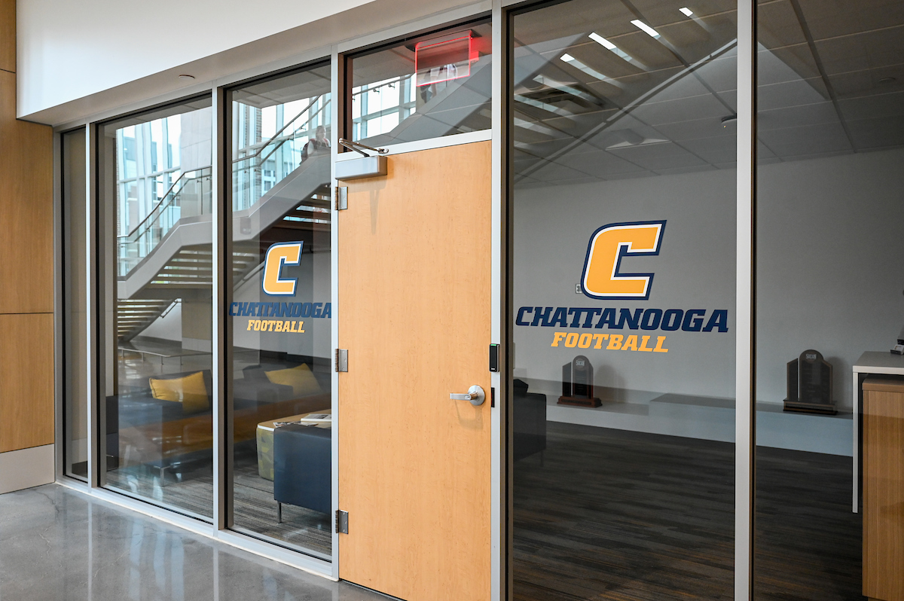

University Updates
Wolford Athletic Center

Slide 22
University Updates
University Center
Multi-year renovation
Starting in late August/Sept. 2024
Temporary spaces
Moving tour center – Raccoon Mtn. Room
Mocs One Center has moved to Chattanooga Room A. Registrar has moved to Lupton Hall
Game room will move to existing tour room space
Admissions will relocate during renovation to Chattanooga Rooms B-C (Late Fall/Early Spring)

Slide 23
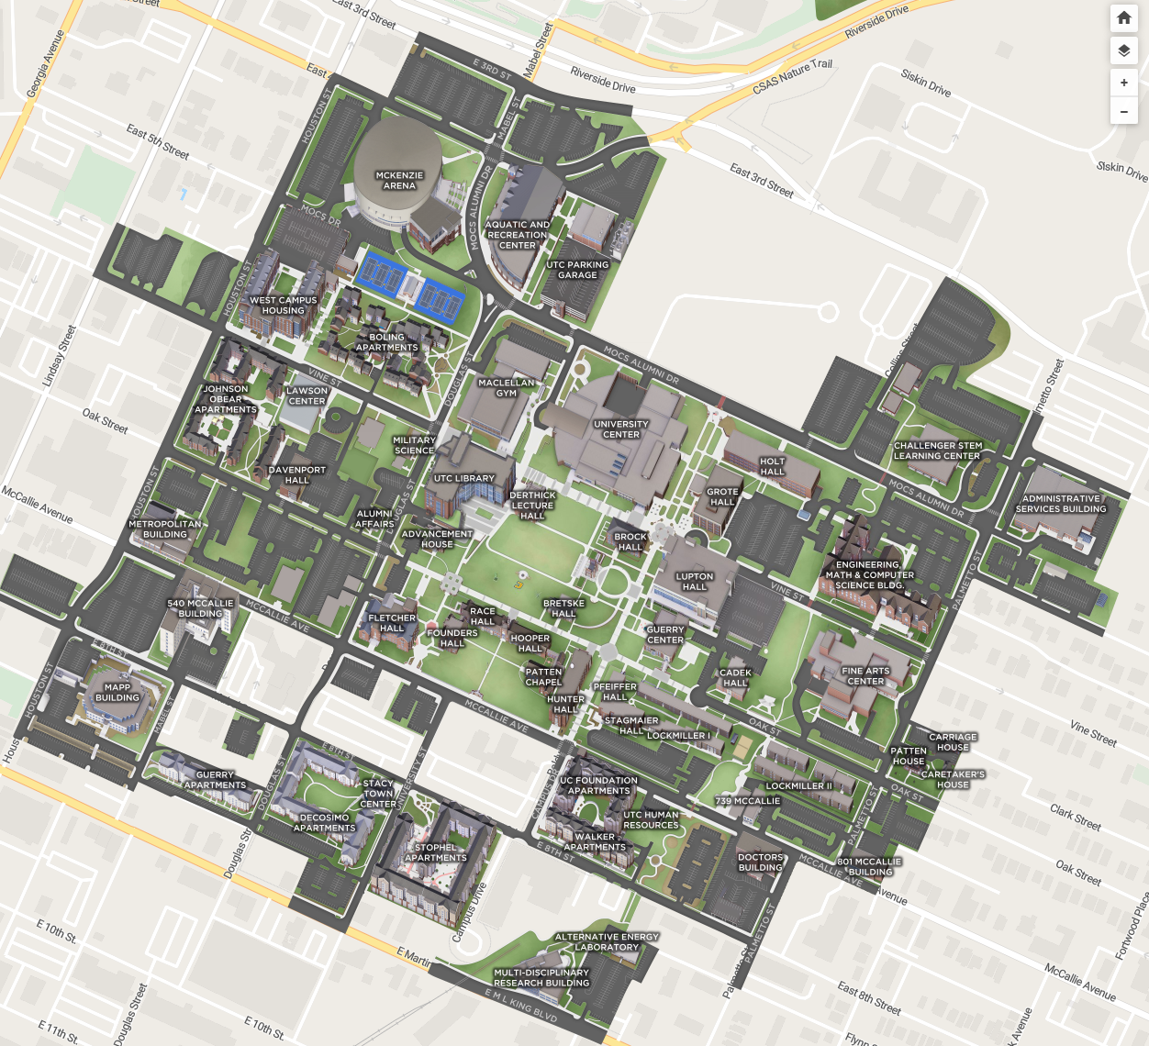
University Updates
Other Projects
Additional $30 million from Gary & Kathleen Rollins
Addition to Fletcher Hall including a skywalk (blue arrow)
UTC Nursing received a $8 million gift from The Kennedy Foundation
New Nursing Building - breaks ground in late 2024 (gold arrow)
New UTC housing complex (gray arrow) – breaks ground in 2025

Slide 24
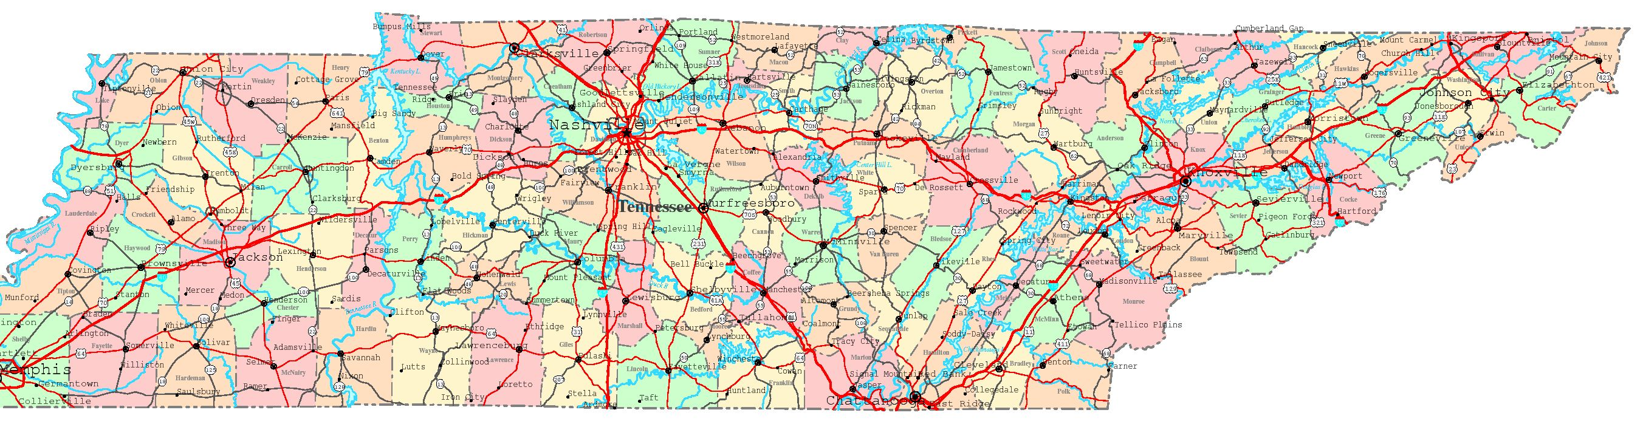
Staffing changes
Terrence Banks – Associate Director
Terrence-Banks@utc.edu
Langdon Cloyd
Langdon-Cloyd@utc.edu
Middle TN
Mattie Mills
Mattie-Mills@utc.edu
East Tennessee
Keith Mayes
Keith-Mayes@utc.edu
Regional - Memphis
Whitney Richardson
Whitney-Richardson@utc.edu
Transfer Students
Jay Freeman
Jay-Freeman@utc.edu
Local students

Slide 25
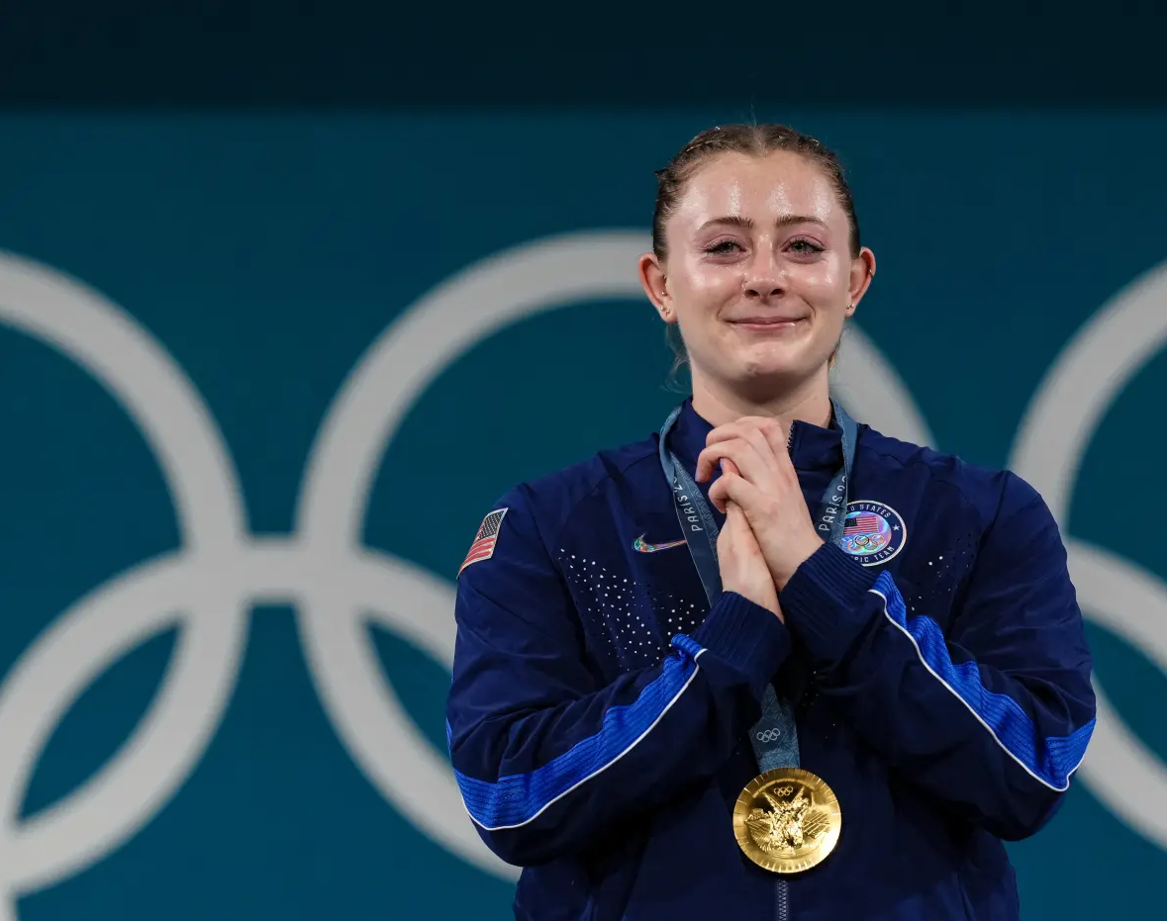
Olivia Reeves
first Olympic gold medalist and the first weightlifting gold in 24 years!

Slide 26
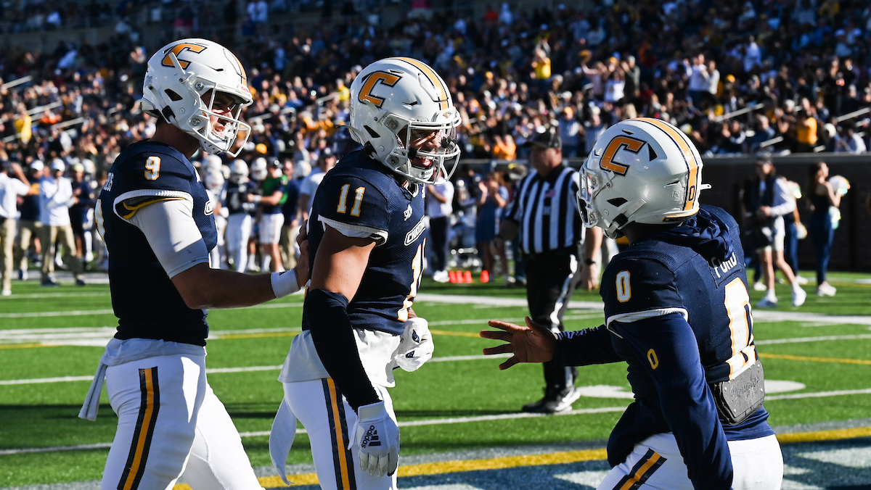
Go Mocs
Preseason
#9 in FCS top 25
First Game
August 31st at UT Knoxville

Slide 27

Thanks for listening!
Feel free to reach out. We are here to help!
UTC Admissions office
admissionsrequest@utc.edu
tours@utc.edu
transcripts@utc.edu
423-425-4662
Jason Lyon
Director
Jason-Lyon@utc.edu
423-425-5737

