Slide 2
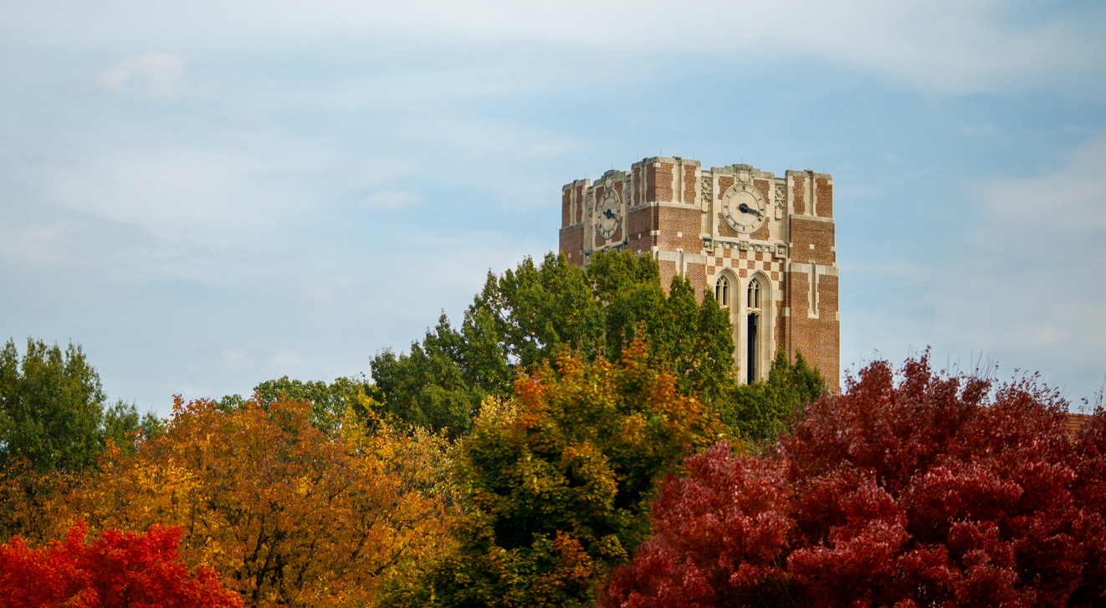
UT Breakfast For Counselors
Greetings from Rocky Top
Notes:
Greetings and introductions

Slide 3
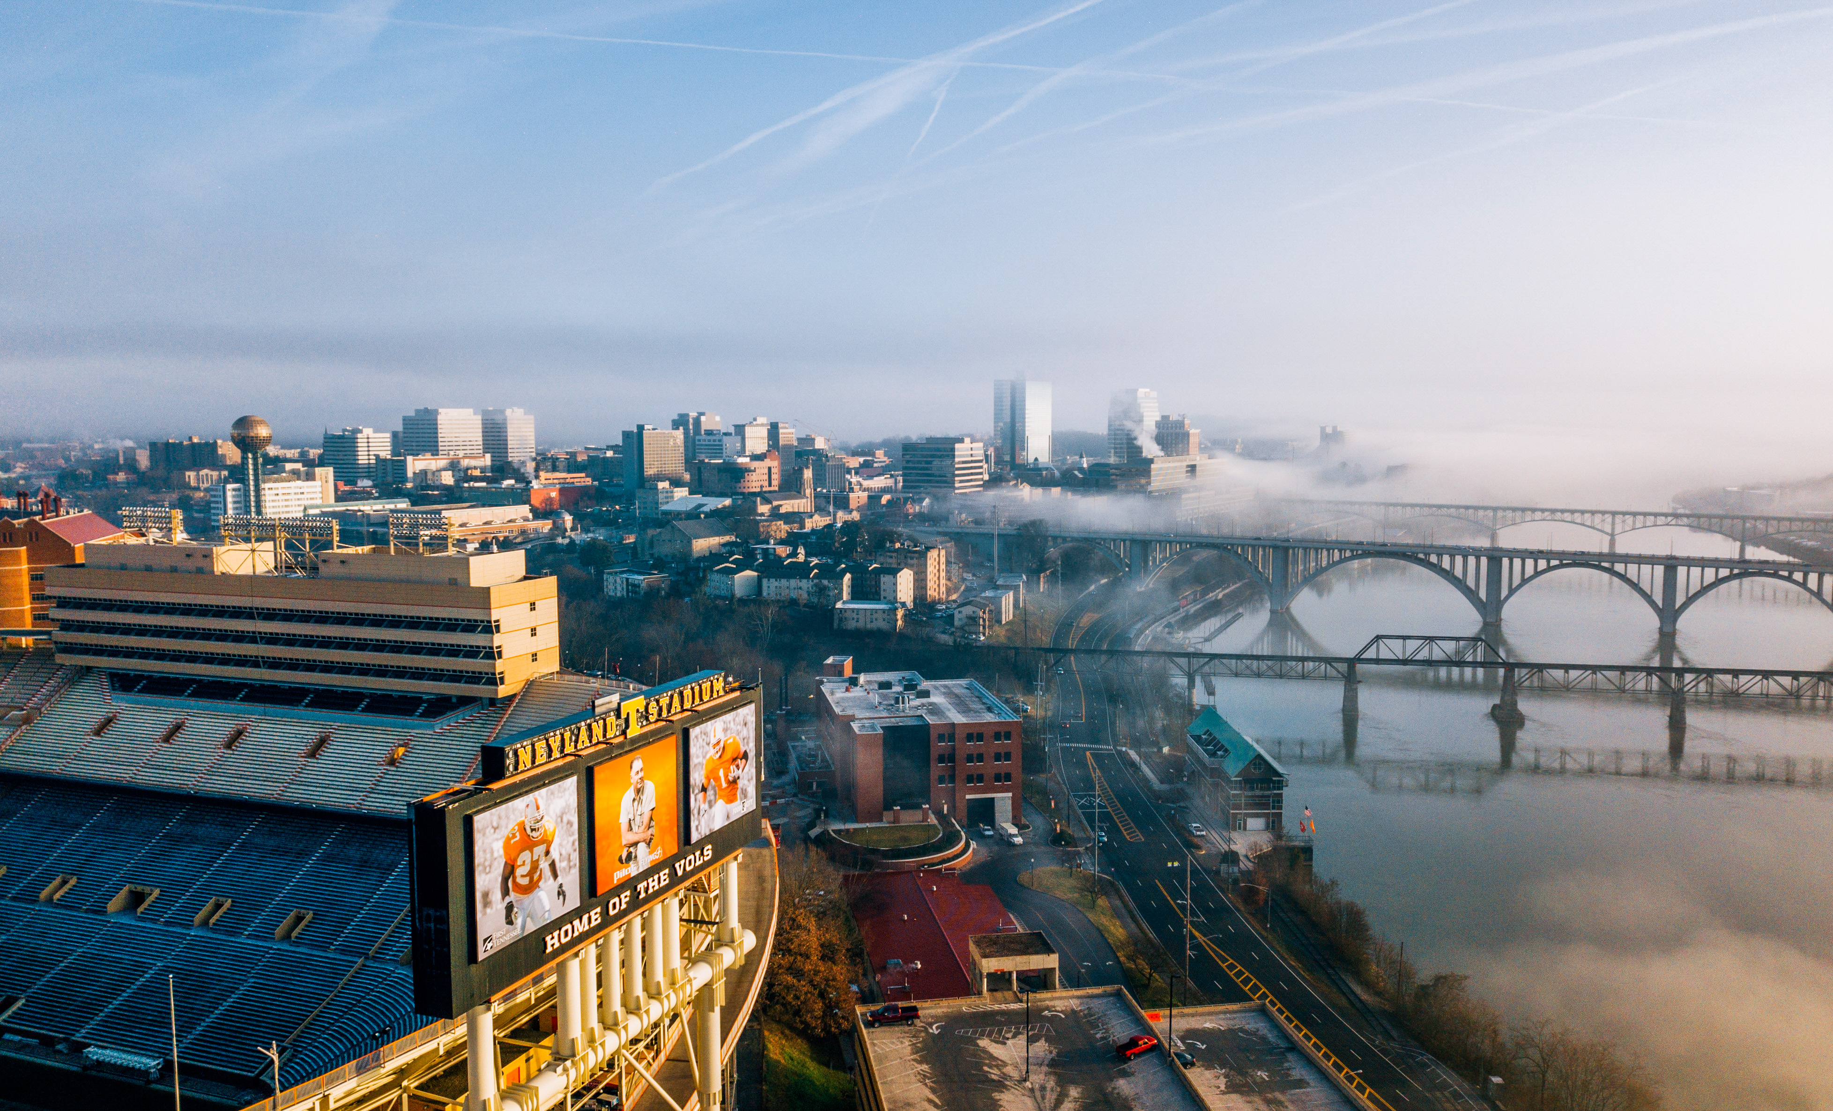
It’s great to be a Tennessee Vol !

Slide 4



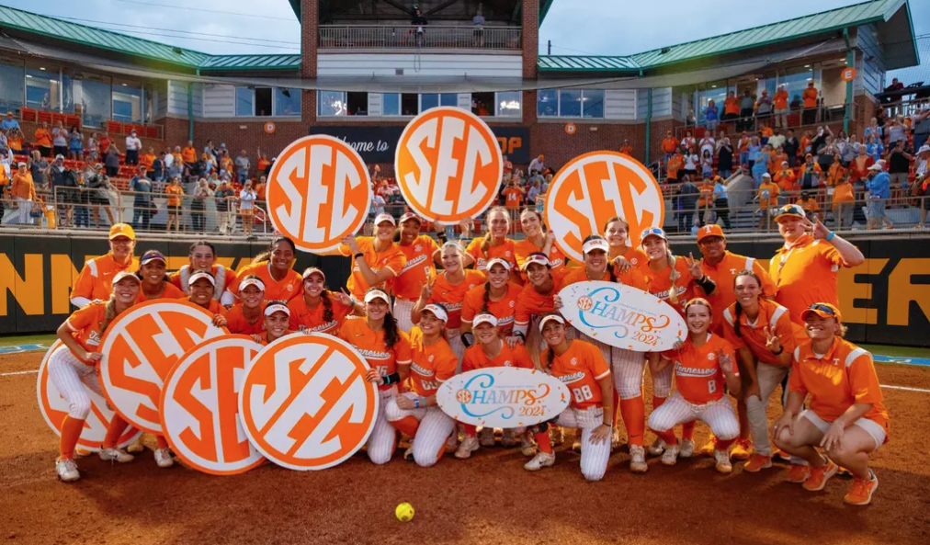


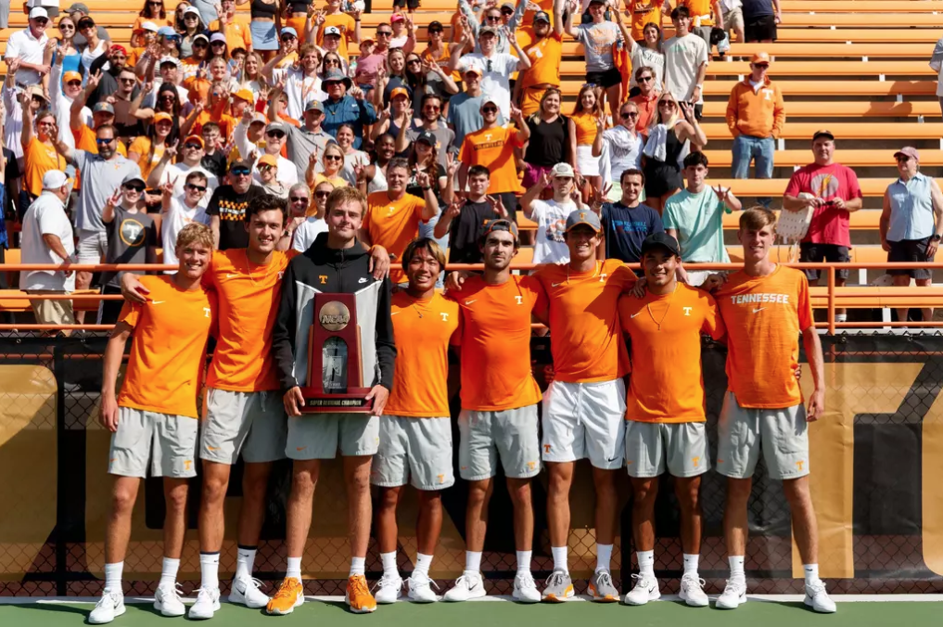
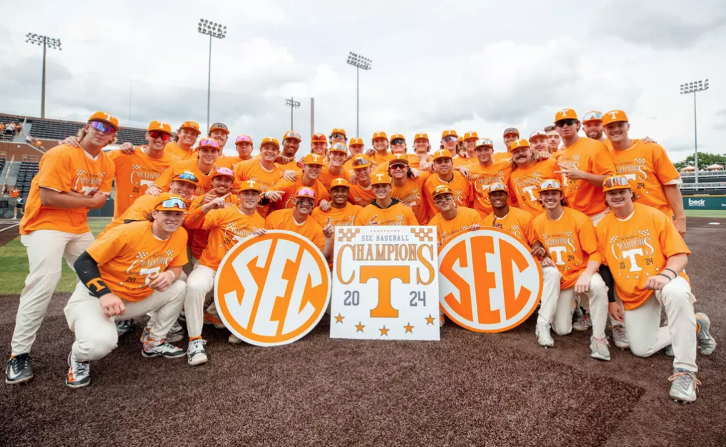

Notes:
UT is one of only two schools ever to earn three consecutive SEC All-Sports titles from USA Today Network. The Vols captured both the regular-season and tournament titles in baseball along with regular-season titles in softball and men’s basketball, making UT the first school in SEC history to win championships in all three sports in the same year.
31 Vols in Paris, 2nd most from the SEC, 6th most in the U.S. (3 of 31 alums)

Slide 5
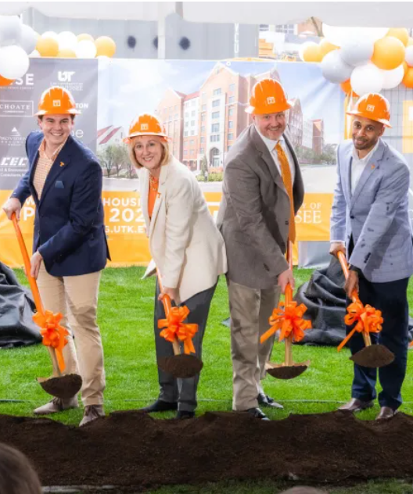
BREAKING GROUND
The physical transformation you’re seeing across campus reflects the progress happening throughout our university. We’ve had another banner year, setting records in research expenditures, enrollment, student success, athletic success, and other areas.

Slide 6
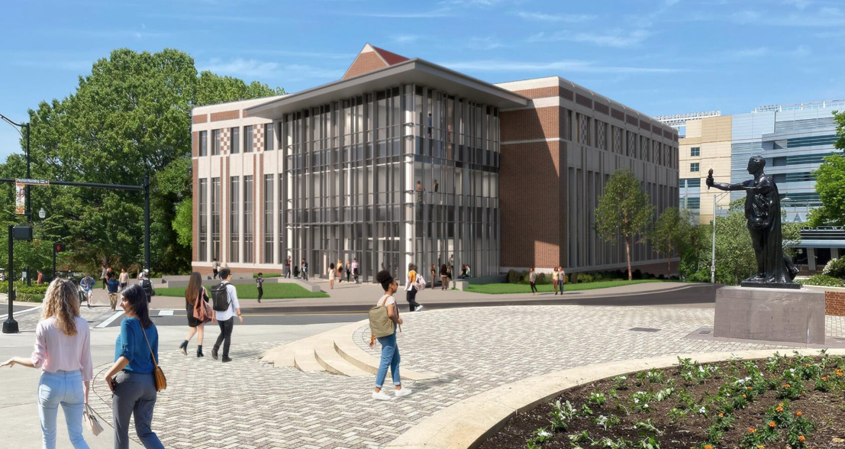
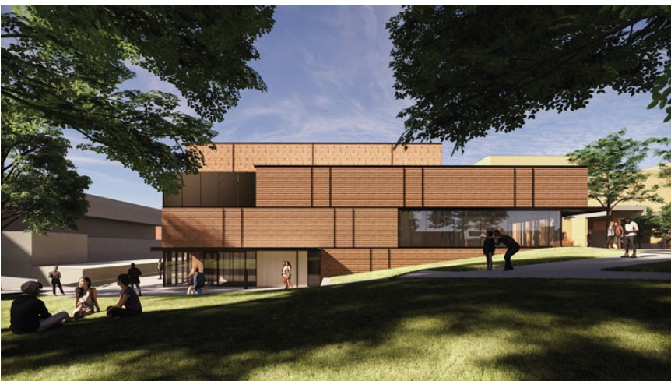
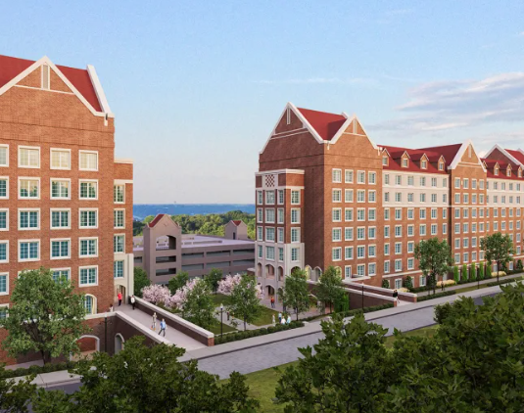
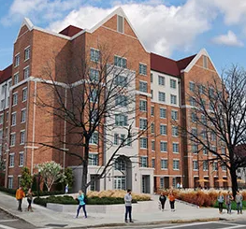
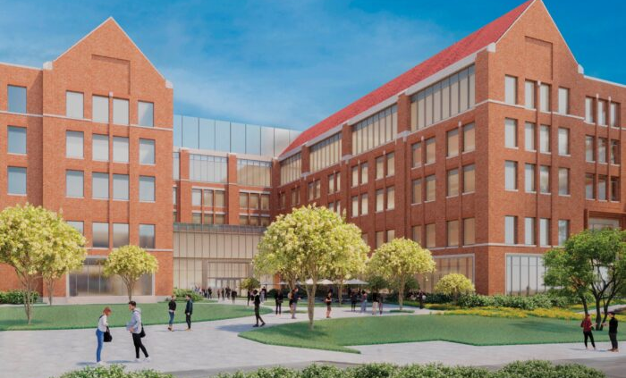
Jenny Boyd Carousel Theatre ($15M)
Fall 2025 | Croley Nursing Building ($85M)
Growth on Rocky Top
LIFE ON ROCKY TOP​
Fall 2027 | Haslam College of Business Expansion (300,000 sq. ft. bldg.) ($227M)

Slide 7



Fall 2024 Applications
Data as of 8/9/2024
OVERALL
IN-STATE
59,760
Applications
24,863
Admits
13,519
Applications
9,479
Admits
(70% Admit Rate)
26–31
Mid-50% ACT Composite Superscore
4.00–4.46
Mid-50% UT Core GPA
25–31
Mid-50% ACT Composite Superscore
4.21–4.54
Mid-50% UT Core GPA
878 Flagship High School Applicants
Notes:
4,371 Students of Color Applicants – TN
Hispanic trumps because of the "Regardless of Race"
Two or More trumps all of the single race categories except Hispanic
Non-Resident Aliens (International) are still asked the two questions, but are reported as this regardless of answers.

Slide 8
Fall 2024 Guaranteed Admission
Data as of 8/9/2024
6,194
Qualified Applicants
4,231
Qualified with 4.0 UT GPA
69
Qualified with Top 10%
1,893
Qualified with both 4.0 UT GPA & Top 10%
25–32
Mid-50% ACT Composite Superscore
4.21–4.54
Mid-50% UT Core GPA
105
Qualified with 4.0 UT GPA
37
Qualified with Top 10%
156
Qualified with both 4.0 UT GPA & Top 10%
Flagship
High School
Students
Notes:
qualified with 4.0 core GPA
1,083 students of color)
top 10% designation
44 students of color)
4.0 core GPA & top 10% classification
568 students of color

Slide 9
Fall 2024 Confirmed
Data as of 8/9/2024
OVERALL
IN-STATE
6,971
Confirms
48
States Represented
4,376
Confirms
93
TN Counties
Represented
25–30
Mid-50% ACT Composite Superscore
3.88–4.40
Mid-50% UT Core GPA
25–30
Mid-50% ACT Composite Superscore
3.89–4.43
Mid-50% UT Core GPA
258 Flagship High School Confirms
Notes:
1,098 students of color confirms – TN
Alaska, North and South Dakota not represented /// D.C and TN are included
Cannon and Lake counties not represented

Slide 10


Important Dates
ADMISSION DEADLINES
COMPLETION DEADLINES
DECISION RELEASE DATES
VIEW A FULL LIST OF DATES!
November 1
Early Action Admission
Deadline
December 16
Regular Admission Application Deadline
November 15
Early Action
Completion Deadline
January 17
Regular Application
Completion Deadline
December 4
In-State Early Action Release
December 17
Out-of-State Early Action Release
March 4
Regular Decision Release
tiny.utk.edu/ FYDATES
Notes:
The 2025-2026 Free Application for Student Aid (FAFSA) will open in Fall 2024. Visit onestop.utk.edu/fafsa for more details.

Slide 11

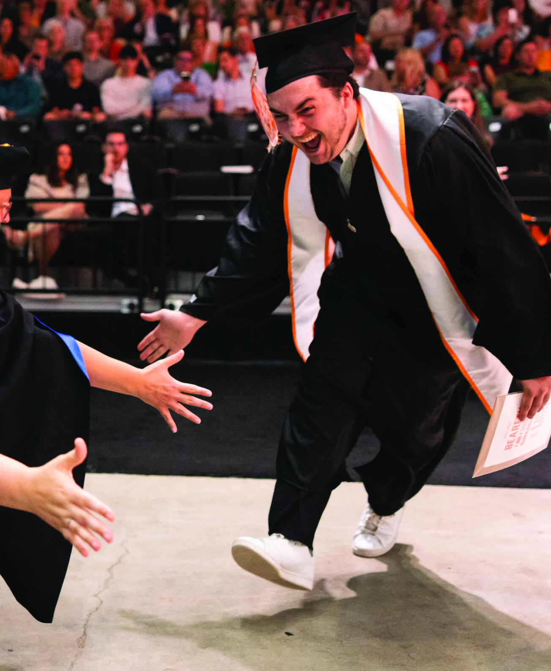


MAY 1
Confirmation Deadline
Notes:
“why UT”

Slide 12

Application Updates
Application Fee = $75
New Application Fee Waiver form available in Slate.org
Top 10% Form available in Slate.org
Free Application Week | September 16-20
University Honors Essay Deadline | November 20, 11:59 p.m. (ET)
Admissions letters will be available digitally in students' Go Vols Portal

Slide 13
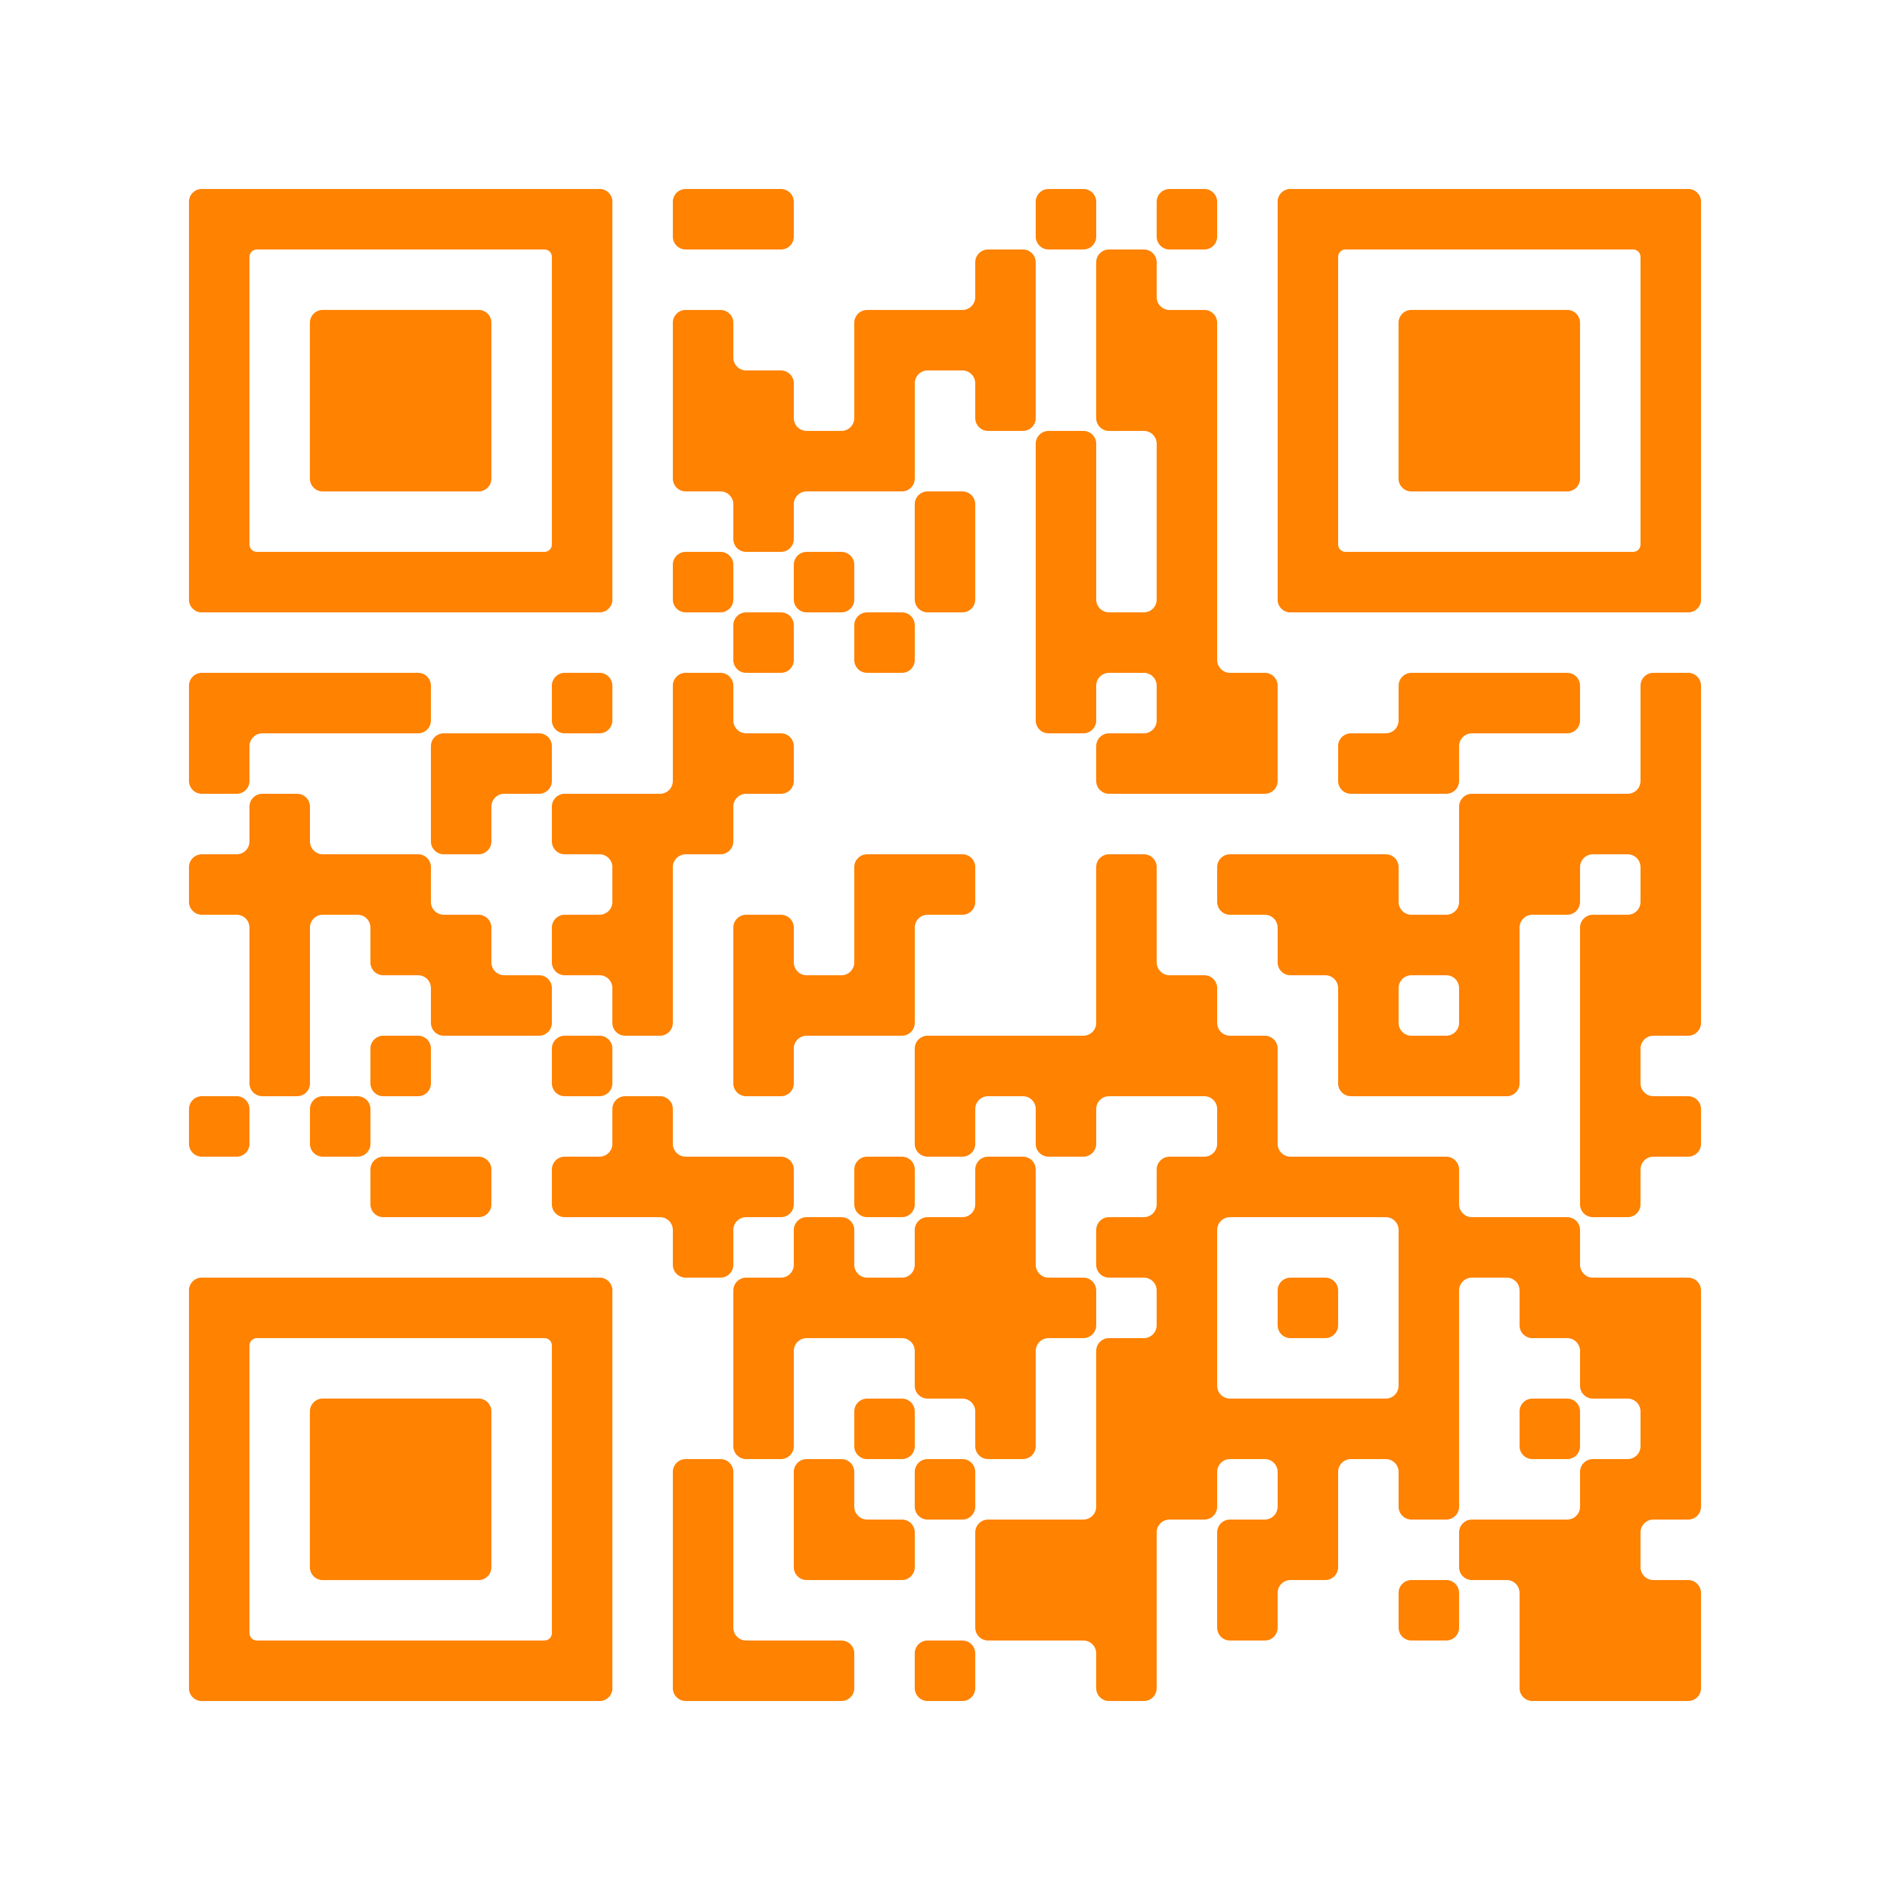
New In-state Guaranteed Admission Policy
4.0 UT CORE GPA
TOP 10%
More Policy Details
UT calculated core GPA
Minimum composite super score of 24 ACT or higher (SAT 1160)
Math subject score must be 19 or higher
(SAT Math 510)
English subject score must be 19 or higher
(SAT ER+W 500)
Post Junior Year
Minimum composite super score of 24 ACT or higher (SAT 1160)
Math subject score must be 19 or higher
(SAT Math 510)
English subject score must be 19 or higher
(SAT ER+W 500)
OR
admissions.utk.edu/guaranteed-admission
Notes:
The 2025-2026 Free Application for Student Aid (FAFSA) will open in Fall 2024. Visit onestop.utk.edu/fafsa for more details.

Slide 14
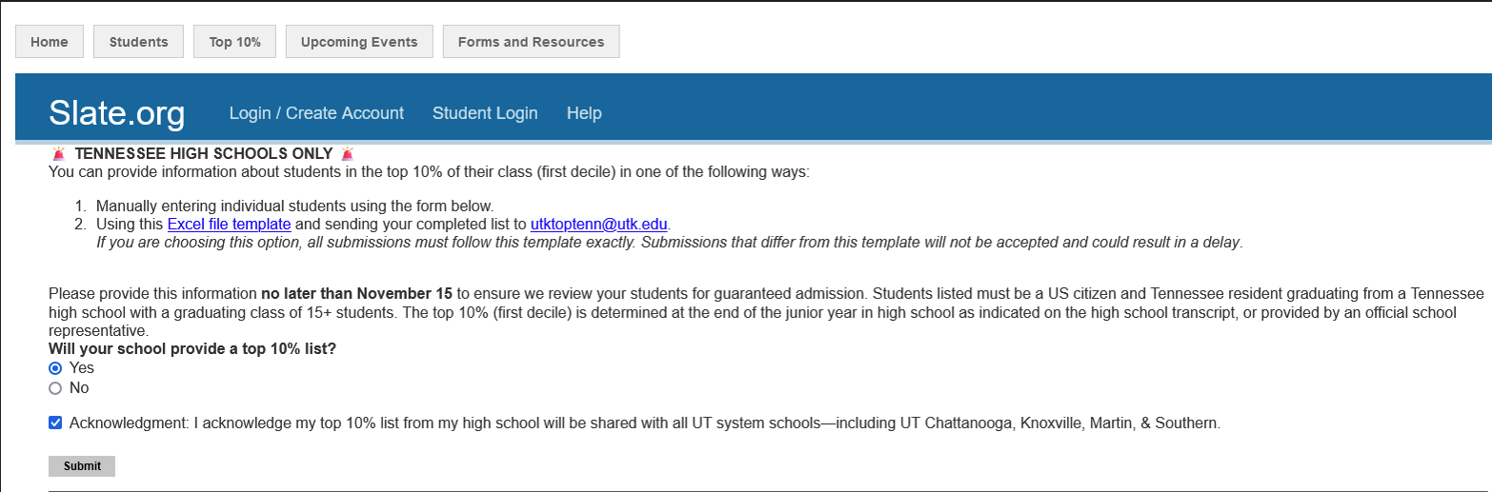
Reporting Top 10%

Slide 15
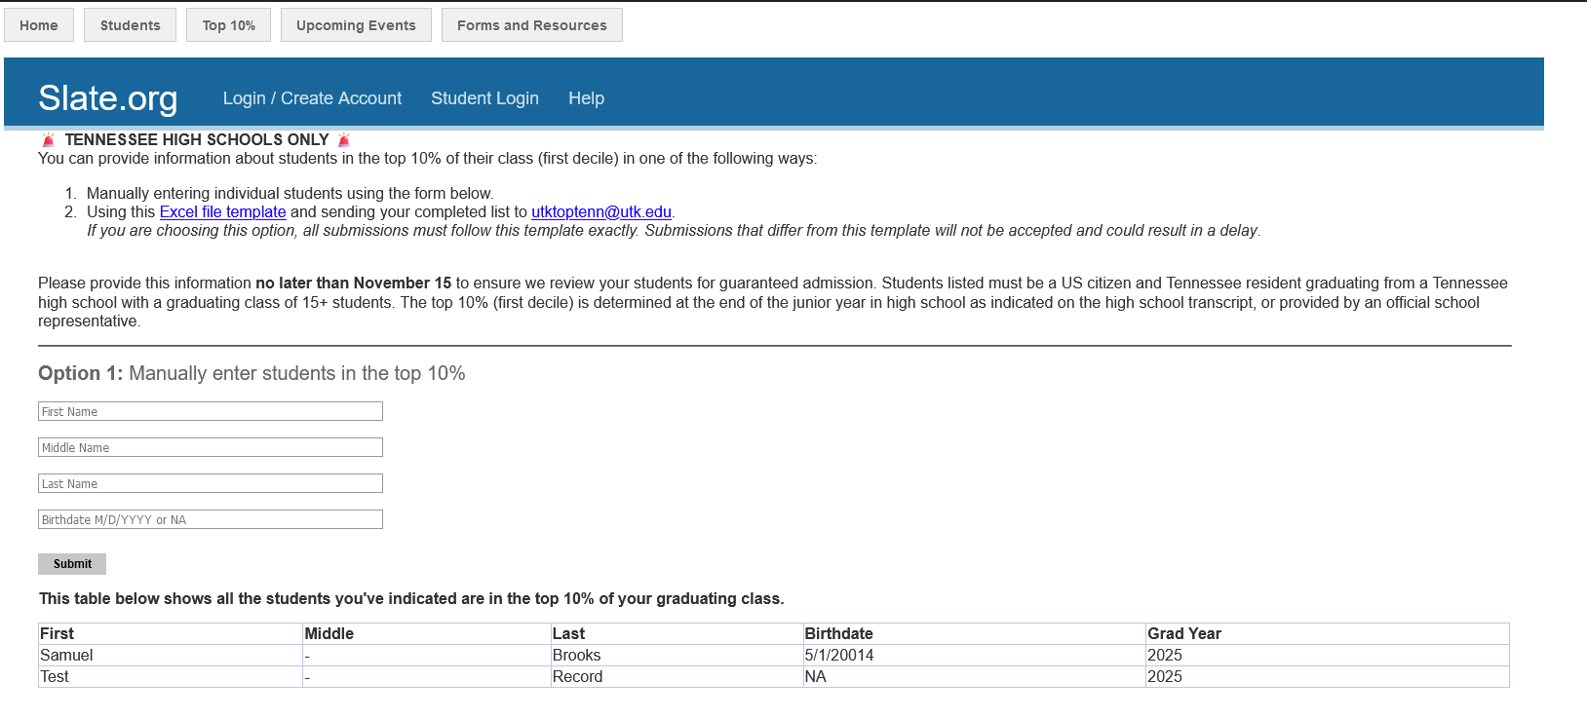
Reporting Top 10%

Slide 16
Self-Reported Academic Record Reminders
Multiple grading scales during HS = enter letter grades, not numerical grades
Enter all tests and subject scores, do not enter a super score
Core courses taken in 8th grade should be entered with 9th grade courses
Applicant’s full name and current school must be visible on the unofficial academic record included with the SRAR
Computer Science will not count as a math course in UT’s Core GPA calculation
Select “Full Year” for core courses receiving a full credit, taken in one semester
Enter all courses, including senior year in-progress
Notes:
If an applicant has experienced multiple grading scales during high school, letter grades should be entered instead of numerical grades
When multiple tests exist, enter each individual test and subject scores. Do not enter only a super score. The SRAR will automatically calculate a super score
Core courses, like Algebra 1, Physical Science, a foreign language, taken in 8th grade can be included with 9th grade course listing, but only if there is a grade and credit value on the transcript.
In the Length/Credit column of the SRAR, select “Full Year” even when the course was taken only during one semester (so long as the credit value is not half)

Slide 17

SCHOLARSHIPS
UT provides a variety of scholarships for students! The criteria for the individual scholarships vary, and there are scholarships awarded for academic merit, financial need, and more.
For updated scholarship information, visit onestop.utk.edu/scholarships.
50%+
$84M
of students graduate with NO DEBT
was offered to students in 2024

Slide 18
IN-STATE MERIT SCHOLARSHIPS
UT CORE GPA* | ACT/SAT (M+ERW)* | ANNUAL AWARD | FOUR-YEAR WITH HOPE (AVG. MAX)
3.8+ | 34–36 ACT // 1490–1600 SAT | $9,000 | $56,400
 | 30–33 ACT // 1360–1480 SAT | $5,000 | $40,400
 | 28–29 ACT // 1300–1350 SAT | $3,000 | $32,400
VOLUNTEER SCHOLARSHIP
UT CORE GPA* | ACT/SAT (M+ERW)* | ANNUAL AWARD | FOUR-YEAR WITH HOPE (AVG. MAX)
3.6–3.79 | 28-36 ACT // 1300-1600 SAT | $1,500 | $26,400
3.6+ | 24-27 ACT // 1160-1290 SAT
ORANGE & WHITE SCHOLARSHIP
Amounts shown are for the 2024-2025 academic year.
*UT weighted core GPA, composite superscore.
These awards cannot be combined.

Slide 19
TRI-STAR SCHOLARSHIP PROGRAM
UT PROMISE SCHOLARSHIP (UT SYSTEM-WIDE) | PLEDGE SCHOLARSHIP (UT KNOXVILLE ONLY) | FLAGSHIP SCHOLARSHIP (UT KNOXVILLE ONLY)
Tennessee residents Adjusted gross income of less than $75,000 HOPE eligible | Tennessee residents Adjusted gross income of $40,000 or less | Tennessee residents Graduate of one of the 38 “Flagship” High Schools
Tuition & mandatory fees | Tuition & mandatory fees Housing & food | Tuition & mandatory fees
Volunteer service (8 hours per semester) Volunteer mentor Separate application required
Amounts shown are for the 2024-2025 academic year.

Slide 20
Distinguished Tennessean Award
Tuition + Mandatory Fees, Renewable for 4 years
Eligibility Requirements
Incoming first-year student
Resident of Tennessee
US citizen, permanent resident or domestic international student
Apply by November 1, 2024 for priority consideration
Minimum 3.2 UT Core GPA
“
It is a privilege and honor to be the one in my county to receive this award. I would have never thought about winning an award for community service, I really love helping and serving my town!
Eli Park
Loudon County
Fall 2024 Distinguished Tennessean
”
One student selected from each of Tennessee’s 95 counties
(based on county of residence)
Must enroll the fall semester immediately following HS graduation
Cannot be combined with other institutional merit scholarships

Slide 21
Prospective Student Events
September 3
NASHVILLE
The Factory
September 17
CHATTANOOGA
Top Golf
September 18
TRI-CITIES
The Gallery
October 1
MEMPHIS
Botanical Gardens

Slide 22

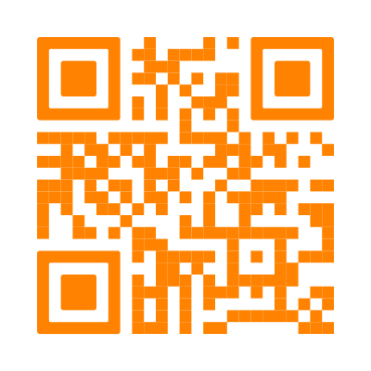
Counselor
Luncheons
Sept. 5 | Nashville
Mere Bulles
Sept. 24 | Chattanooga
The Public House
Oct. 1 | Memphis
The Capital Grille
Oct. 1 | Tri-Cities
Gourmet & Company
Oct. 2 | Memphis
The Capital Grille
To register and for more information, visit govols.utk.edu/portal/
counselorluncheon.

Slide 23
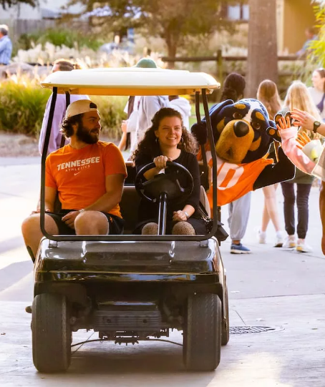
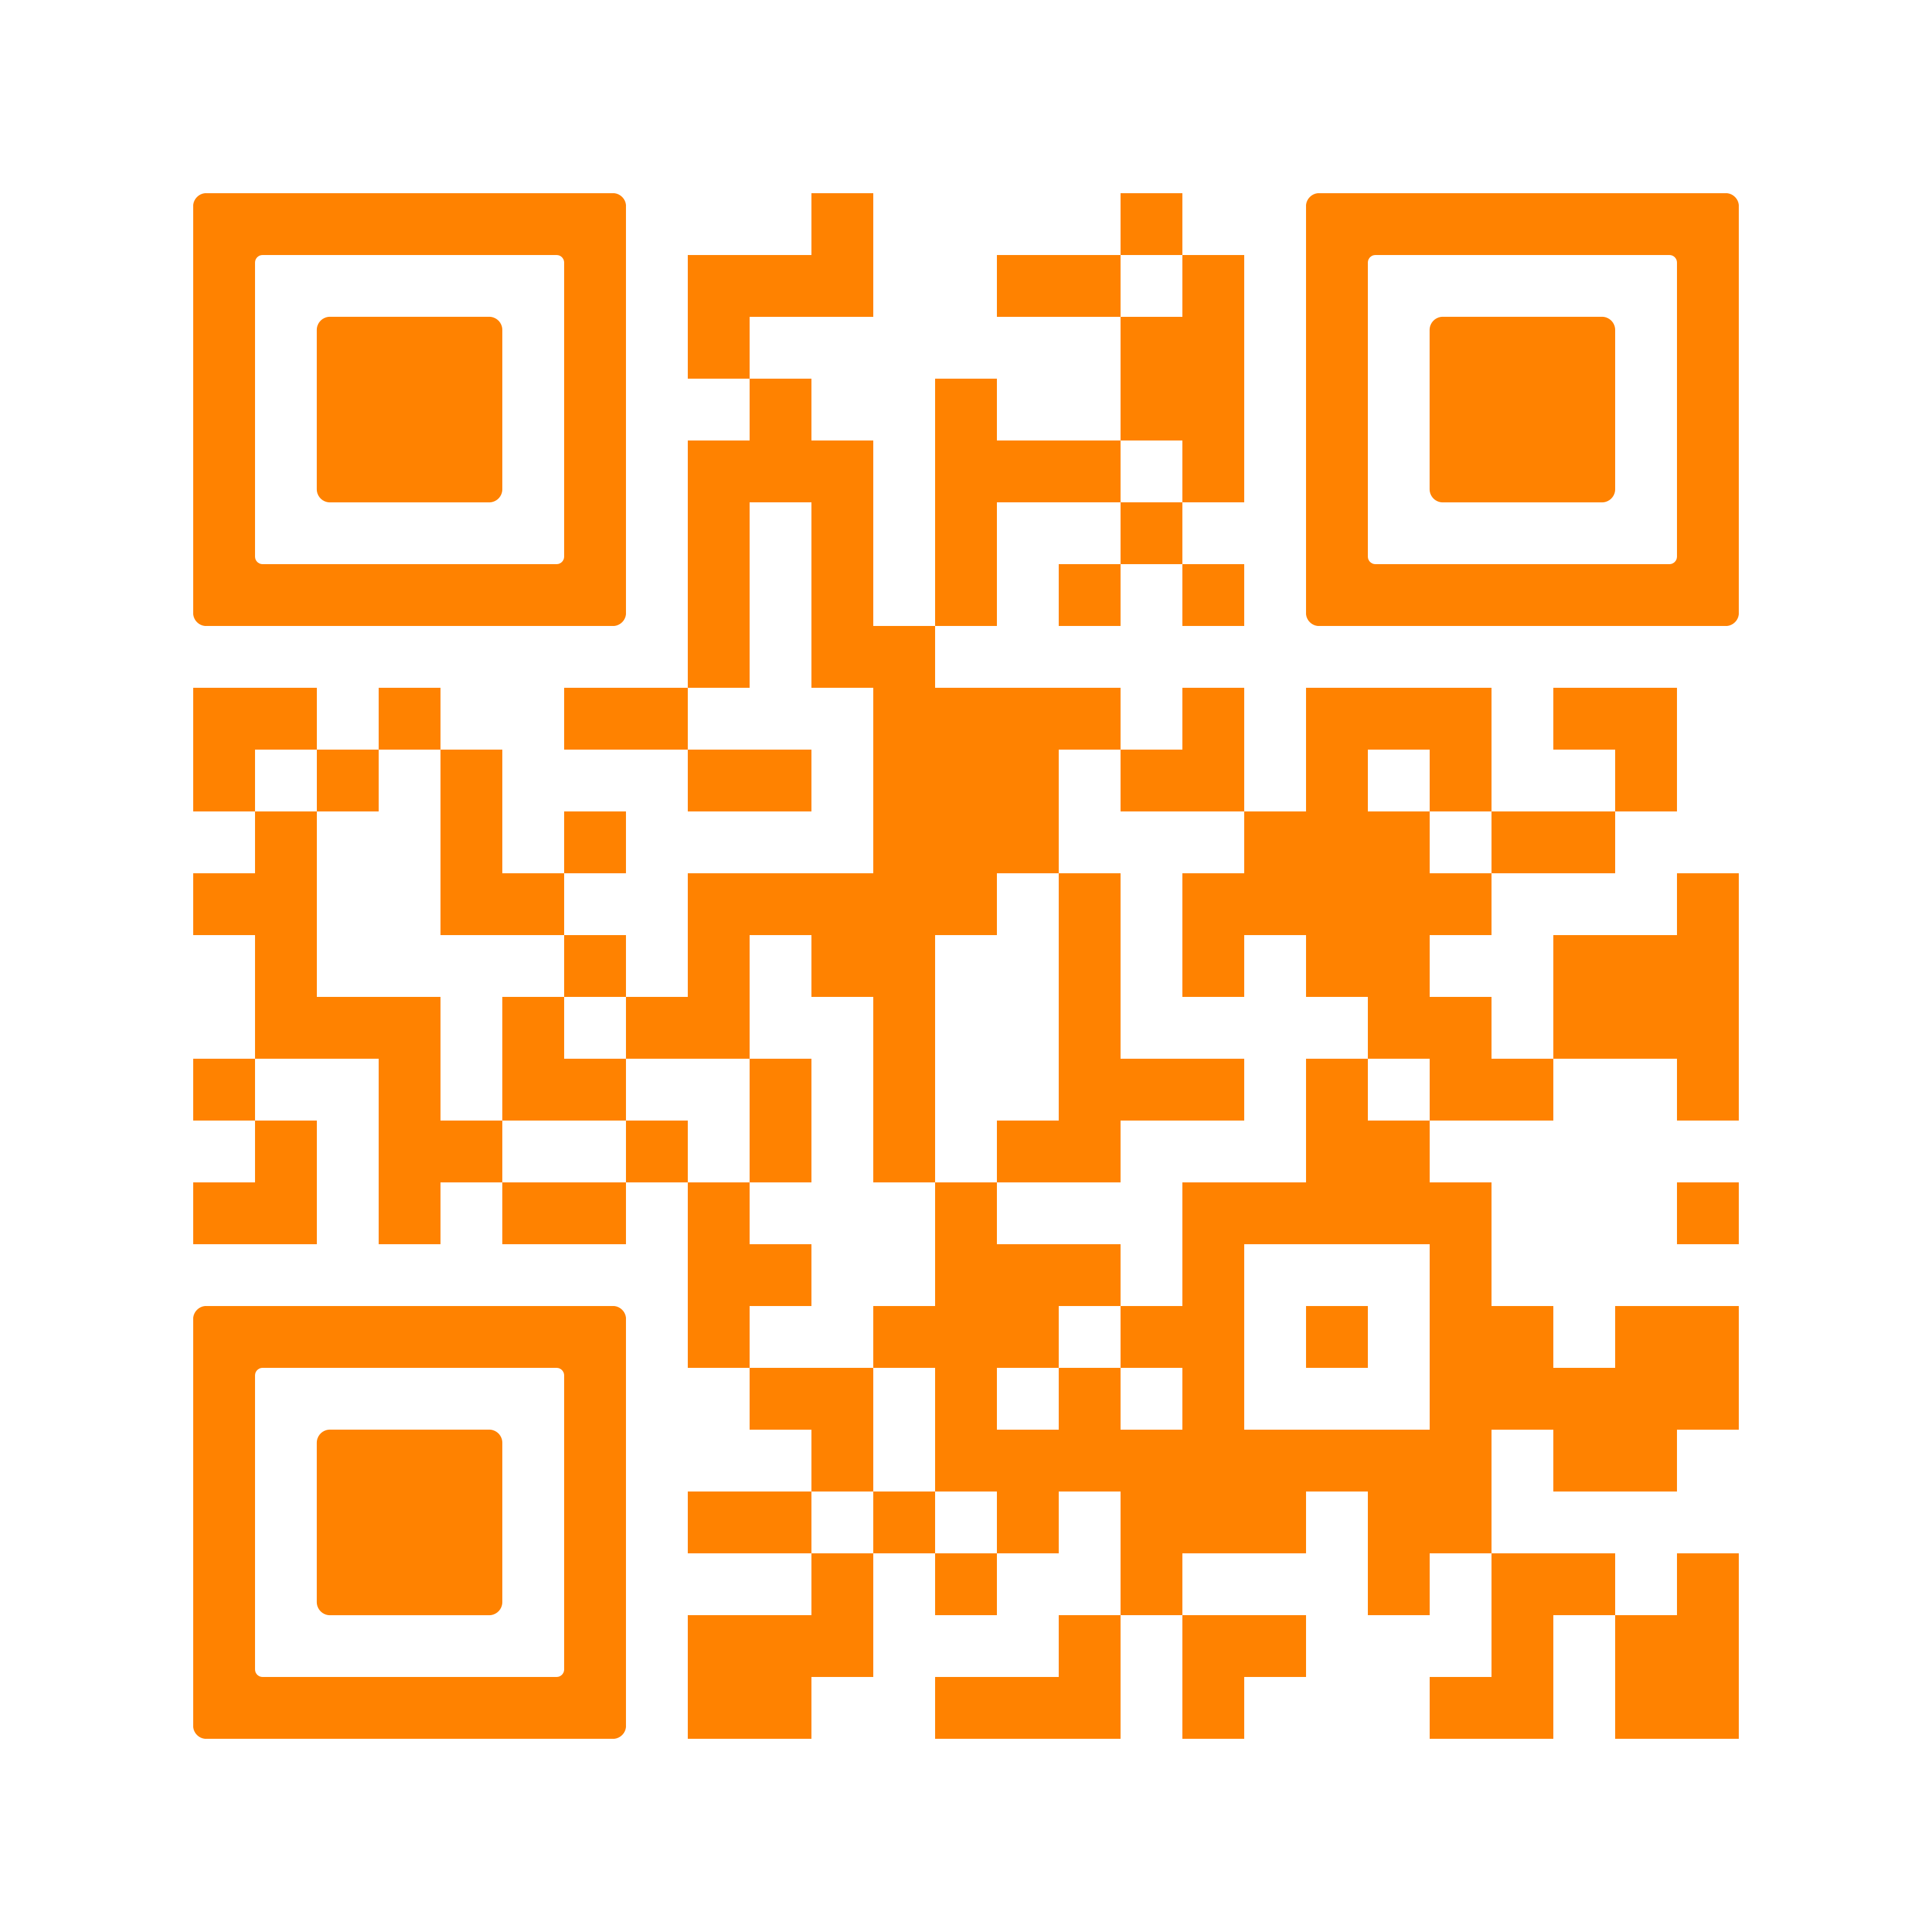
FALL CAMPUS EVENTS
September 14
Rocky Top Tailgate
September 20-21
Come See Tennessee
October 26
Big Orange Preview
EVENTS
INFORMATION
admissions.utk.edu/
tours-and-events

Slide 24



QUESTIONS

Slide 25



18:1
STUDENT TO
FACULTY RATIO
94%
of first-year students receive
FINANCIAL AID & SCHOLARSHIPS
90%
of graduates report
THEY'RE EMPLOYED OR IN GRADUATE SCHOOL within six months of graduation
30,000+
360+
UNDERGRADUATE
STUDENTS
UNDERGRADUATE PROGRAMS OF STUDY

