Slide 1

The University of Tennessee Southern
Counselor Breakfast Tour 2024

Slide 2
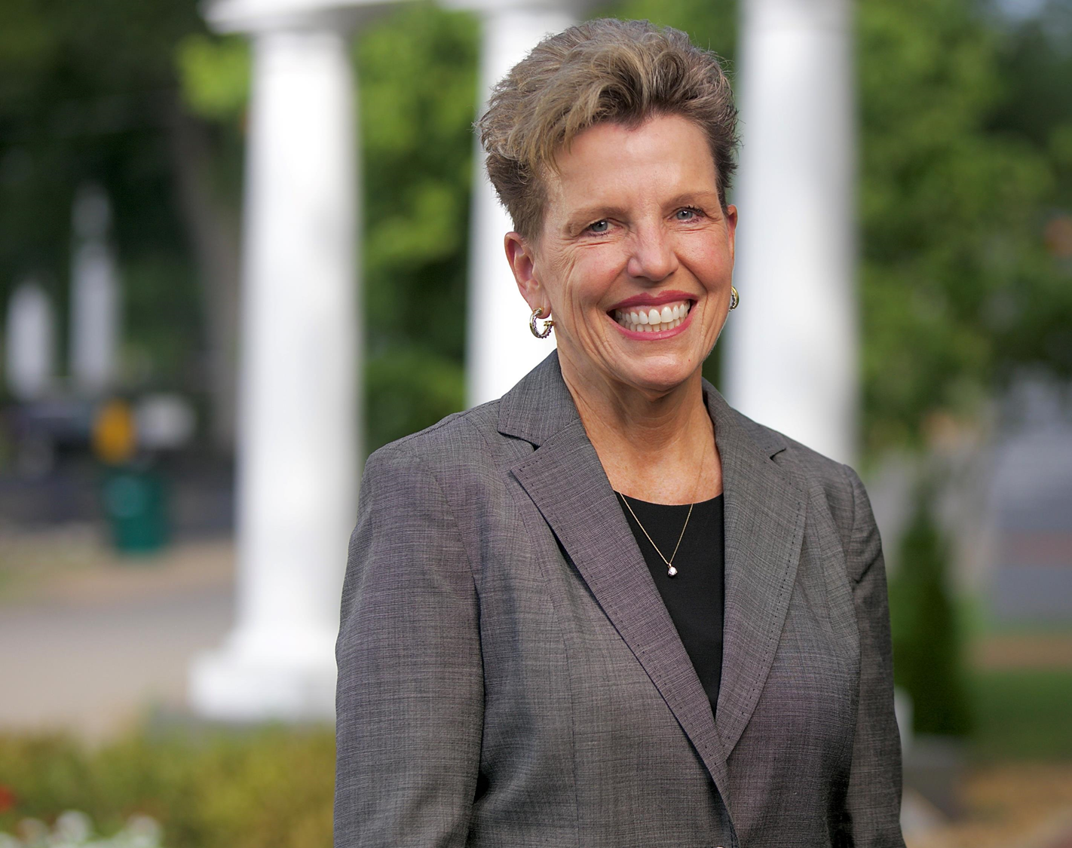
Dr. Linda Martin
Chancellor
UT COUNSELOR BREAKFAST 2024

Slide 3
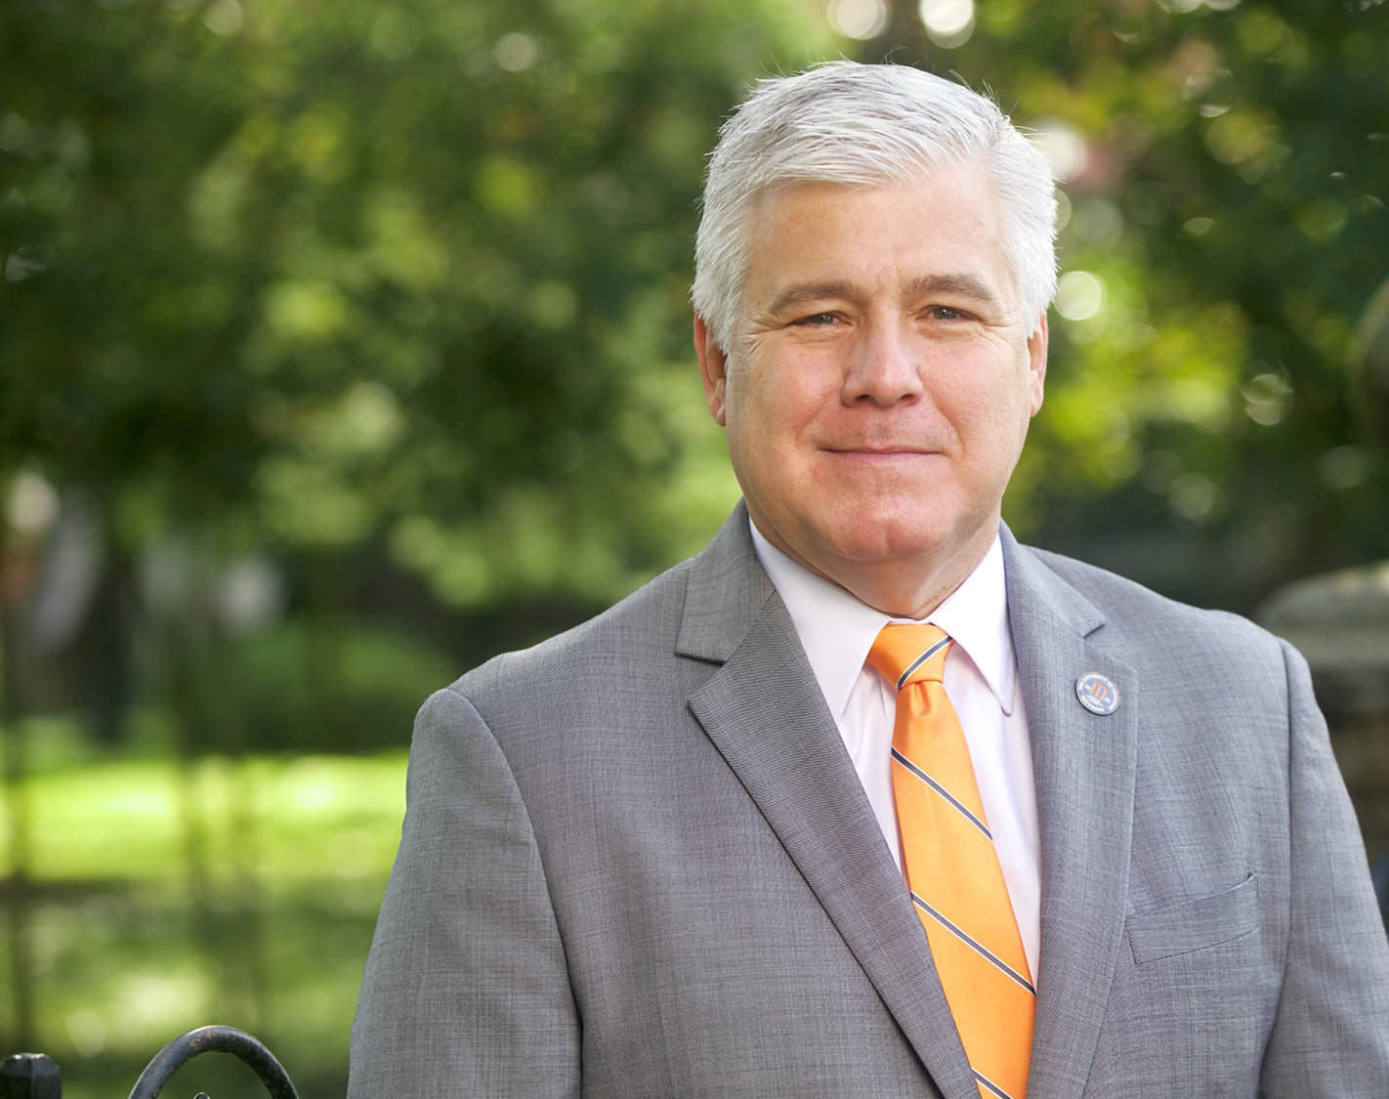
Dr. Brent Wren
Vice Chancellor of Enrollment & Student Affairs
  bwren1@utsouthern.edu
  256-658-2195
UT COUNSELOR BREAKFAST 2024

Slide 4
Admissions Team
Skylaur Poarch – International Admissions Counselor, First-Time Freshman (Last Name G-N); Graduate Admissions Counselor, and Dual Enrollment Advisor
Dakota Ortega – Transfer/Readmit Admissions Counselor, First-Time Freshman (Last Name O-Z)
Taylor McNairy – First-Time Freshman (Last Name A-F)
Robin Hood – Application Coordinator
UT COUNSELOR BREAKFAST 2024

Slide 5
Campus Highlights
Power of UT brand in a small school environment
Enthusiasm and excitement, but controlled growth
Significant health, safety, and facility upgrades
Crafting the Southern Experience
New Academic Programs
UT COUNSELOR BREAKFAST 2024

Slide 6
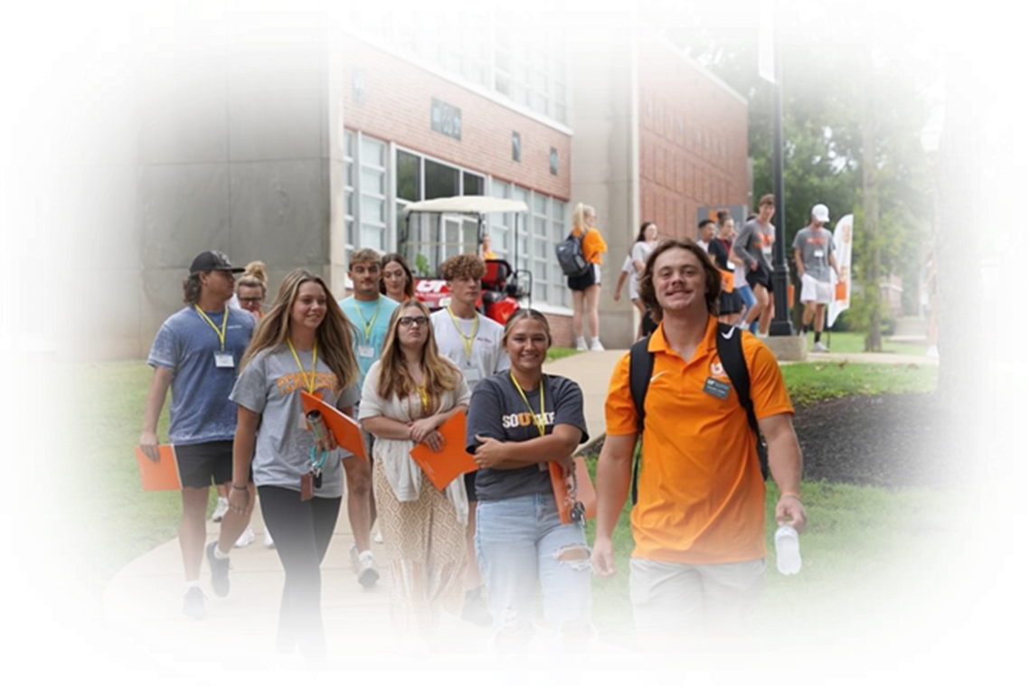
Enrollment
20% Growth since
becoming UT Southern
  978 Fall 2023
  1050 Fall 2024
  1200 Fall 2025
  2500 Fall 2030
115% Growth in Transfers
100% Growth in Out-of-State
Expanding Dual Enrollment
IMAGE
UT COUNSELOR BREAKFAST 2024

Slide 7
Dual Enrollment
Step 1:
Speak with interested students and gauge their interest about the program.
Step 2:
Help them complete the dual enrollment application at apply.utsouthern.edu
Step 3:
Ensure that all high school transcripts, any ACT/SAT scores are submitted to UT Southern. (A minimum 3.0 GPA is required)
Step 4:
Complete the dual enrollment grant application online at tn.gov/collegepays
UT COUNSELOR BREAKFAST 2024

Slide 8

Academics
Top Majors:
  Nursing
  Business
  Education
  Behavioral Sciences
  Criminal Justice
A student-teacher ratio of 13:1
100% free tutoring for ALL classes
154 years educating in Tennessee
IMAGE
UT COUNSELOR BREAKFAST 2024

Slide 9
38+ degree programs
General Education
Johnston School of Business
Grissom School of Education
Martin School of Arts & Humanities
Mathematics & Science
Travis School of Nursing & Health Sciences
Social Sciences
Undecided
Accounting, Management, Management Information Systems, Sport Management
Dramatic Arts, English, Interdisciplinary Studies, Religion and Philosophy
Biology, Chemistry, Computer Information Systems, Cybersecurity, Mathematics
BSN Nursing, Public Health Education
Behavioral Sciences, Criminal Justice, History, Homeland Security
Elementary Education, Human Performance and Physical Education, Special Education, Secondary Education
UT COUNSELOR BREAKFAST 2024

Slide 10
New Programs
Licensure for Special Education
Public Health Education
Cyber Security
Computer Information Systems
Human Performance and Coaching
Ag Science/Business/Leadership
GYO/Job Embedded Teacher Licensure
UT COUNSELOR BREAKFAST 2024

Slide 11
UT Southern Application
Apply at utsouthern.edu
Send transcripts and ALL test scores to admissions@utsouthern.edu
Receive your admissions decision within 48 hours
UT COUNSELOR BREAKFAST 2024

Slide 12
Admissions Standards
17+ ACT & 3.0 GPA on a 4.0 scale
18+ ACT & 2.0 GPA on a 4.0 scale
Additionally, the University of Tennessee Southern, guarantees first-year admission to all Tennessee high school students who meet both of the following eligibility criteria:
Achieve a 3.2+ cumulative GPA or finish in the top 10% of their high school’s graduating class; and have an ACT composite score of 23+ (or an equivalent SAT score).
UT COUNSELOR BREAKFAST 2024

Slide 13
Cost to Attend
2024-2025 Estimated Basic Charges
 | Commuter | Residential Double Dorm | Residential Single Dorm | Apartment
Tuition/Year Fees/Year | $9,640 $1,284 | $9,640 $1,284 | $9,640 $1,284 | $9,640 $1,284
Room/Year Meals/Year | N/A N/A | $3,800 $4,500 | $5,500 $4,500 | $7,000 $4,500
Room & Board Total |  | $8,300 | $10,000 | $11,500
Grand Total | $10,924 | $19,224 | $20,924 | $22,424
UT COUNSELOR BREAKFAST 2024

Slide 14
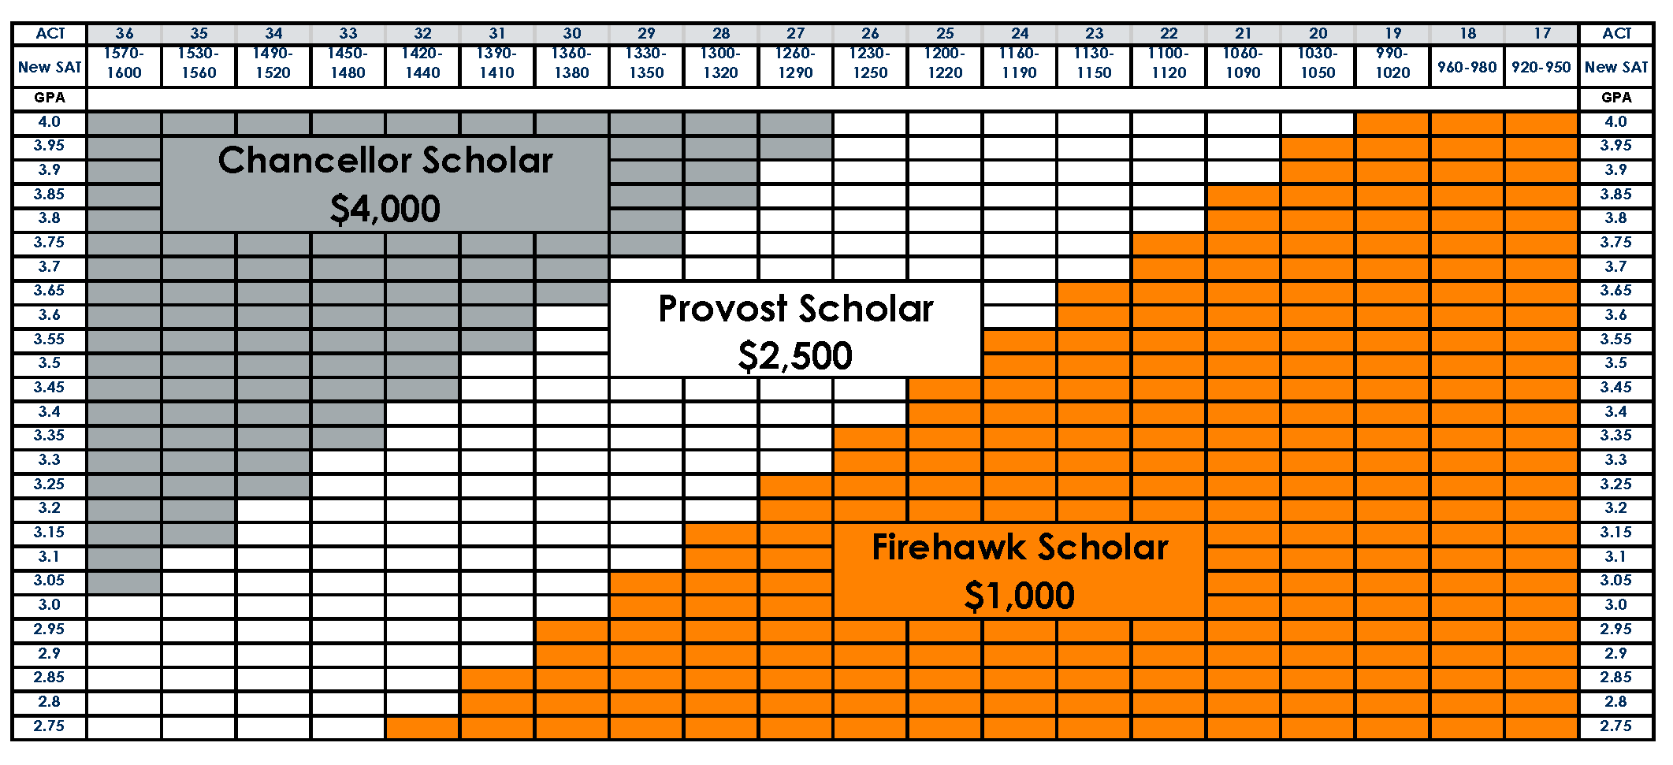
Financial Aid
UT Promise
TN Hope
Merit Based
Foundation
/Competitive
Athletics
UT COUNSELOR BREAKFAST 2024

Slide 15
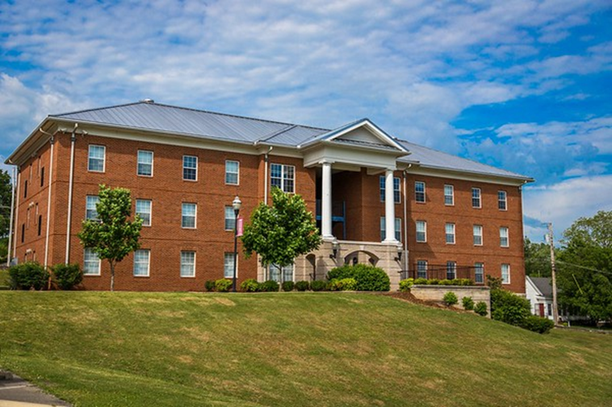
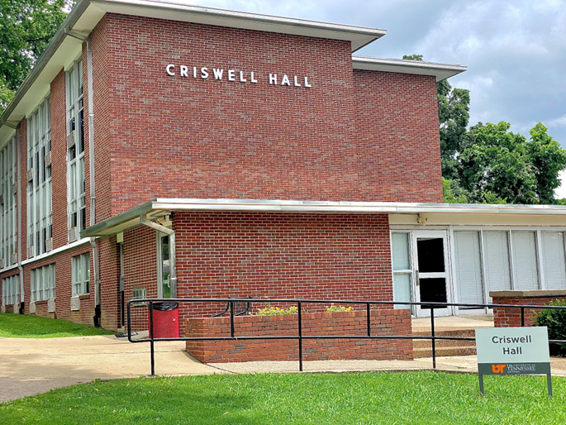
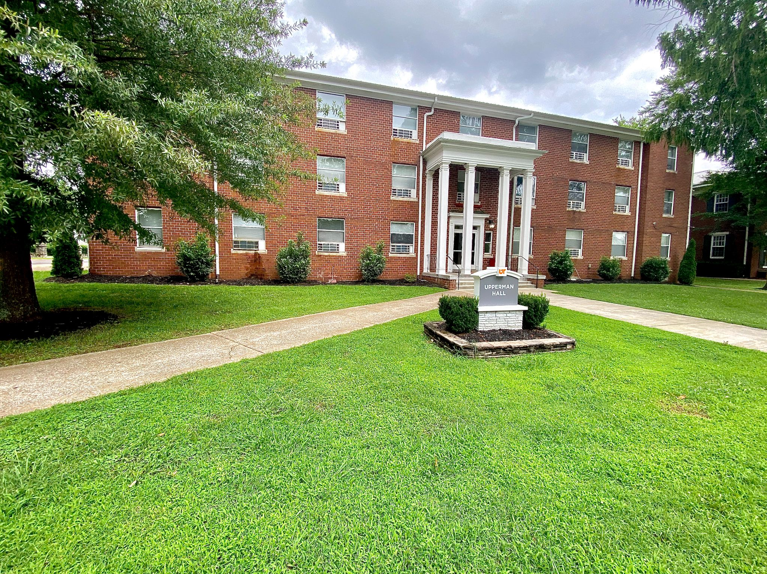
Housing Options
Student Apartments
Suite style, four bedrooms, two full baths, laundry room with free laundry, kitchen, living space
Criswell Hall (Females)
Community style, lounge, free laundry, kitchen, furniture included
Upperman Hall (Co-Ed)
Community style, lounge, free laundry, kitchen, furniture included
UT COUNSELOR BREAKFAST 2024

Slide 16
UT Southern Housing Upgrades
UT COUNSELOR BREAKFAST 2024

Slide 17
UT Southern Housing Upgrades
UT COUNSELOR BREAKFAST 2024

Slide 18
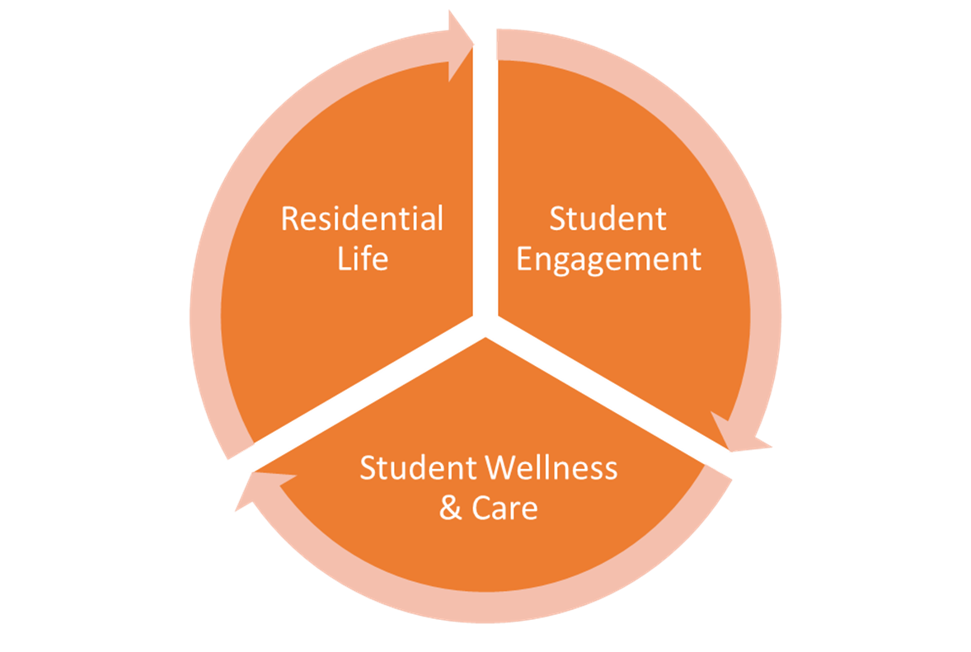
Student Life
Students living on campus have higher success rates
Safe, clean, affordable
Community programming
Ensures connections and helps students find their place
Student activities
Student organizations
Entertainment
Mental and Physical Health, CARE Team
UT COUNSELOR BREAKFAST 2024

Slide 19
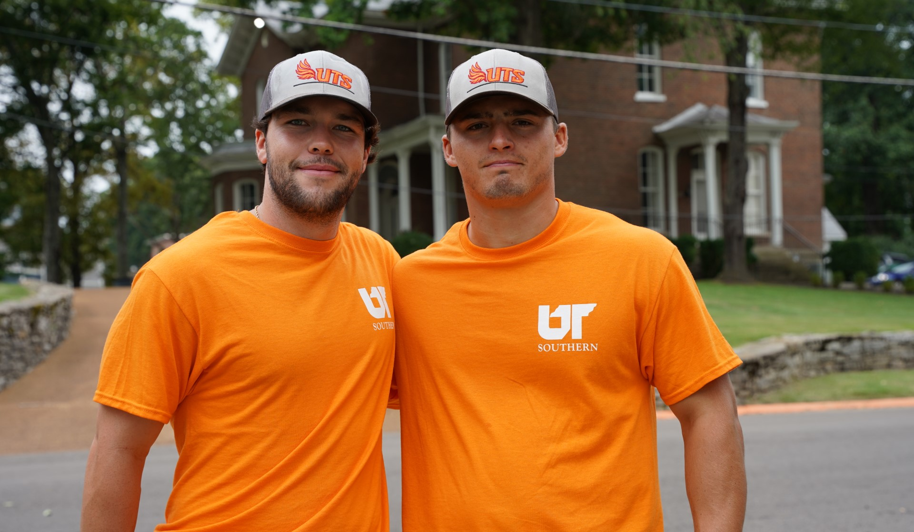
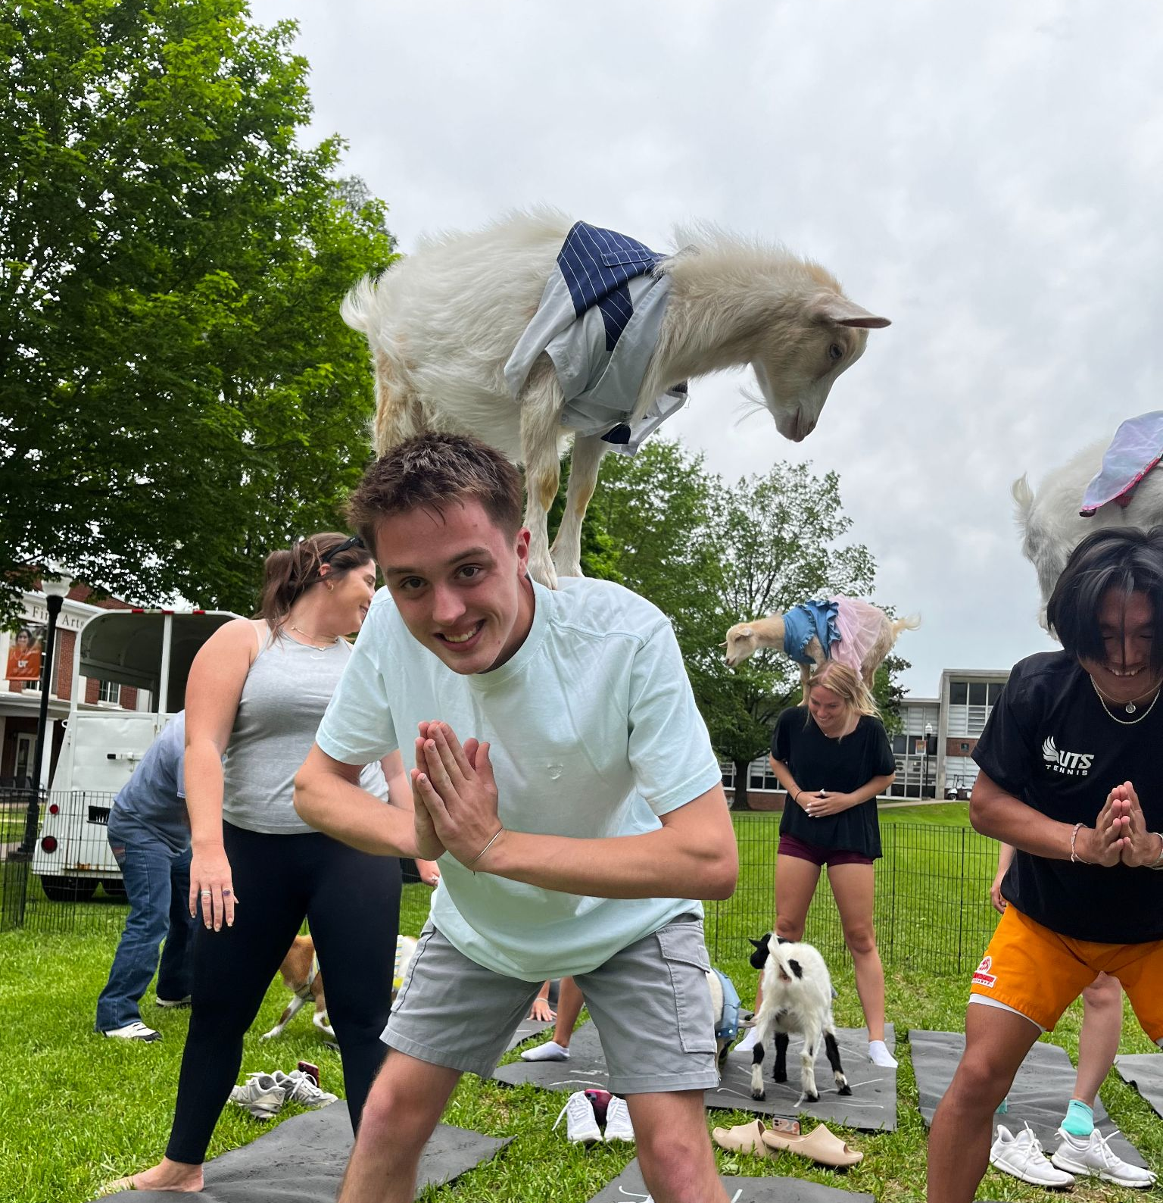
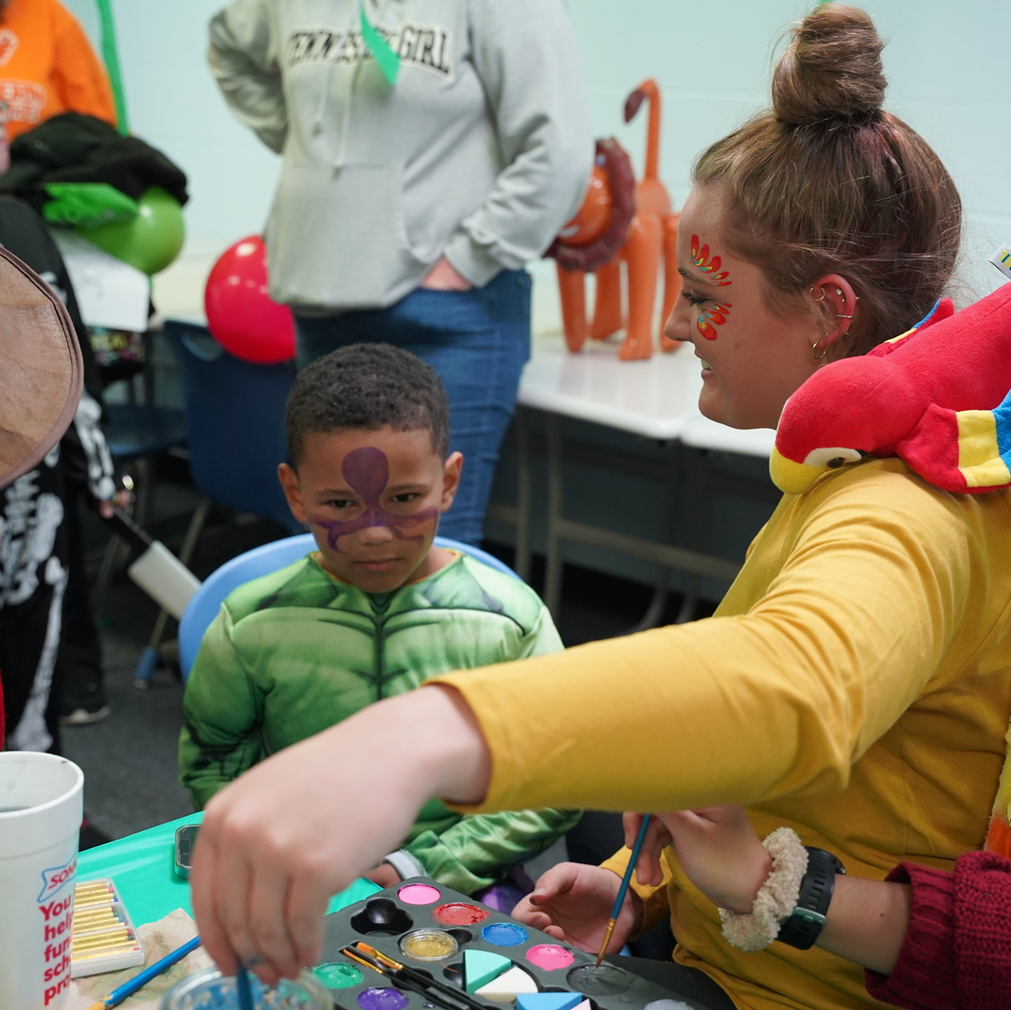
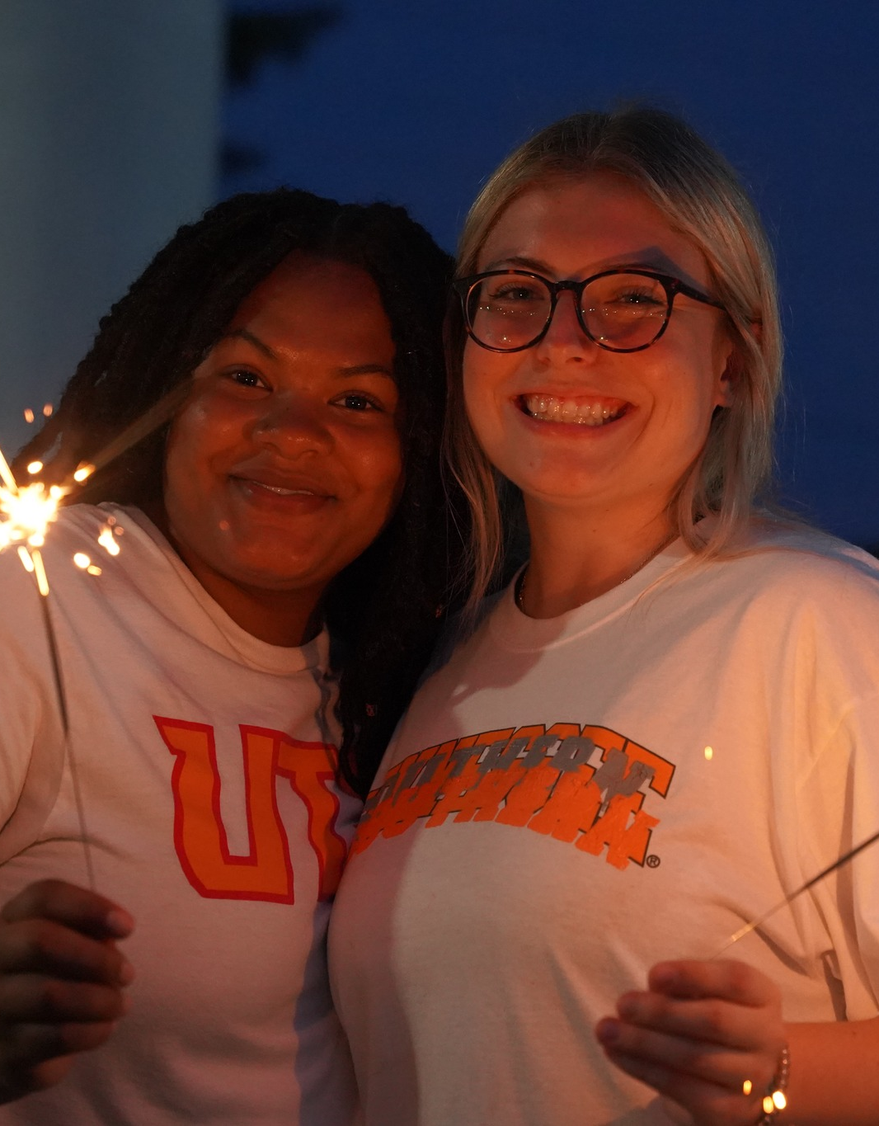
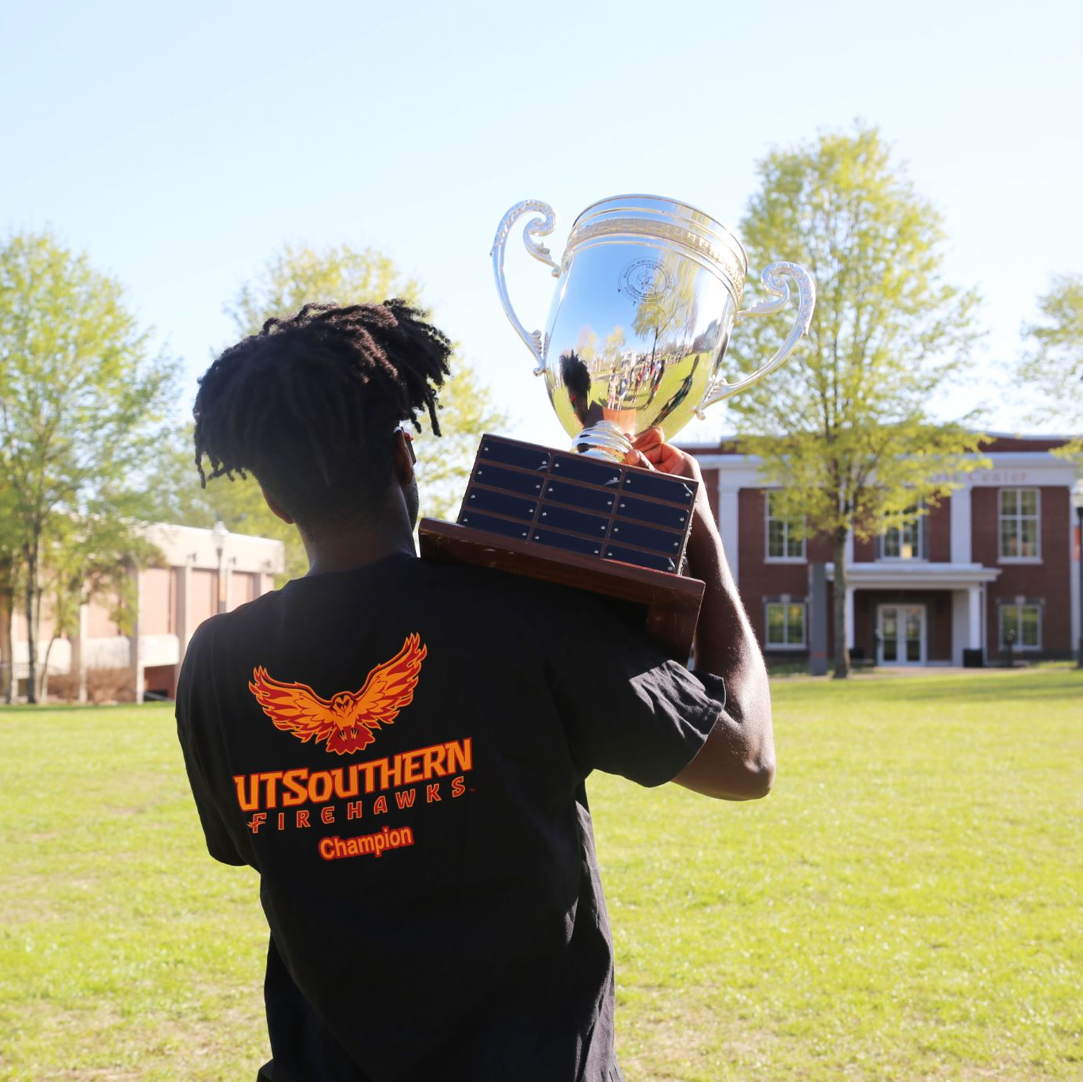
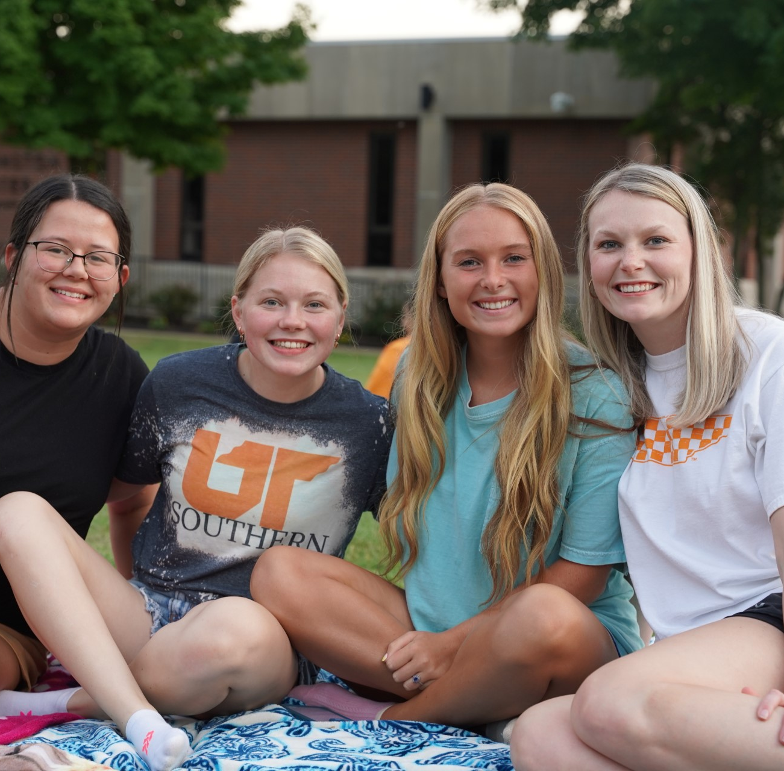


Slide 20

Athletics
UT Southern Athletics offers 19 Intercollegiate Sports
Women’s Sports: 9
Basketball
Cross Country
Golf
Soccer
Softball
Swimming
Tennis
Track & Field
Volleyball
7
Men’s Sports: 8
Baseball
Basketball
Cross Country
Golf
Soccer
Swimming
Tennis
Track & Field
Co-ed Sports: 2
Cheerleading
Clay Target
UT COUNSELOR BREAKFAST 2024

Slide 21
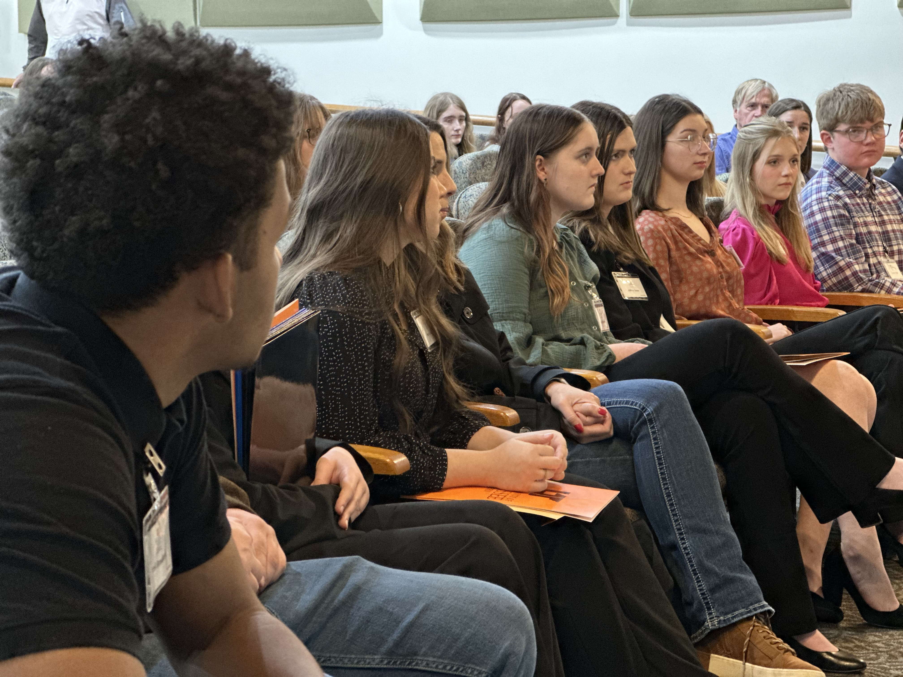
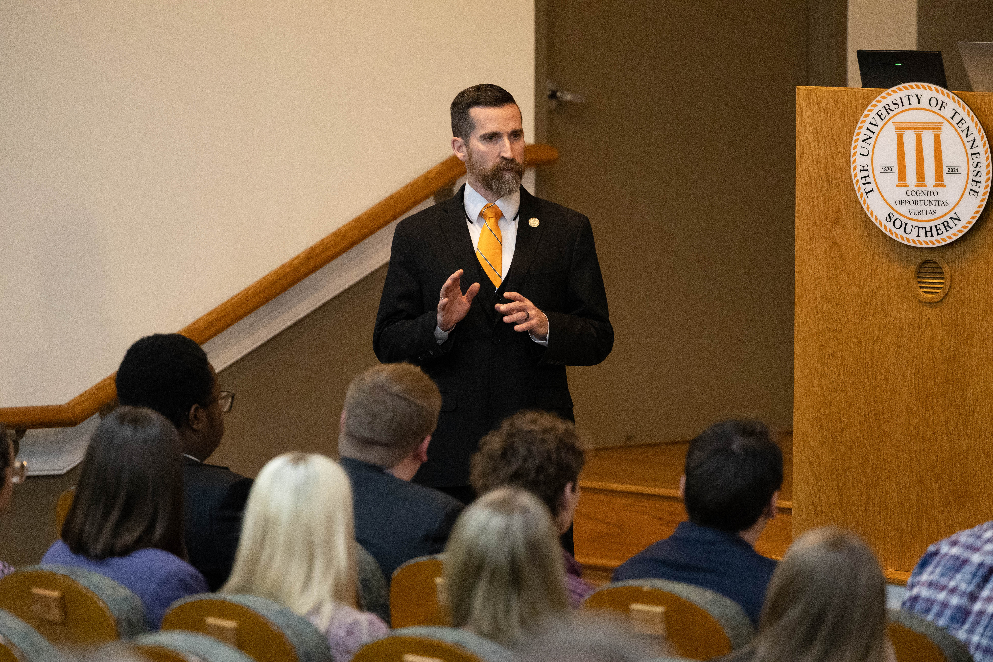
Visit UT Southern
We pride ourselves on having a personal education for students in our rural communities which leads us to have personalized tours and group visits.
Campus Visits:
Monday through Friday at various times.
Group Visits:
Email the admissions team to set this up at admissions@utsouthern.edu
Orientation/ Registration for Fall 2025 begins in April
UT COUNSELOR BREAKFAST 2024

Slide 22
Questions?
UT COUNSELOR BREAKFAST 2024

Slide 23
THANK
YOU!
UT COUNSELOR BREAKFAST 2024

Slide 24
HELPFUL TIPS
Please delete this slide after reading as it does not need to be included in your presentation. This template is to serve as a guide, you are welcome to use different lay outs for each slide that contribute to the success of your presentation.
Do not alter the gray box at the bottom of the slides or the UT Southern logo. All slides should include the footer with the gray box and logo. To replicate it, duplicate a slide that already contains the items.
Please fill in the bottom right presentation title for each slide.
Fonts used should be “Arial” or “Goudy Type.”
Please use the dark gray and orange used in this template.
As a reminder: Black is not in our color palette and should not be used in any UT Southern materials. Please substitute dark gray for any black you may want to use.
Anything with the UT Southern logo must adhere to brand guidelines. If you have any questions about what those are, please reach out to marketing@utsouthern.edu
PRESENTATION TITLE

