Slide 1

Learn more about
John Carroll, the work of City Leadership & the Grand Challenges they are addressing here.
FIND JOHN ON SOCIAL:
@JOHNCARROLL77

Slide 2


Slide 3
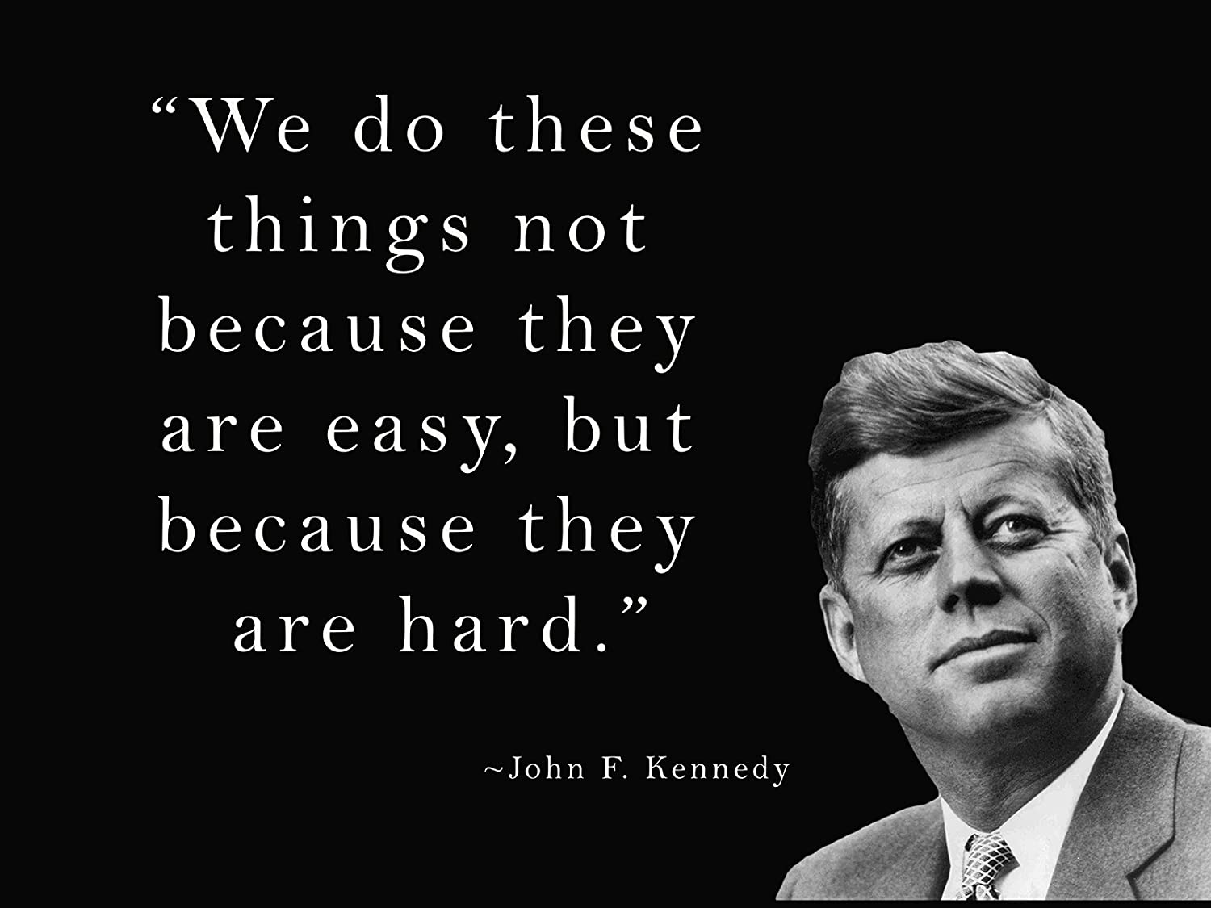

Slide 4



Slide 5


Slide 6


Slide 7


Slide 8
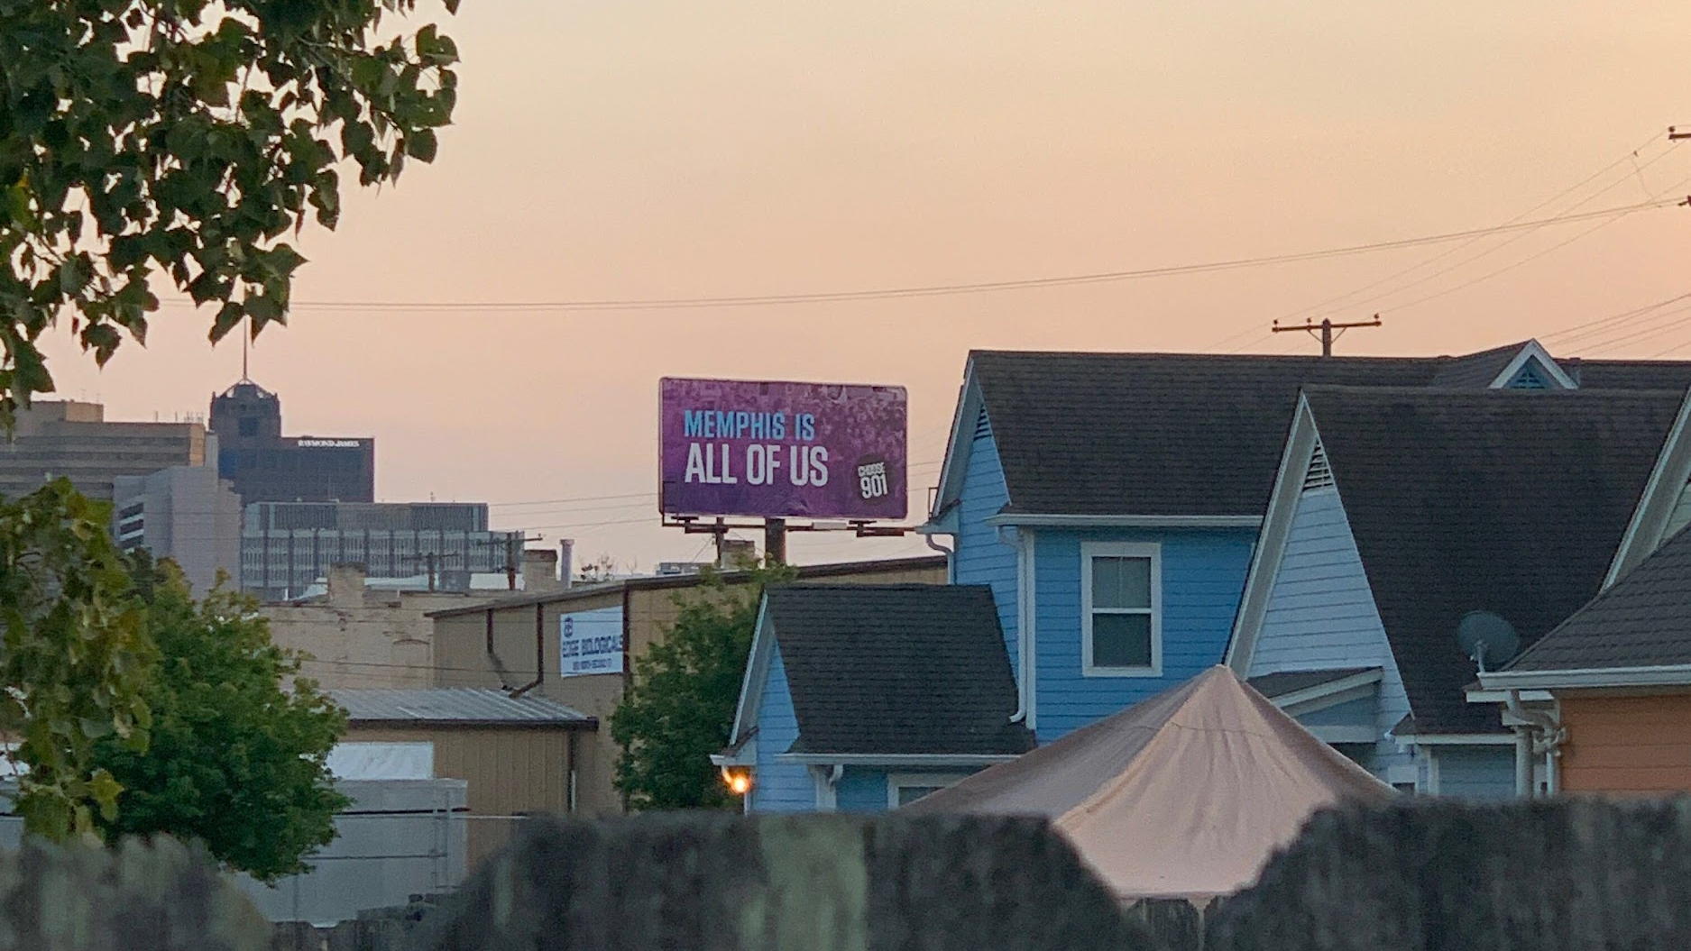

Slide 9



Slide 10


Slide 11


Slide 12


Slide 13



Slide 14


Slide 15
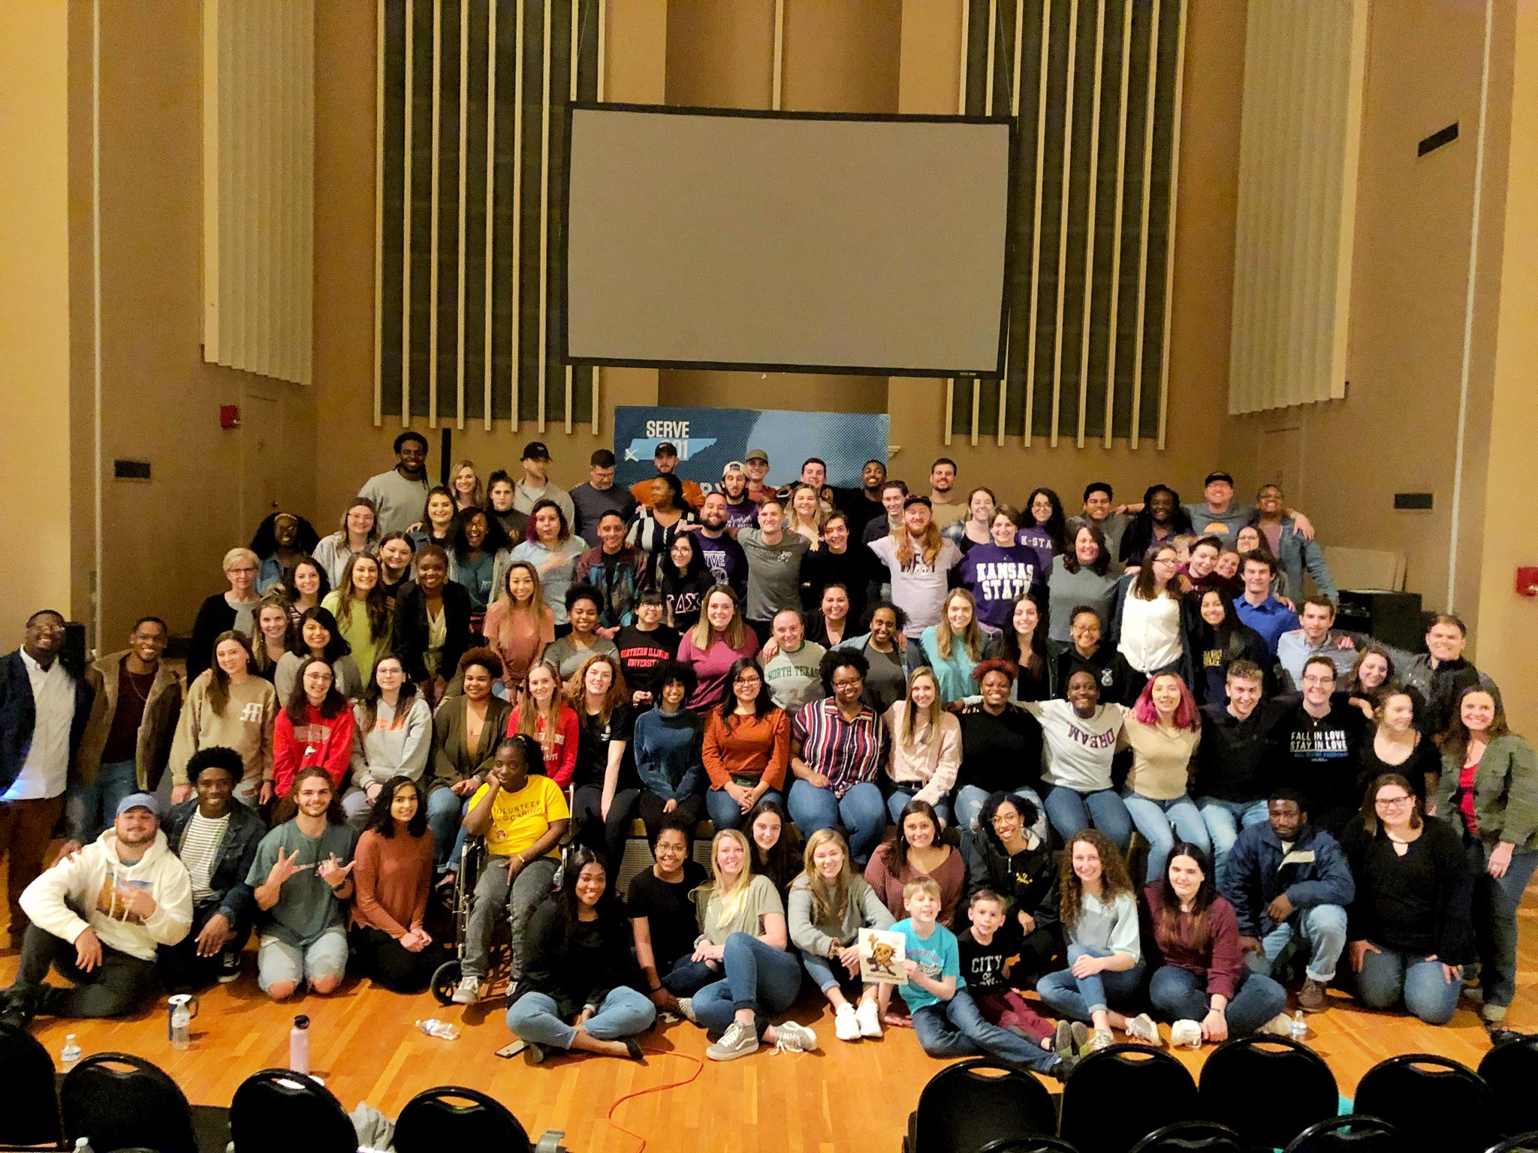

Slide 16


Slide 17


Slide 18


Slide 19


Slide 20


Slide 21


Slide 22


Slide 23


Slide 24


Slide 25





















Slide 26


Slide 27


Slide 28


Slide 29


Slide 30

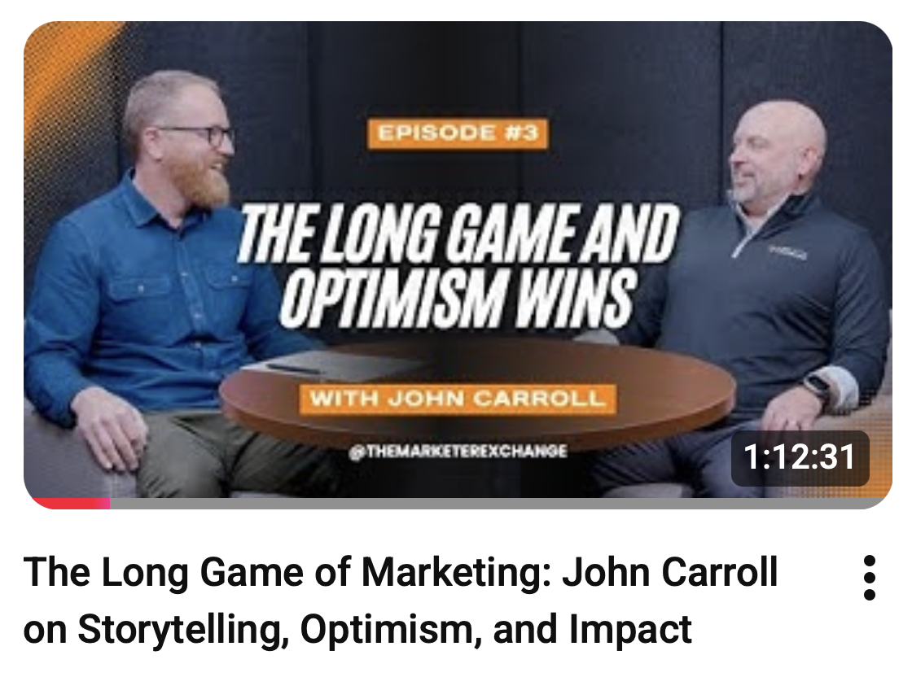

Slide 31
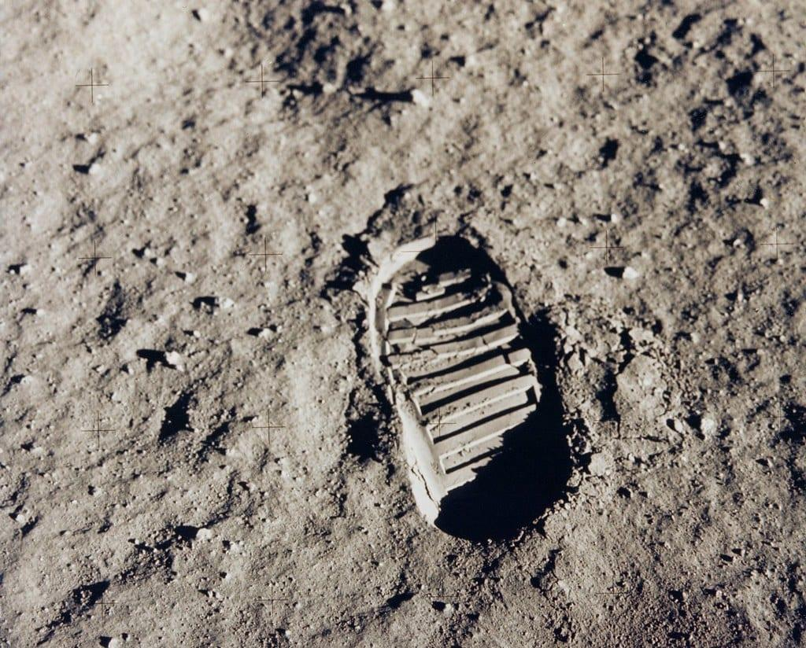

Slide 32


Slide 33


Slide 34


Slide 35
THE DECISION
CLEAR VISION
LEADERSHIP FUEL
SOLVING IS THE SOLUTION
OPTIMISM IS ESSENTIAL
COMMUNICATION IS KEY
THE PROCESS OF PERSEVERANCE
& COLLATERAL BENEFITS
★

Slide 36


Slide 37


Slide 38
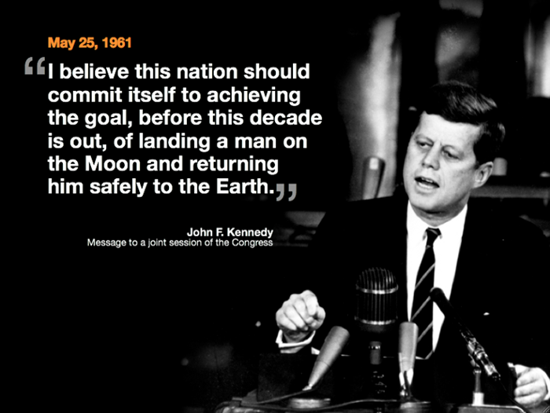

Slide 39
COLLATERAL
DAMAGES
BENEFITS
★

Slide 40
THE
COLLATERAL
DAMAGE
CAN’T BE YOU!
★

Slide 41
YOU DON’T GET BONUS POINTS FOR SELF-DESTRUCTION

Slide 42
YOU ARE A COLLATERAL
BENEFIT

Slide 43
THE PROCESS
OF
PERSEVERANCE
★

Slide 44
NASA NOT ONLY ENGINEERED ROCKETS, THEY ENGINEERED HUMAN SUSTAINABILITY

Slide 45
HUMANS BREAK UNDER SUSTAINED PRESSURE.

Slide 46
They built in:
sleep schedules
rotation shifts in Mission Control
checklists (reduce mental fatigue)
redundancy (no one person carries everything)
quarantine & decompression time after return
psychological support

Slide 47
★
COMMUNICATION
IS KEY

Slide 48
★
COMMUNICATION
IS KEY
TO OUR SAFETY

Slide 49
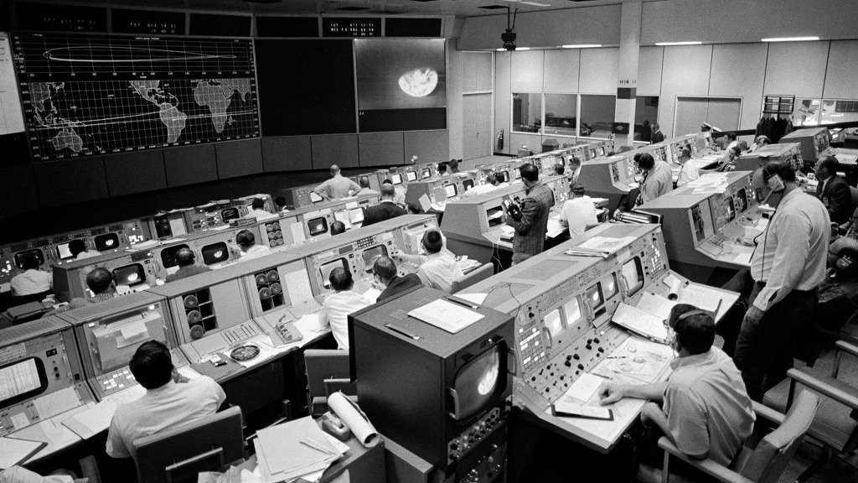

Slide 50
1202

Slide 51
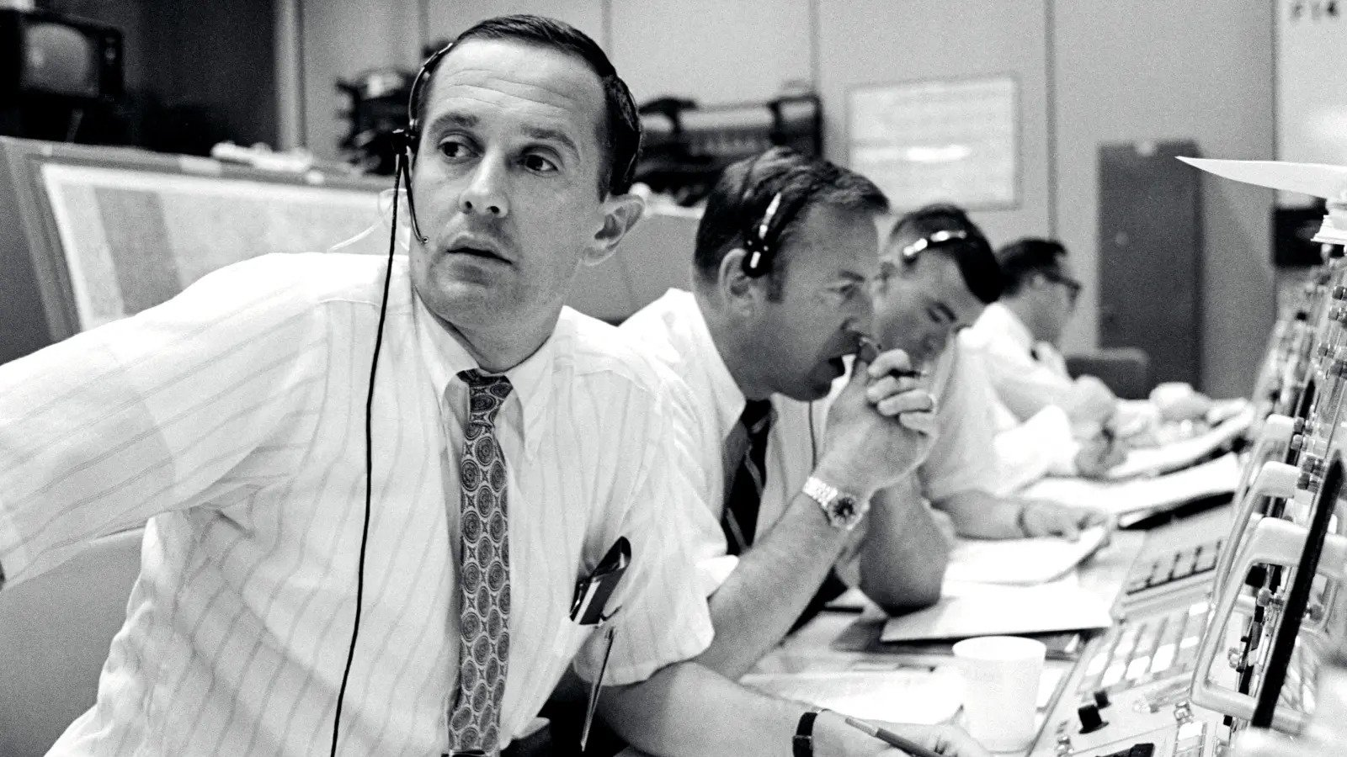

Slide 52
OPTIMISM
IS
ESSENTIAL
★

Slide 53
OPTIMISM REQUIRES ENERGY

Slide 54
Burnout looks like:
cynicism
irritability
isolation
short-term thinking

Slide 55
SELF-CARE ISN’T SELFISH,
IT IS STRATEGIC.

Slide 56
SOLVING
IS THE
SOLUTION
★

Slide 57
RETURNING SAFELY IS WHAT TOOK SO LONG

Slide 58
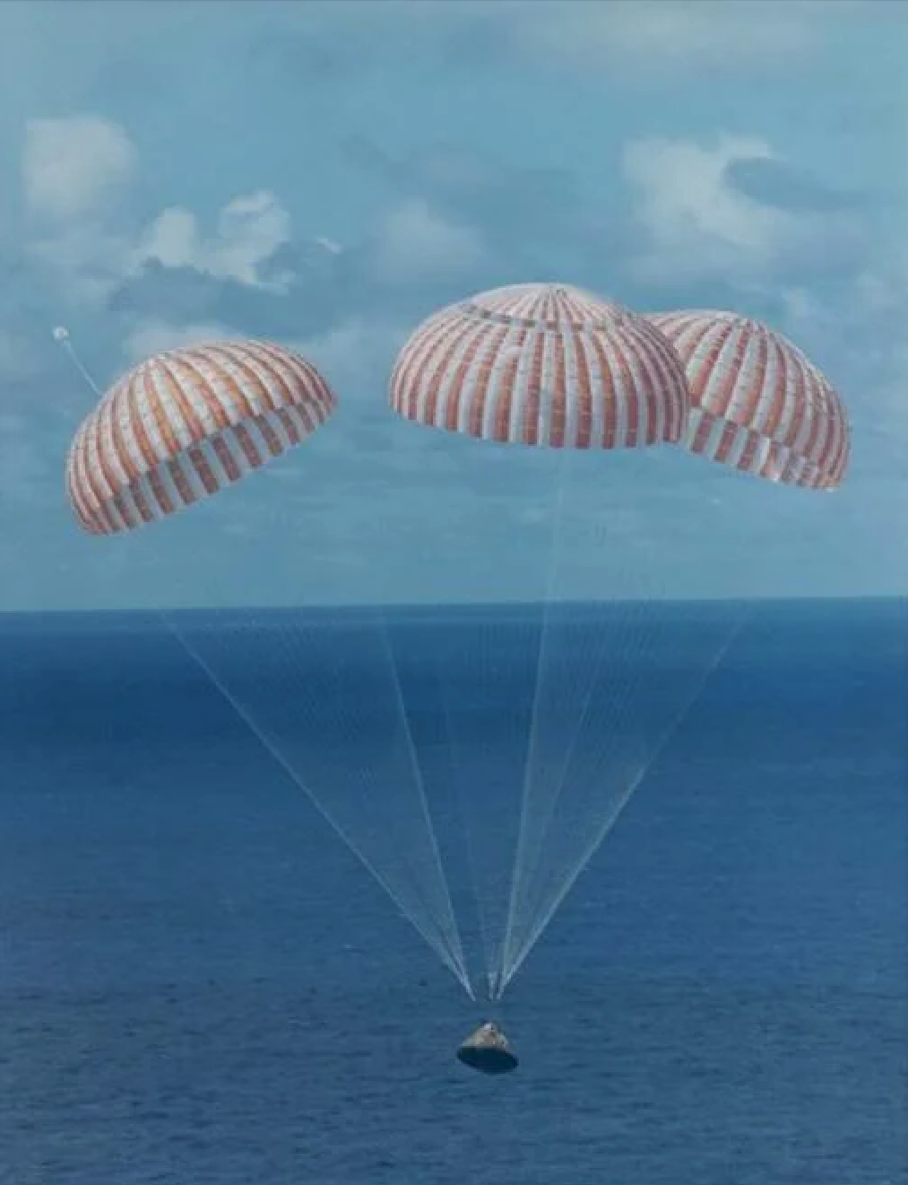

Slide 59
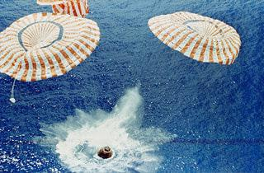

Slide 60
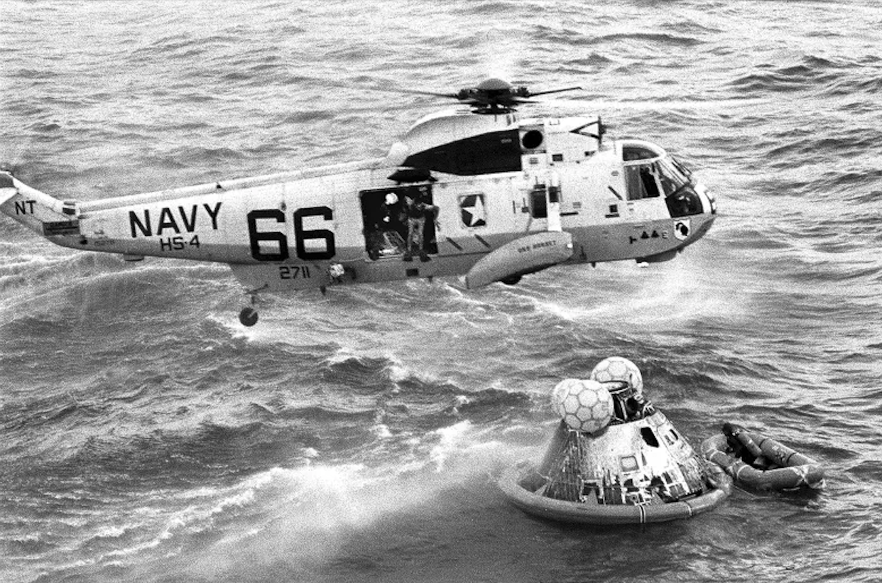

Slide 61
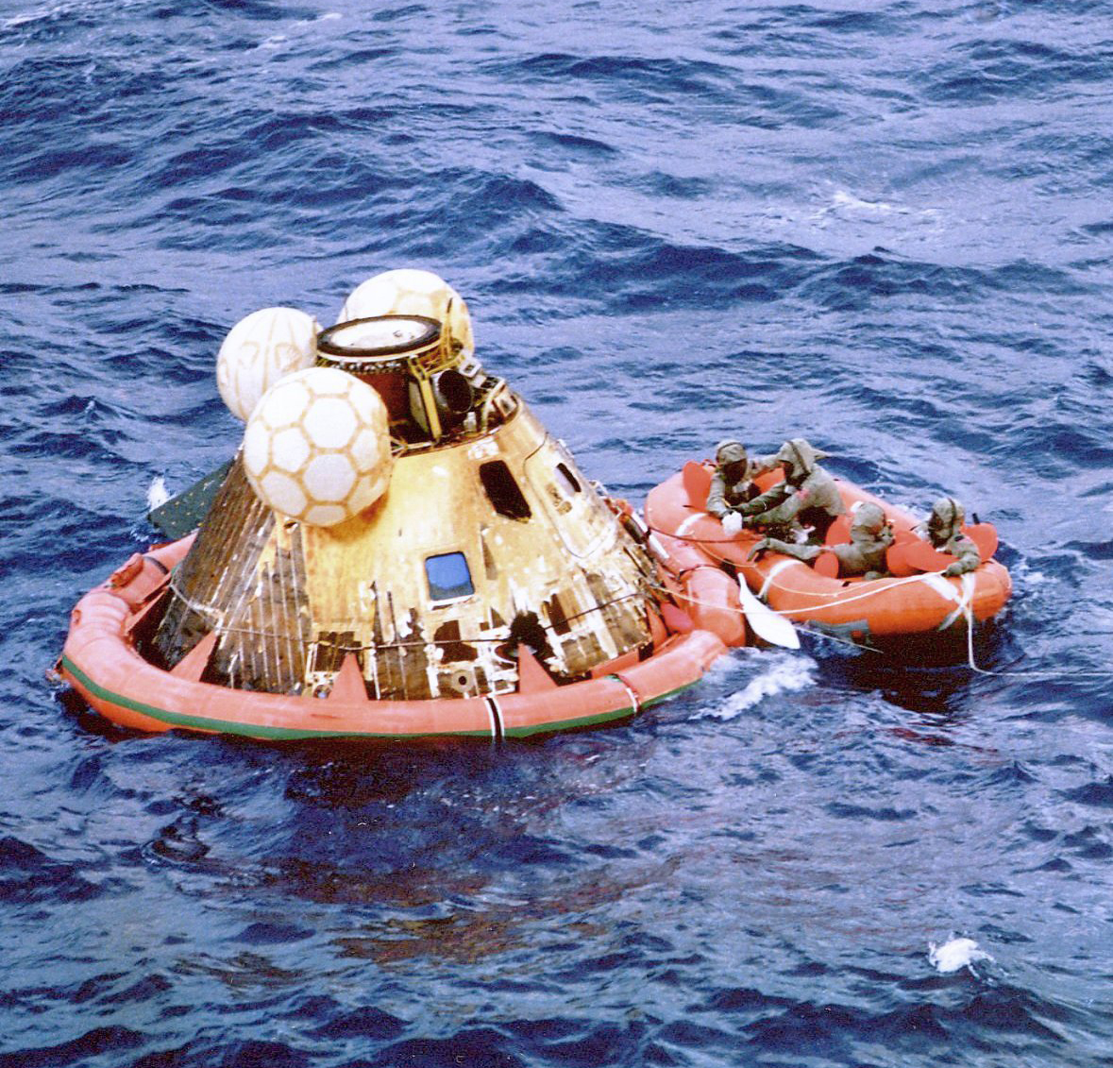

Slide 63
CHUCK LOWRY
Joined NASA in 1962
SIX Years of Testing
139 Drops
Designed Redundancy

Slide 64
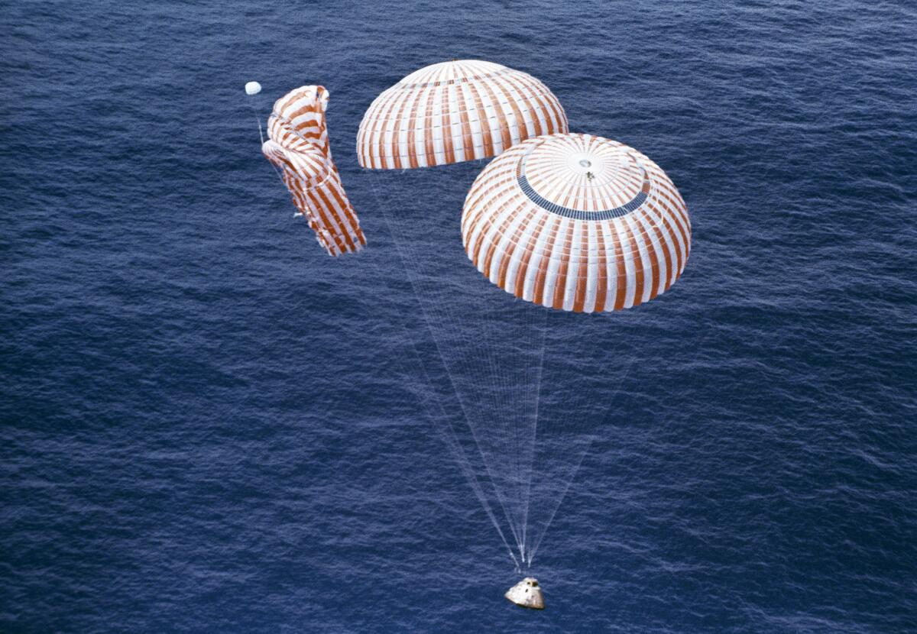

Slide 65
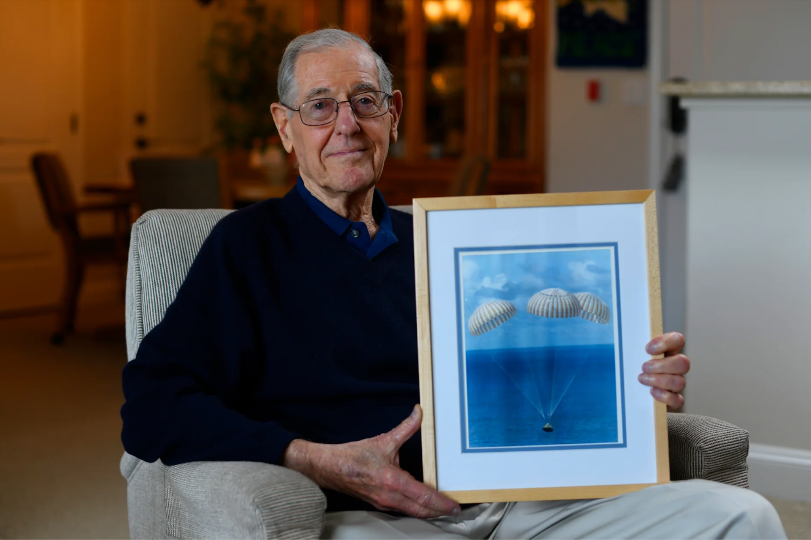

Slide 66
★
Fundamental Fuel:
LEADERSHIP

Slide 67
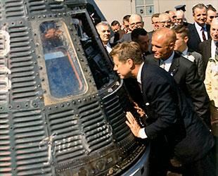

Slide 68
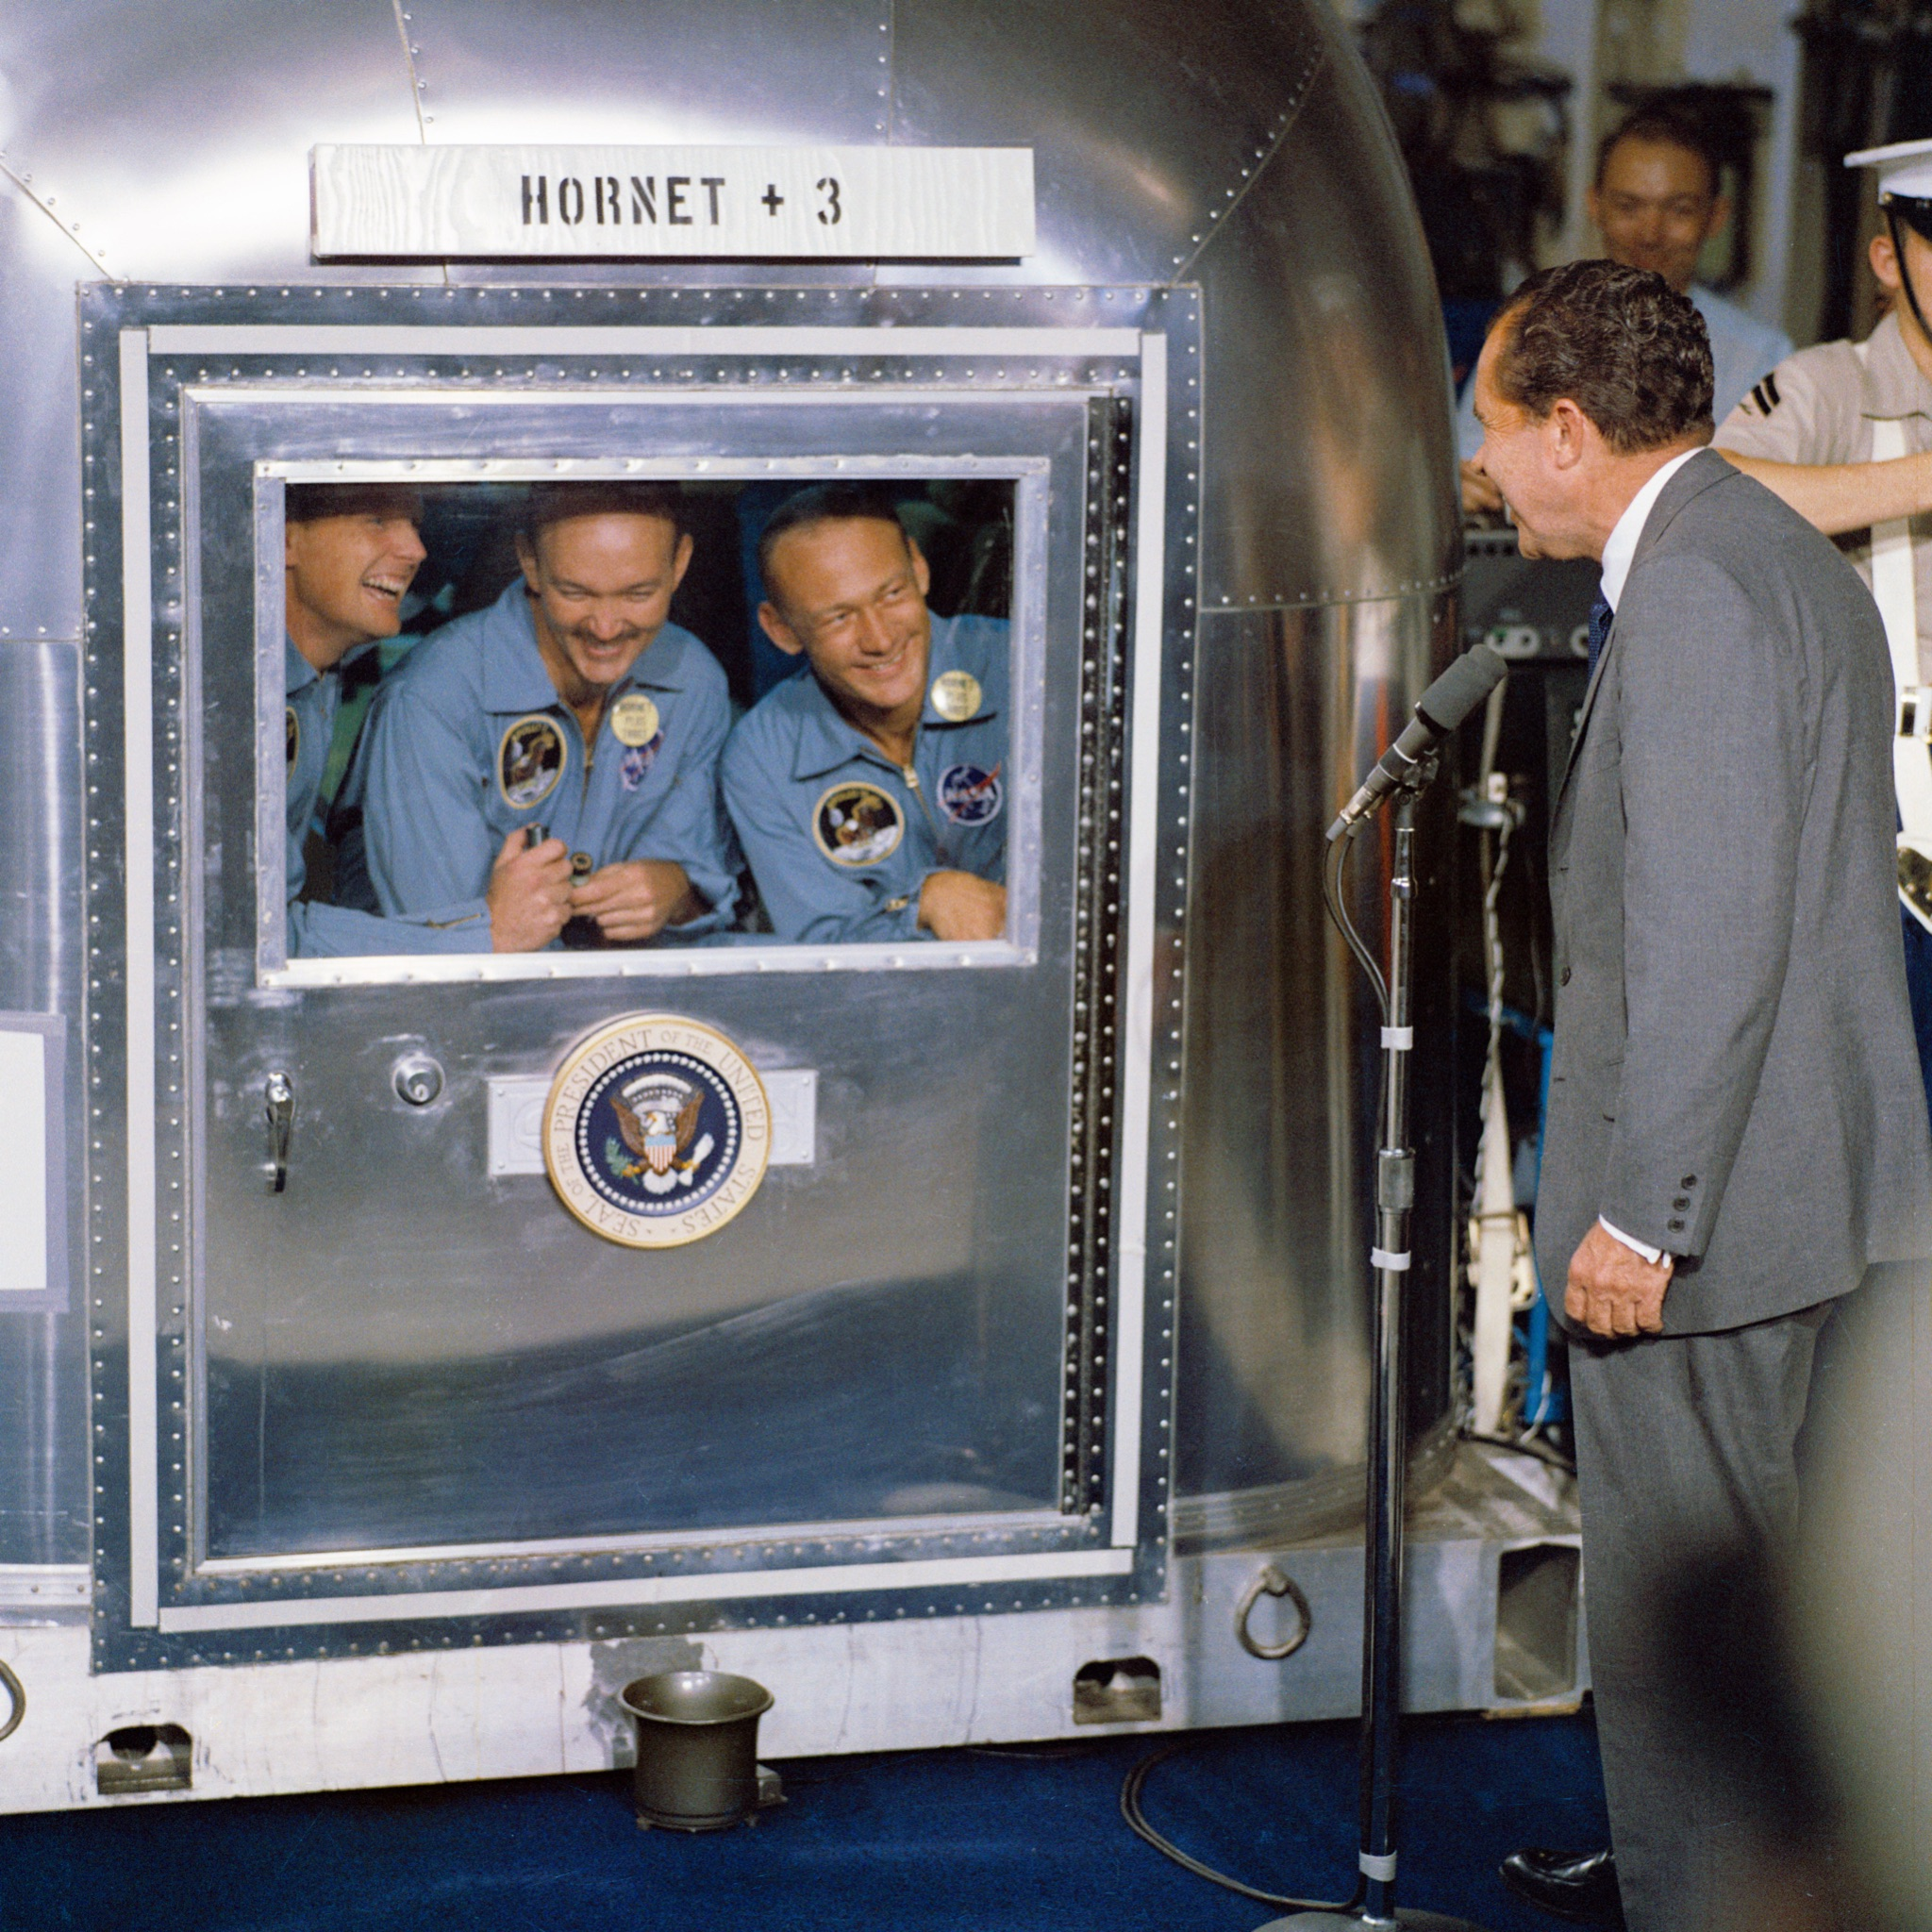

Slide 69
★
Core Ingredient:
VISION

Slide 71
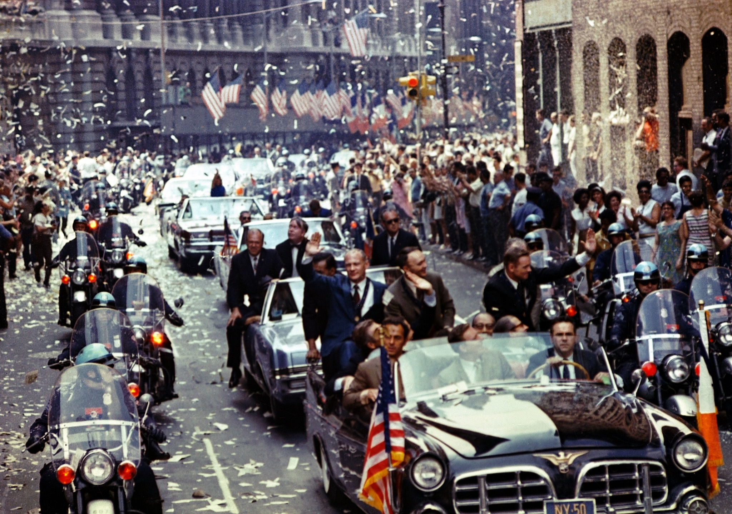

Slide 72
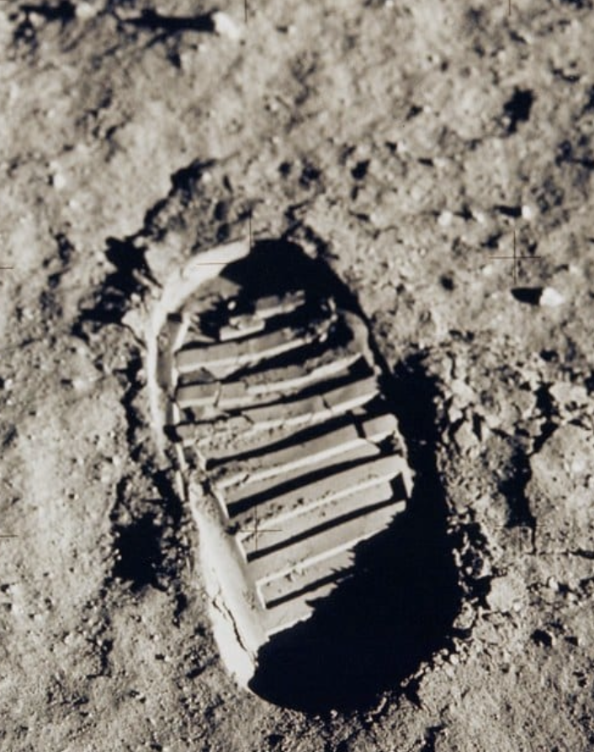

Slide 73
★
First Step:
DECIDING

Slide 74
First Step:
DECIDING

Slide 75
BELIEF FROM THE BEGINNING THAT YOU ALSO MATTER

Slide 76
THE DECISION
CLEAR VISION
LEADERSHIP FUEL
SOLVING IS THE SOLUTION
OPTIMISM IS ESSENTIAL
COMMUNICATION IS KEY
THE PROCESS OF PERSEVERANCE
& COLLATERAL BENEFITS
★

Slide 77
COLLATERAL BENEFITS
THE PROCESS OF PERSEVERANCE
COMMUNICATION IS KEY
OPTIMISM IS ESSENTIAL
SOLVING IS THE SOLUTION
LEADERSHIP FUEL
CLEAR VISION
& THE DECISION
★

Slide 80
Learn more about
John Carroll, the work of City Leadership & the Grand Challenges they are addressing here.
FIND JOHN ON SOCIAL:
@JOHNCARROLL77

Slide 81
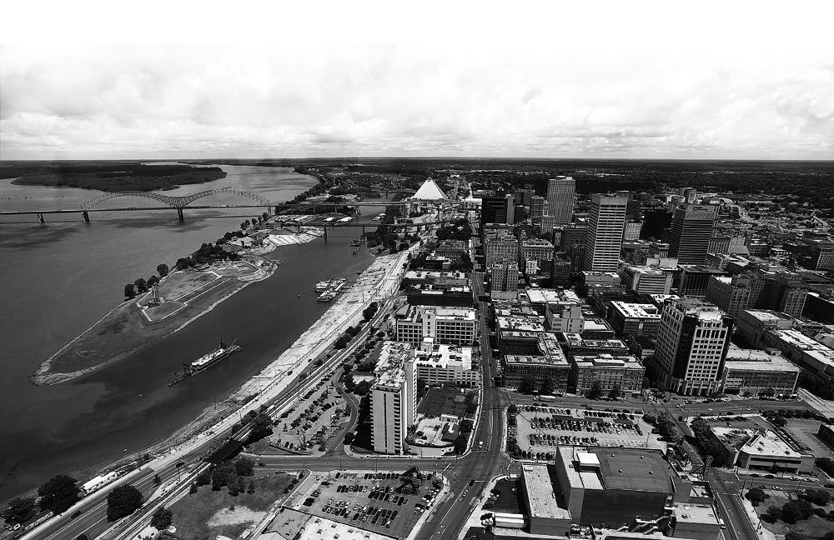
FOLLOW JOHN ON SOCIAL:
@JOHNCARROLL77

Slide 82
