Slide 1

The Certainty of Change: How to Cope and Succeed in a Changing World
Jessi Gold, MD MS (@drjessigold)
Chief Wellness Officer, University of Tennessee System
Associate Professor, Dept. of Psychiatry, University of Tennessee Health Science Center

Slide 2
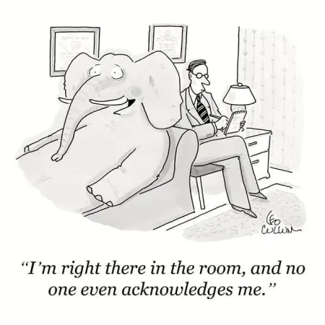
Let’s get something out of the way…
There has been a lot of change, since at least 2020

Slide 3
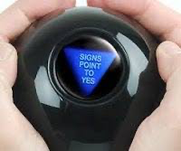
But, We Crave Predictability
And our brains and bodies do, too
Let’s Talk About It..

Slide 4
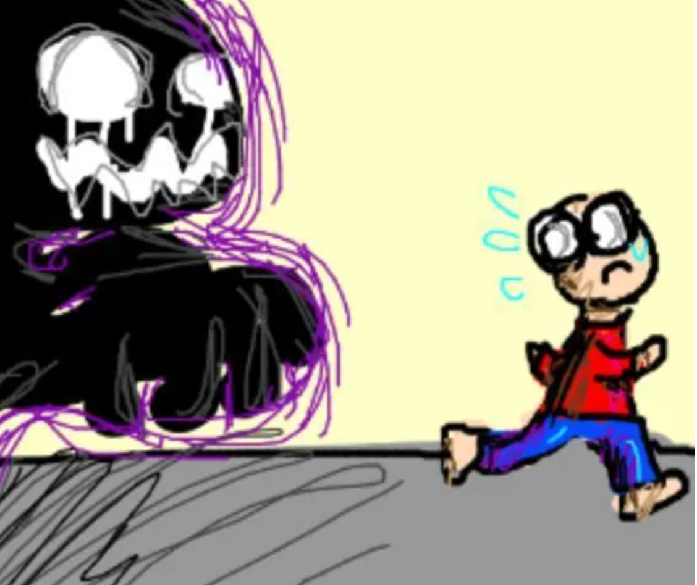
Why Uncertainty Makes Us “Anxious”
Our brains were designed to be run from and predict threats
You act in a way to prevent injury (or possible injury)
  Activation of the sympathetic nervous system or "fight-or-flight”
  Your heart rate increases, breathing quickens, muscles tighten, and blood pressure rises

Slide 5
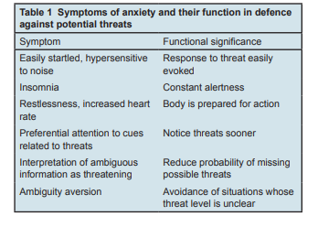
Cognitive effects: Increase the likelihood that imminent threats will be detected early
Physiologic effects: Prepare the body for action
  Hyperventilating to oxygenate the blood
  Diverting blood to the muscles
  Sweating to cool the skin
Bateson M, Brilot B, Nettle D. Anxiety: an evolutionary approach. The Canadian Journal of Psychiatry. 2011 Dec;56(12):707-15.

Slide 6
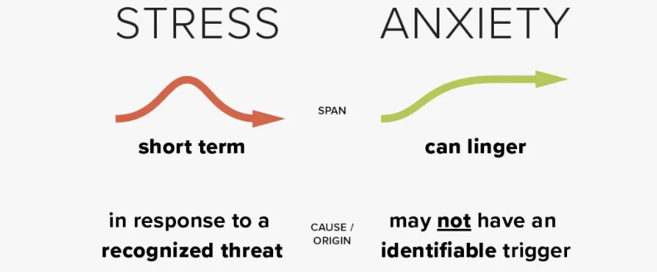
A little stress can be helpful. Too much stress, and/or chronic stress, can wear you down

Slide 7


Take out a piece of paper/your cell phone notes app
Take a few min and write down everything that is currently on your mind, causing you stress

Slide 8
Room Gut Check:
What Do You Want To Do With The List?

Slide 9


What Happens If:
You crumpled up the paper or ripped it in half (Or delete your cell phone note?)
Do You Feel Better?

Slide 10

What If Instead…
You Look At Your List and Ask: “What can I control? What can’t I control?”
Then, you cross off anything that you can’t control (Or circle the ones you can)
Start addressing with what is within your power

Slide 11
Even A Small Action:
Helps You Feel Effective
Do something manageable like clean your desk, send a short email, take a walk.
Take one, small step toward addressing a larger concern.

Slide 12
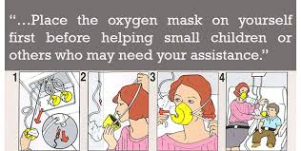
Some Things You Can Control To Succeed Through Uncertainty

Slide 13
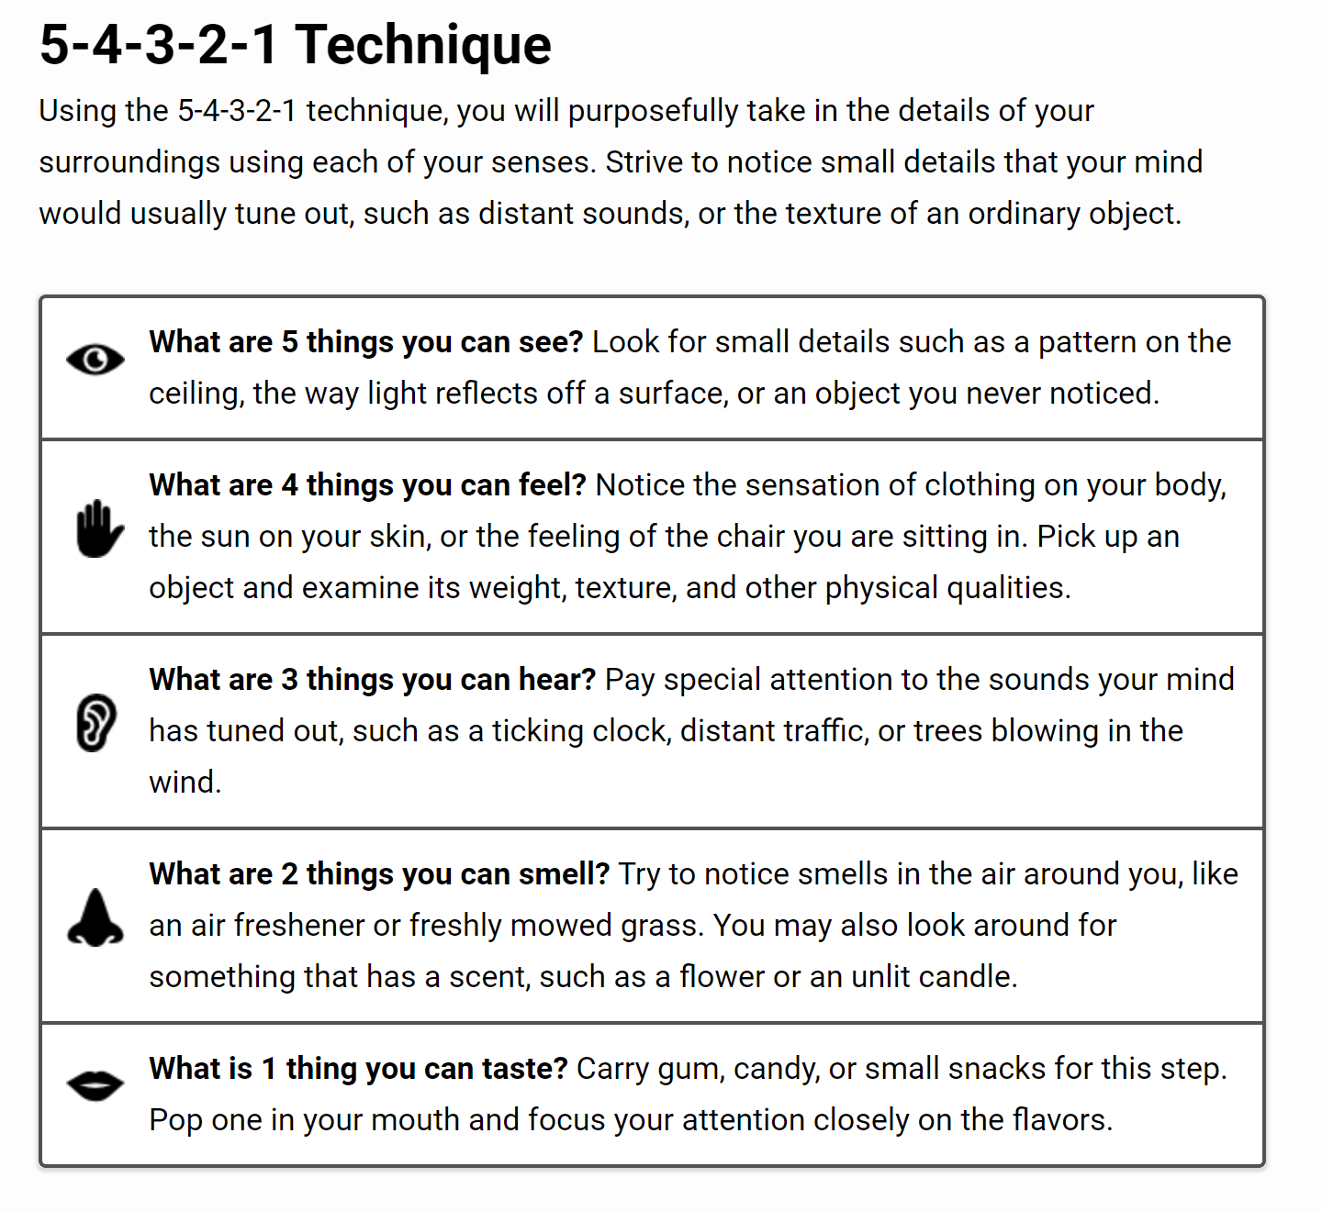
Your Reaction In The Moment
Grounding: Helps turn attention away from thoughts, memories, or worries, and refocuses on the present moment
Can keep certain scents (lavender, mint), or certain things to grab/touch (stress putty) on your desk or near you for this purpose

Slide 14
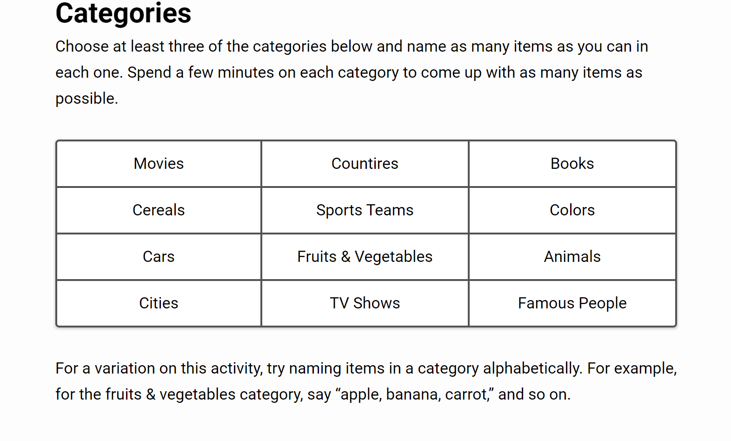

Slide 15
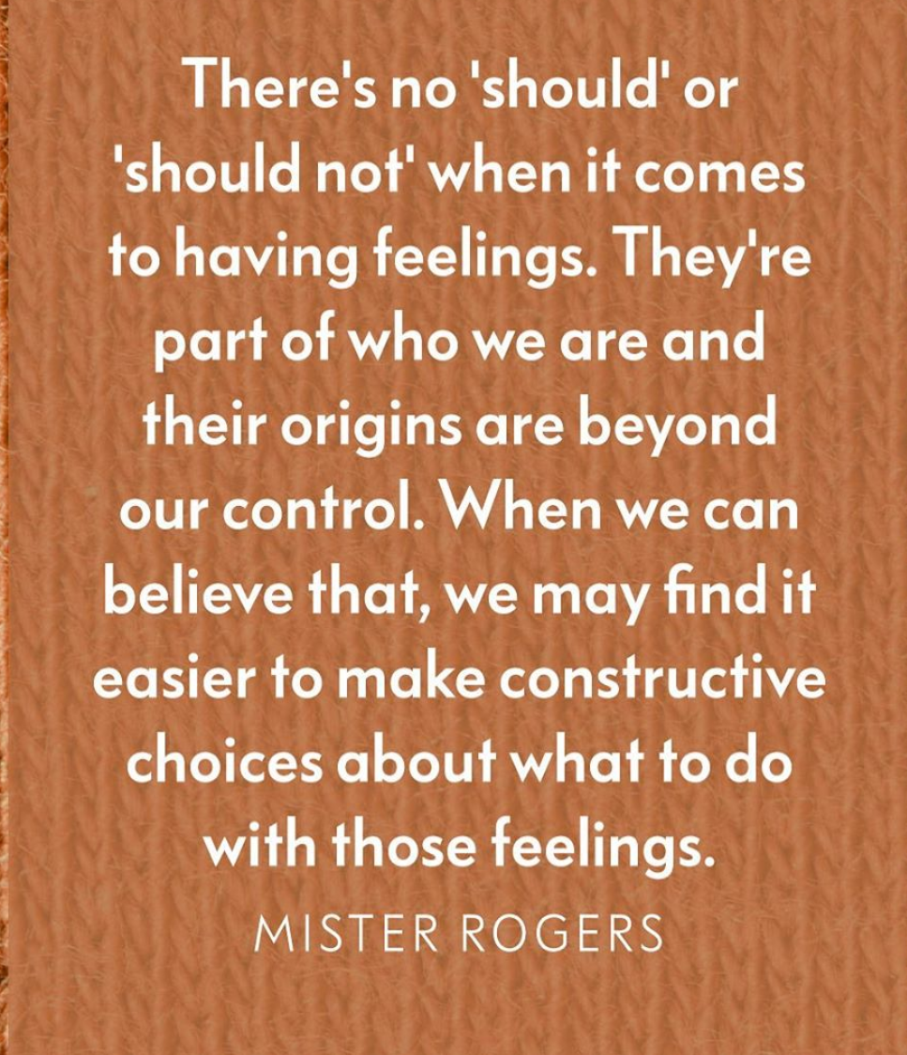
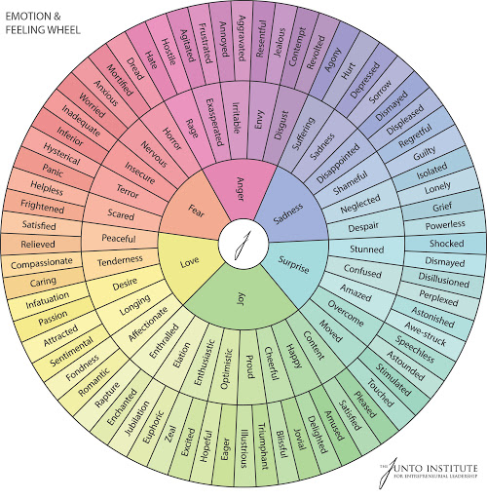
Your Feelings:
Name and Allow Space for Feelings
AND, don’t judge them as “good” or “bad”
@drjessigold

Slide 16

The Power of Wow
If we are aware and see a sunset we like: We stop and appreciate it and say “wow,” and don’t do things like judge the color of it
Can be applied to challenges, pain, uncertainty: “Wow, this is hard. Wow this is weird. Wow, this has gone on forever. Wow, I don't like this”
The stopping to notice and say “wow” is part of the change

Slide 17
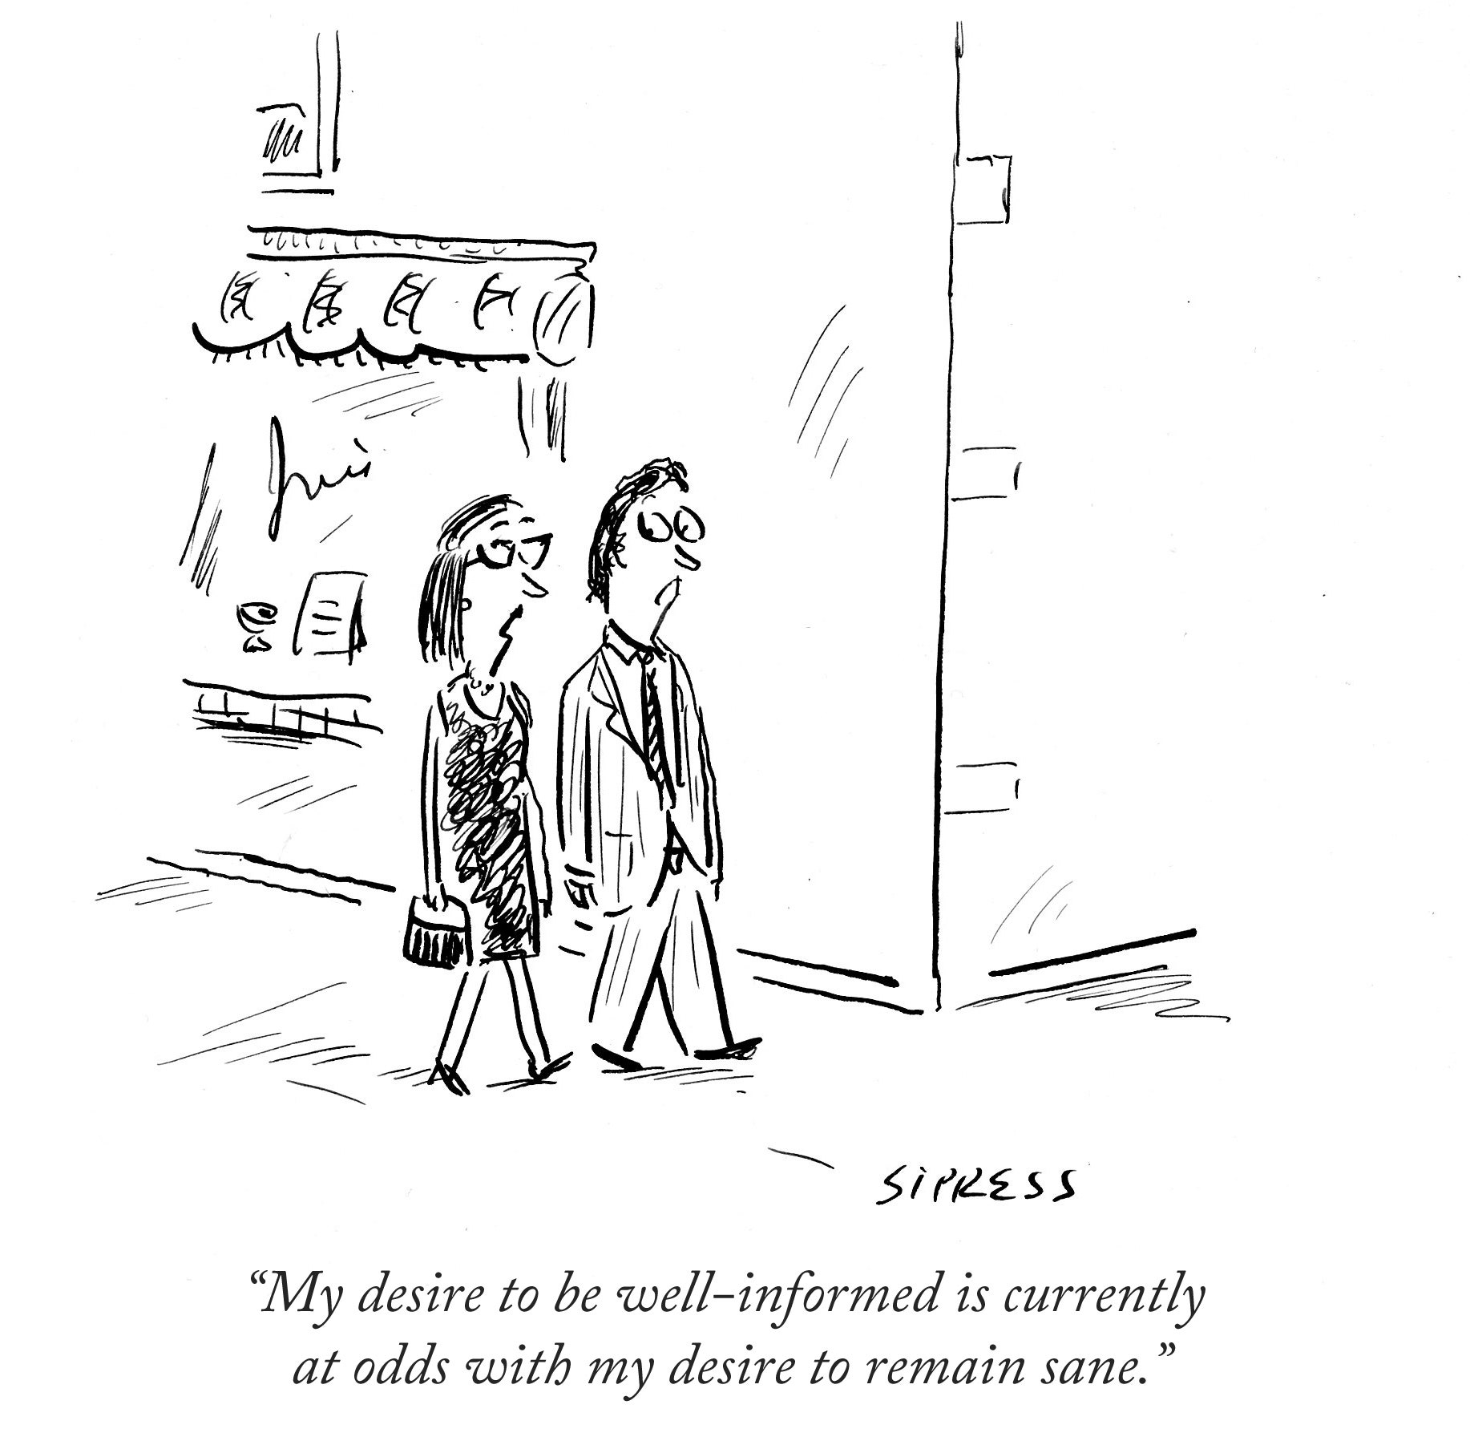
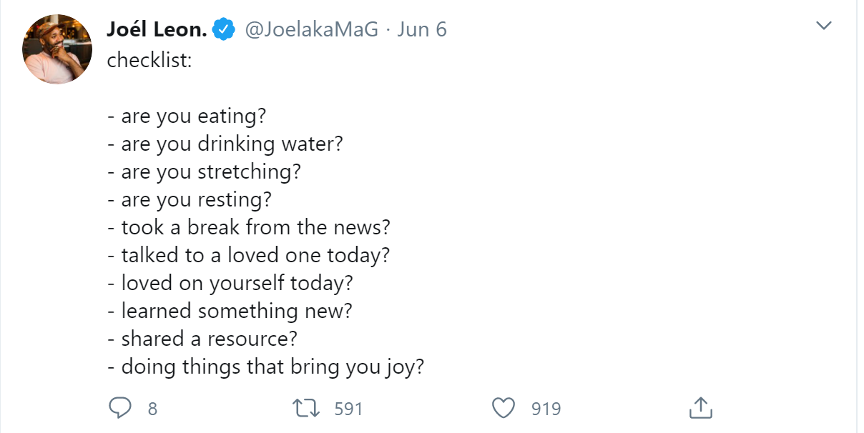
Your Exposure To Triggers
Reduce Notifications- turn off on phone, on computer
Delete Apps (Or Time Limit Some)

Slide 18
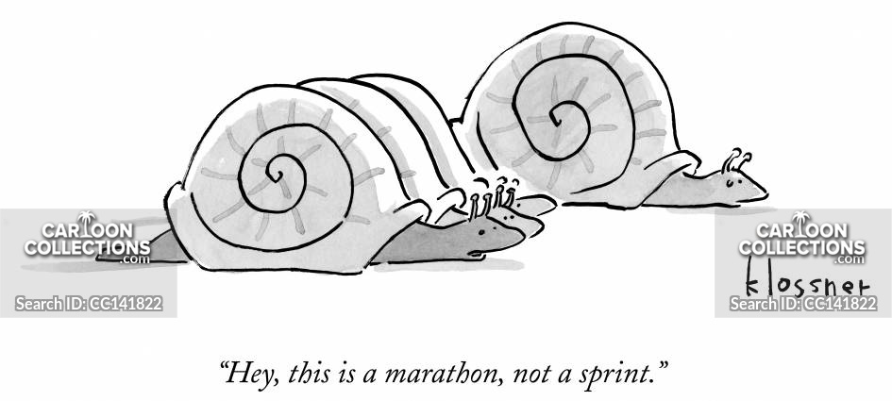
Your Own Routine
Automate Everything:
  Reduce decision making
  Set out outfits, prep meals
Establish a schedule
  Make an easy routine
  Prioritize Sleep
  Include:
    Checking in with yourself (even schedule it in)
    “You time”
    Fun/Rewards
  Shake it up if it feels monotonous

Slide 19
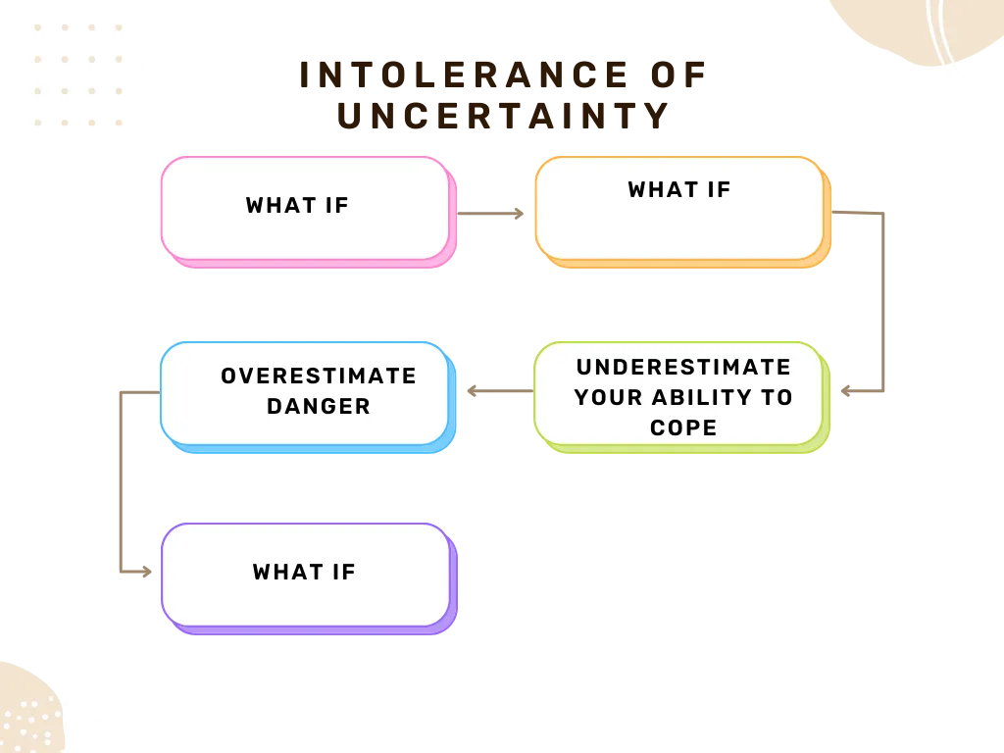
Your Automatic Thoughts
https://mytherapist.ie/cbt/managing-uncertainty-with-cbt/

Slide 20
What Can You Do?
Recognize your triggers:
  Consider: Choose one SMALL situation where you usually avoid uncertainty and commit to facing it head on and reflect on what you learned
Challenge catastrophic thinking

Slide 21
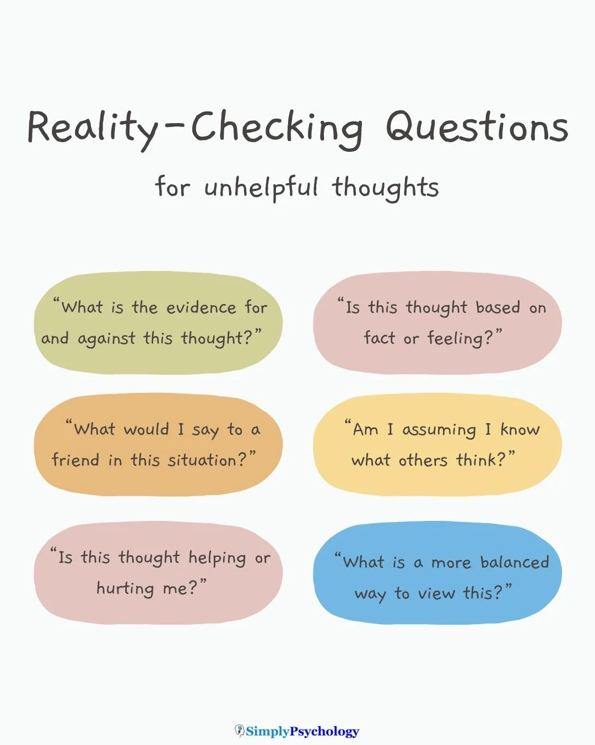
https://www.simplypsychology.org/cognitive-distortions-in-cbt.html

Slide 22
What Can You Do?
Recognize your triggers
Challenge catastrophic thinking
3) Lean into a more balanced thought

Slide 23
Catastrophic Thought: “If I don’t prepare perfectly, everything will fall apart.”
Balanced Thought: “I can do my best and handle any challenges that arise.”

Slide 24
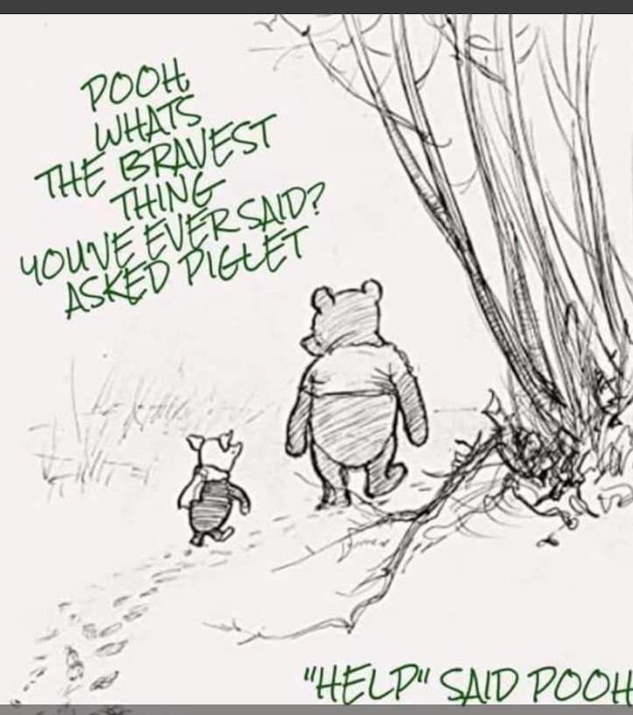
Your Support
Lean into your social connections
Make space for real, value centric conversations and you can even challenge your avoidance and thoughts
Ask for help from a professional when you need it- there is no wrong time to get/ask for help

Slide 25
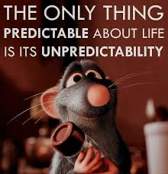
Ultimately
Ratatouille was right….

Slide 26
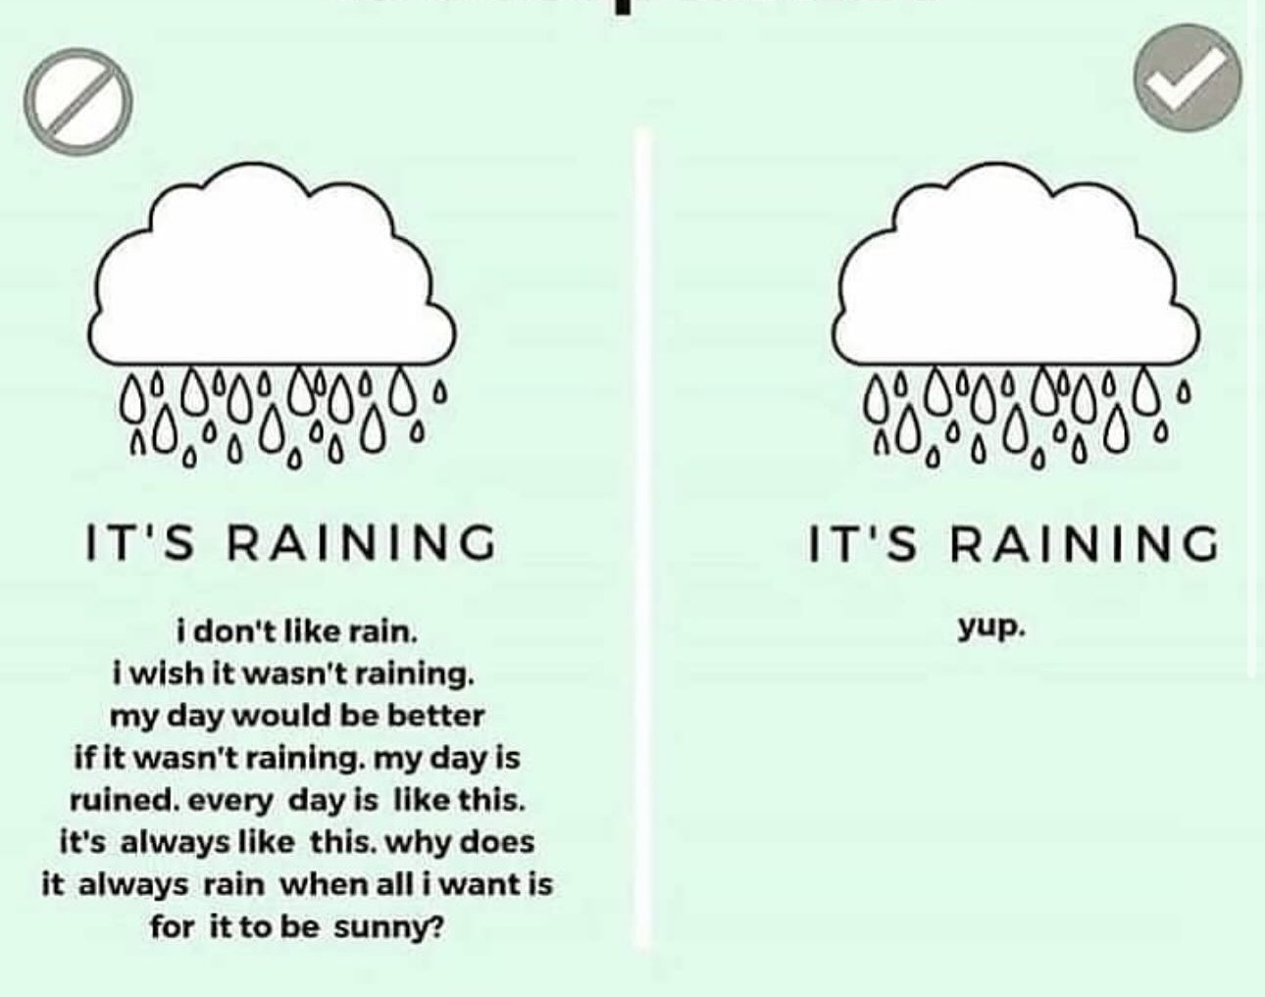
And, we can learn to cope, in part, by accepting that fact.

Slide 27
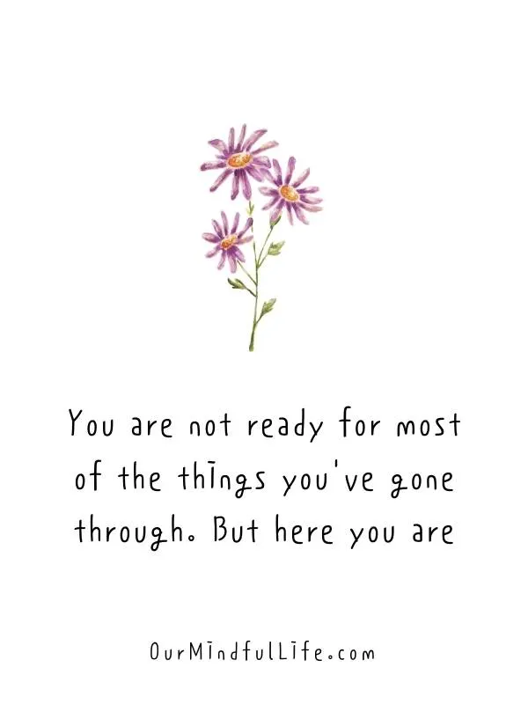
Any Questions?
@drjessigold jgold11@uthsc.edu

